Slide 1
Dr. Patrick Bailey’s PPT Slides
For 8.17-18.19
San Jose Comic Con
Permission Granted
To Use Anywhere!

Slide 2
www.padrak.com/ufo/
To See these Slides

Slide 3

First – Open Your Mind

Slide 4

Second – Expand Your Mind

Slide 5
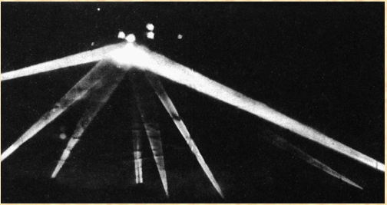
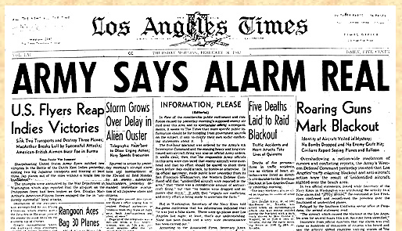
UFOs Fly Over Los Angeles - 2/25/1942

Slide 6
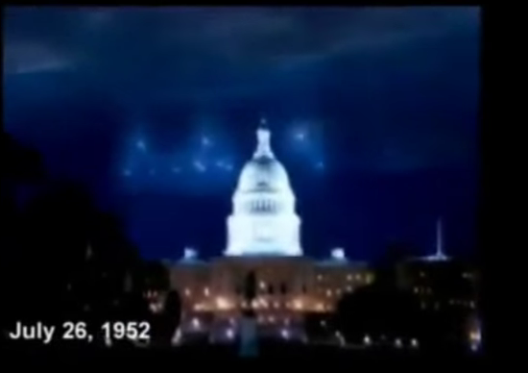
UFOs Waves - Fly Over Washington DC – 7/12-29/1952
UFOs Over Washington DC – Matched Radar Blips
https://www.youtube.com/watch?v=OHVQFqOf3yA (Video 9:00 min)

Slide 7

The BEST UFO Summary Book! Copyright 2016
Thank you Stanton!
We Love and Miss You…

Slide 8
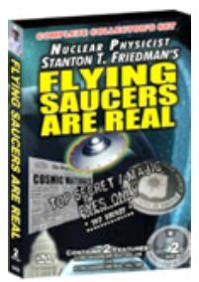
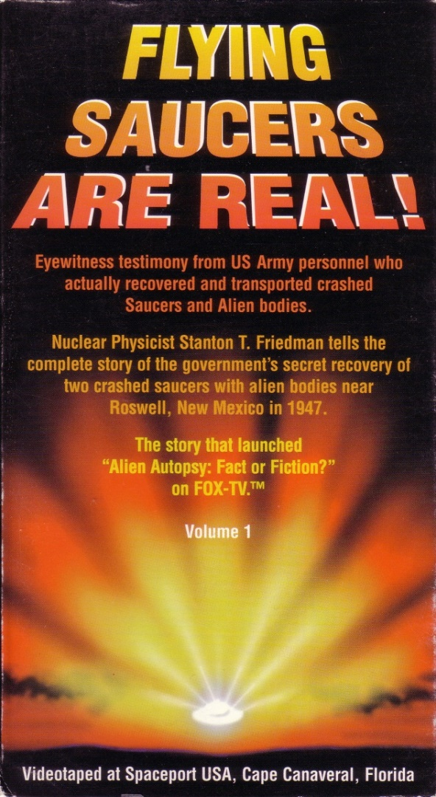

STANTON T. FRIEDMAN (Long Time UFO Researcher and Publisher)

Slide 9
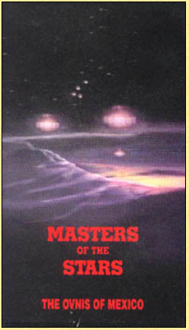
Brit and Lee Elders Really Great Videos!

Slide 10
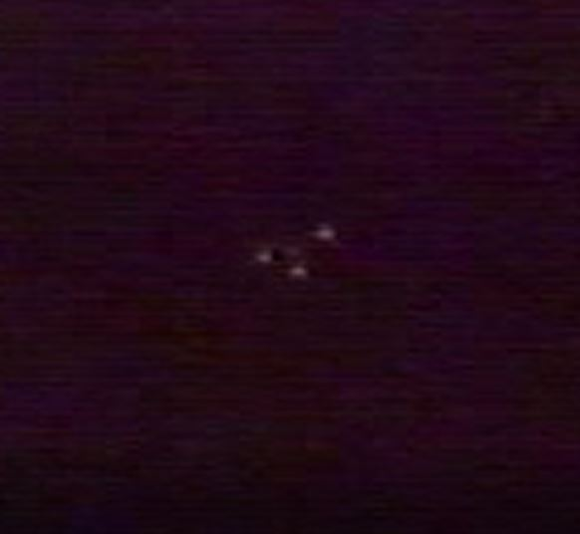
Masters of the Stars Video - Near Mexico City
Video of Triangular Craft Rising and Banking – Japanese Film Crew Video

Slide 11
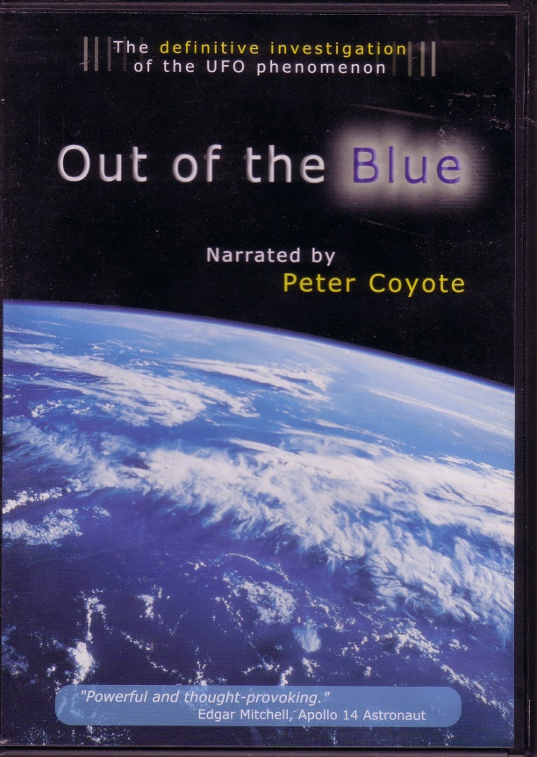

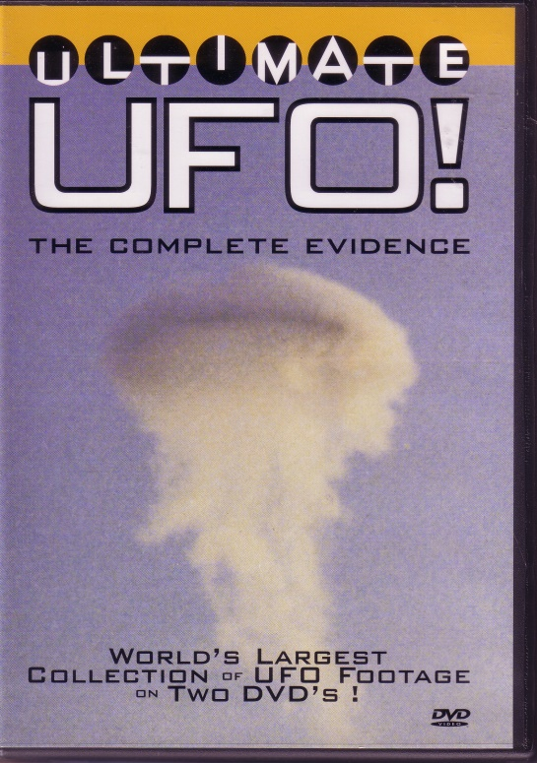
Other UFO Videos

Slide 12
UFOs – Yes They Are Real.
Theirs
Lots
Ours
Now Mixed
and
Heavily
Classified
Above TS Code Word

Slide 13
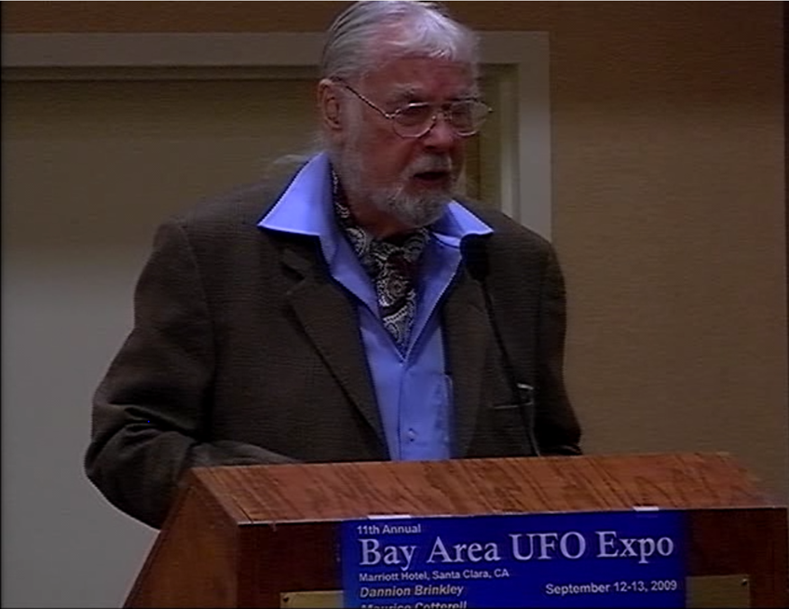
CMS Ret. Robert Dean - NATO “An Assessment” (picture in 2009)
Over 50 Types of UFO Craft Tracked by NATO!!!

Slide 14

CMS Ret. Robert Dean - NATO “An Assessment”

Slide 15
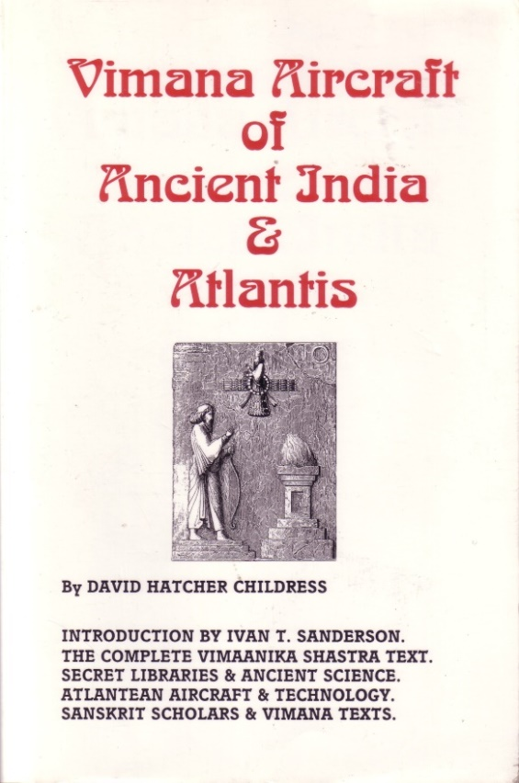

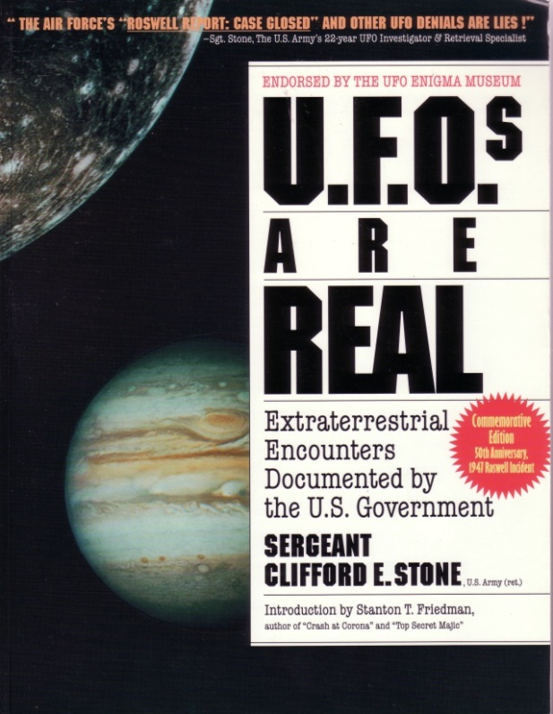
Other UFO References

Slide 16
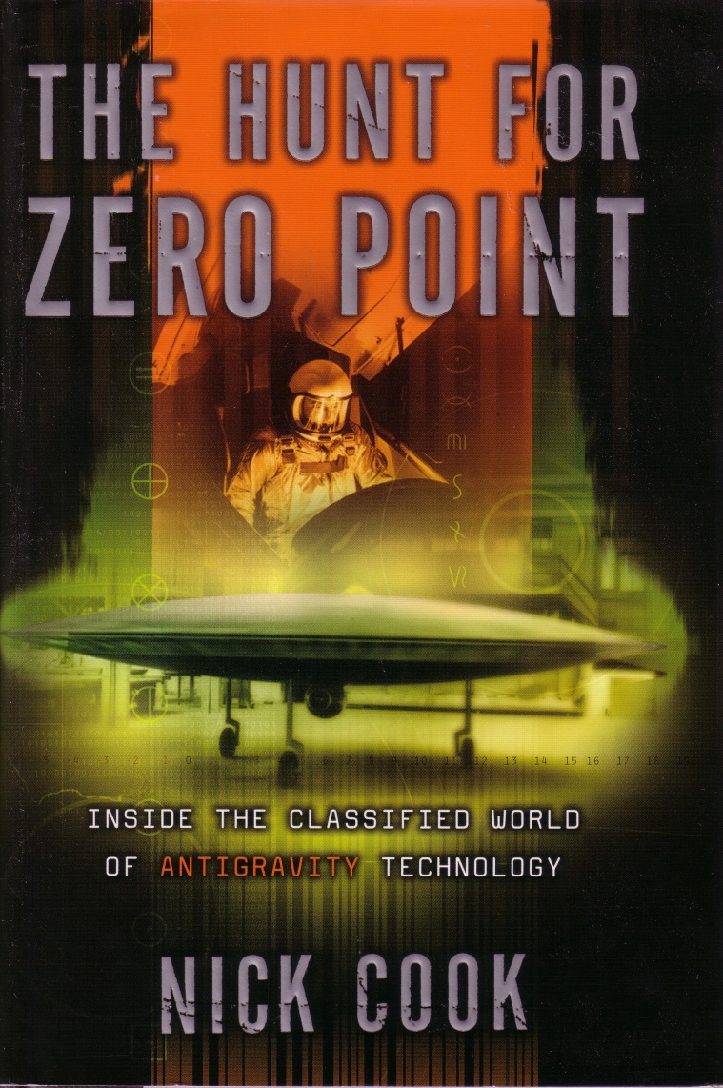
Antigravity Technology
Great German Technology Reference Book
Dr. Bailey Created the Subject Index for the US Edition!

Slide 17
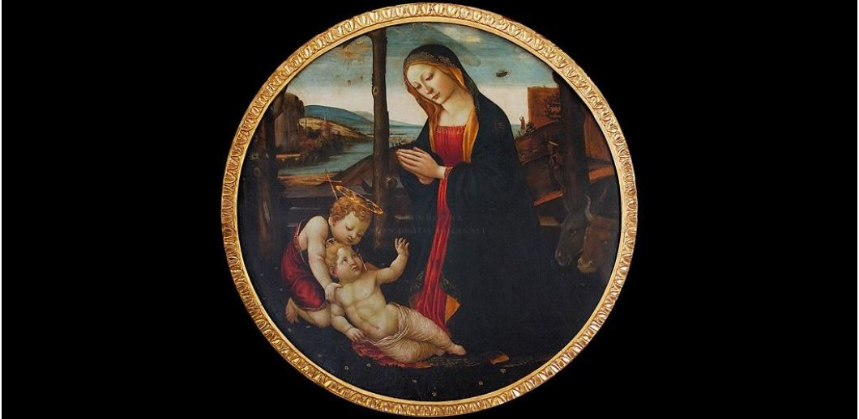
UFOs - 15th Century Italy

Slide 18
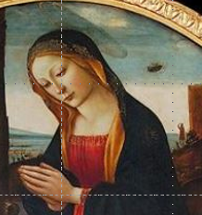
UFOs - 15th Century Italy
Object(s)
Person Looking
← Dog Barking

Slide 19
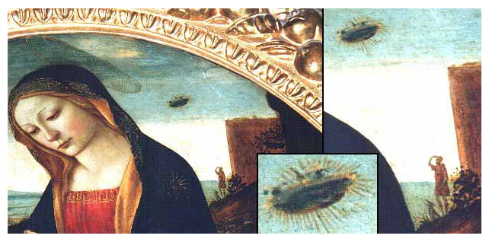
UFOs - 15th Century Italy

Slide 20
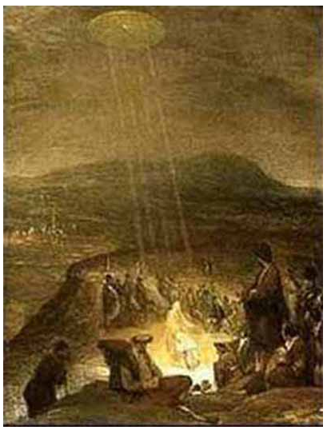
UFOs - Painted in 1710
by Flemish artist Aert De Gelder

Slide 21
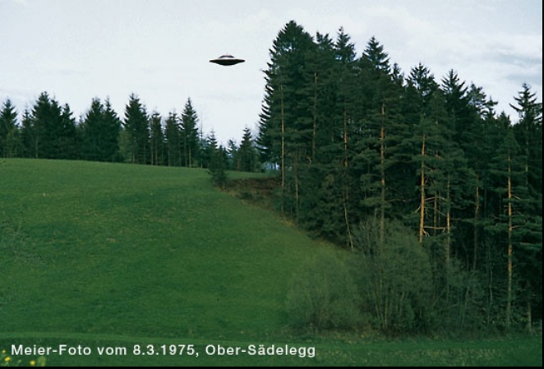
Billy Meier Lots of Photos Online – Michael Horn US Rep. for Billy
http://www.theyfly.com/photos/photos.htm

Slide 22
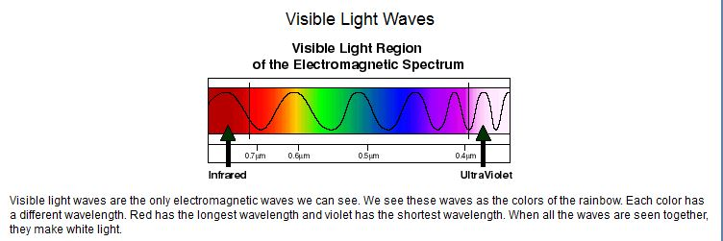
UFOs Hang Out in the Ultra Violet
You see only Visible Light.
Film can see more!
We have some Infra-Red cameras and imagers…
Why not Ultra-Violet Imagers???

Slide 23
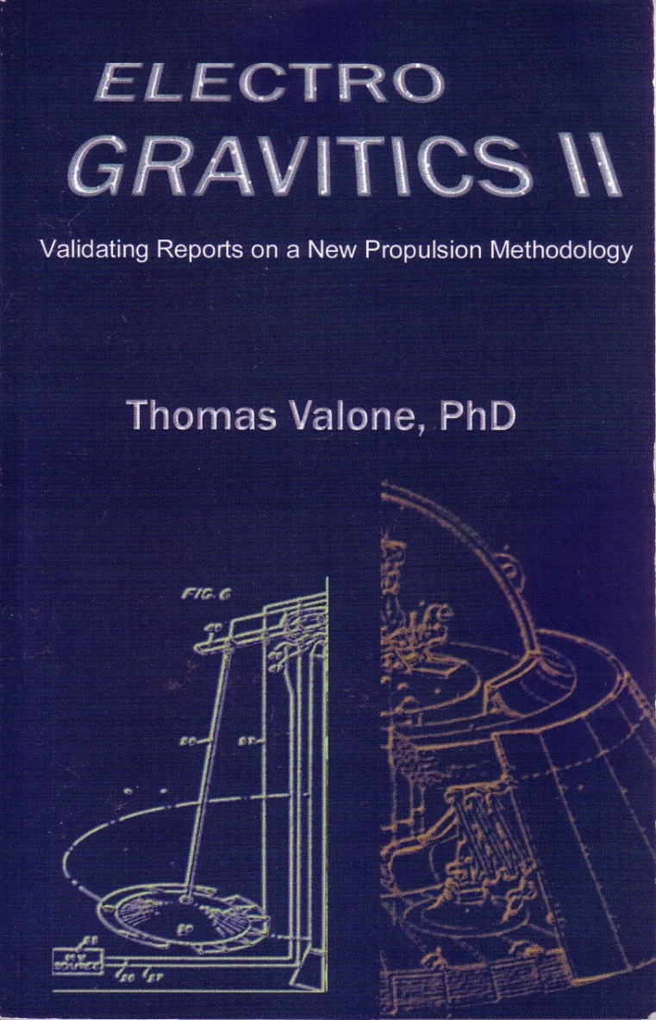
Electro Gravitics - AG

Slide 24
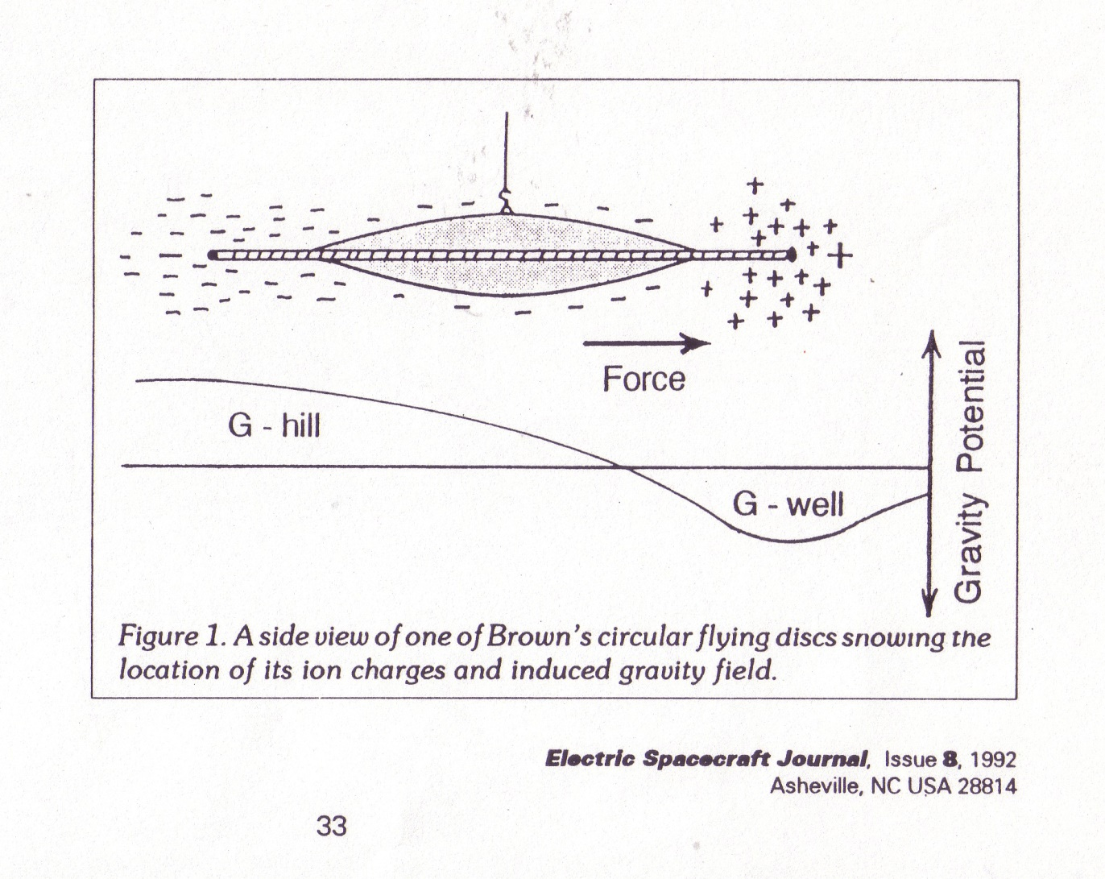
T. Townsend Brown (1920s)

Slide 25
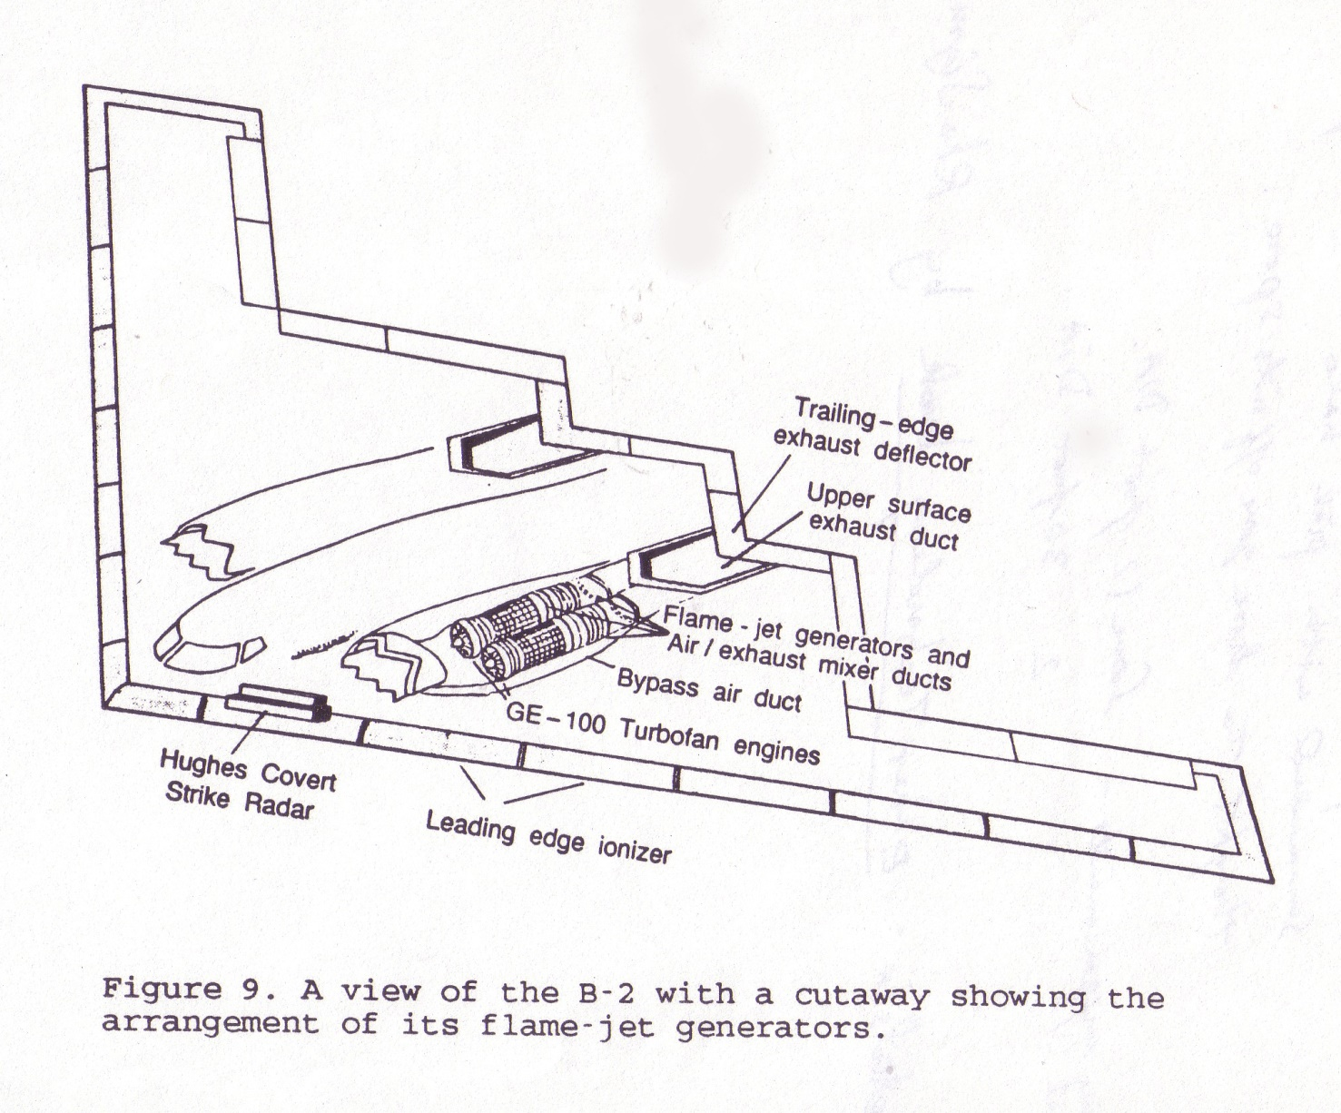
Principle of B-2 Bomber
Flame Jet (Electrostatic not Power) Engines!

Slide 26
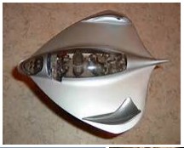
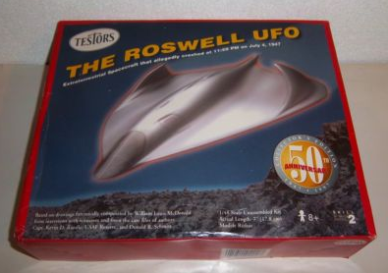
Selected By ETs (Book, c 2015)
[I think, the] Description of Roswell Crash Plane (p 395)
[Remember that the Roswell UFO was like a plane,
That glanced off the ground and then later on suck into a cliff
Like a dart into a dart board.
The UFO Flying Saucer disc (upside down) was at Aztec, not Roswell.]
“They are similar to a manta-ray with shark fin stabilizers on the upper outer wing tips. The are configured for two to six, small personnel and appear to be operated on recon missions. – The alien pilots use their fingers pressed on the control panel surface to guide it.”

Slide 27
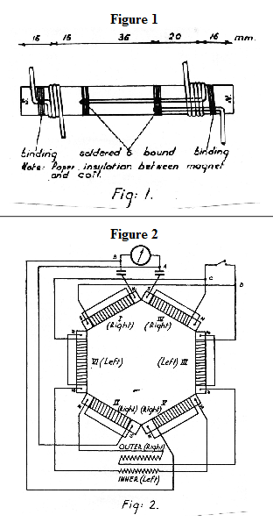
German Hans Coler Device – Declassified from WW2 by British Intelligence
Stromzeuger rexresearch.com/coler/coler2.htm
The AC current
Runs through the
Permanent magnets!
See the freq. tuner!

Slide 28
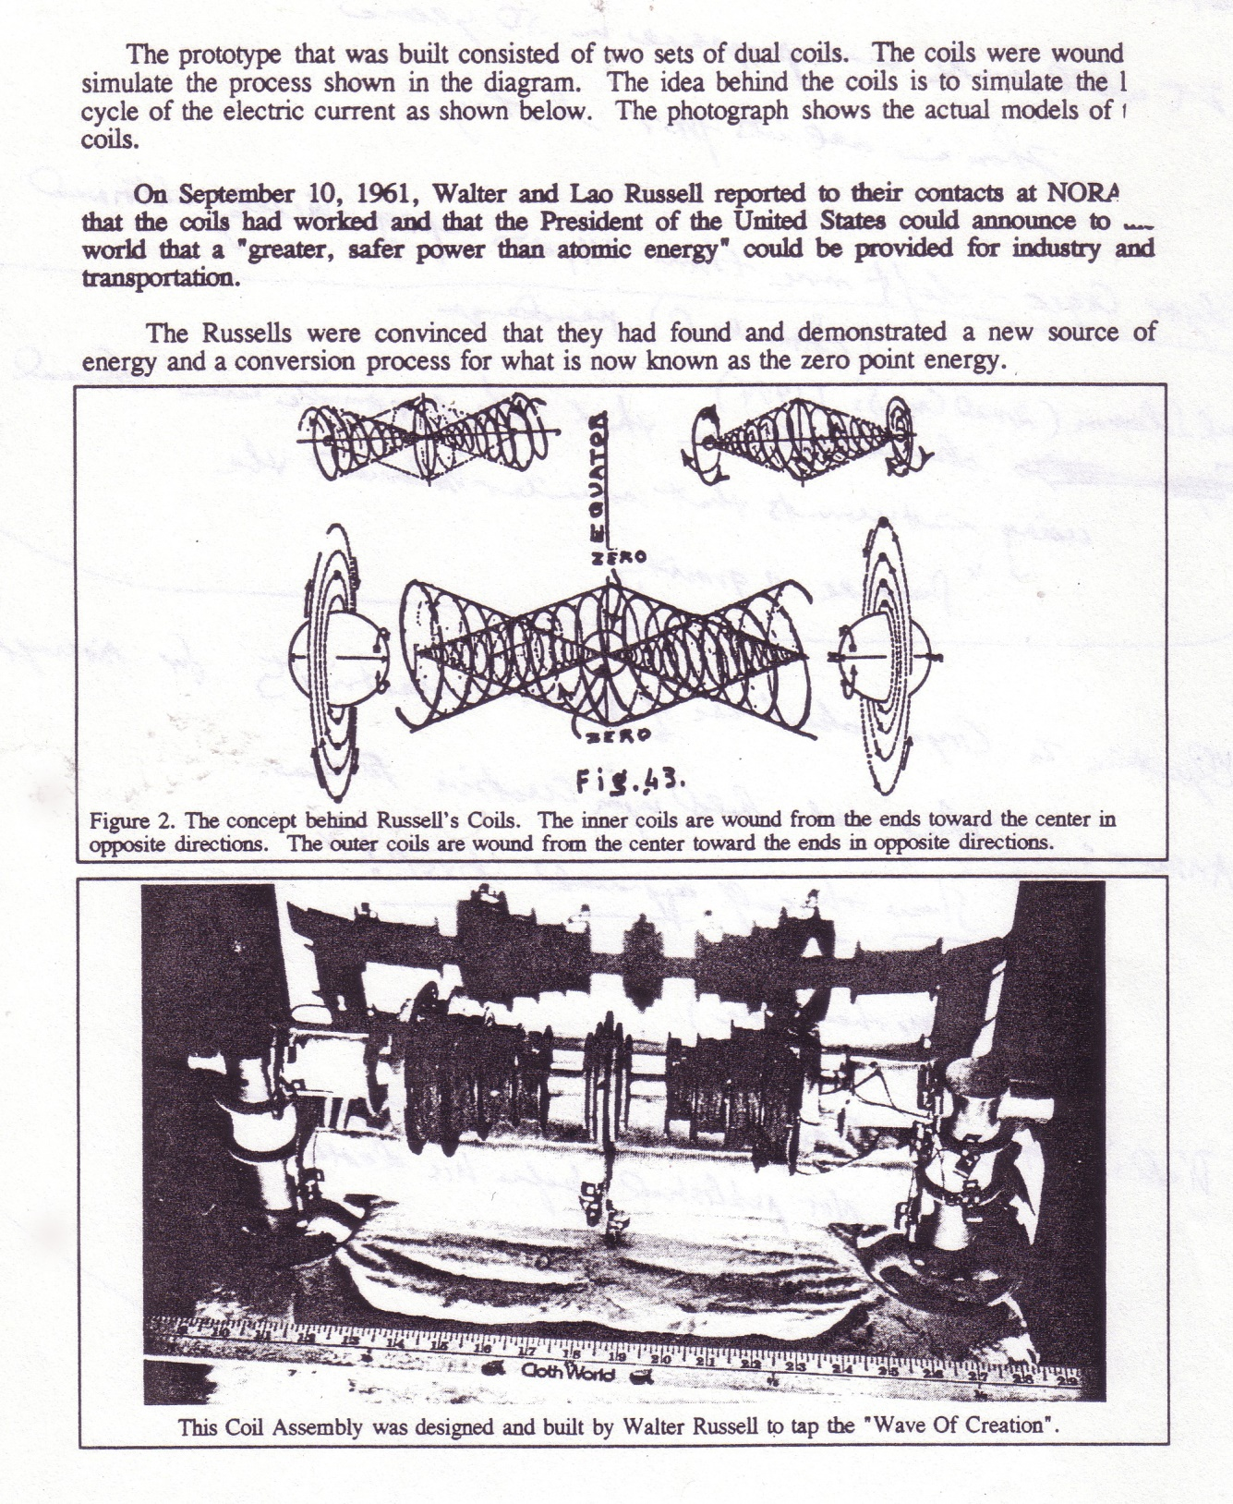
Walter Russel (1961)

Slide 29
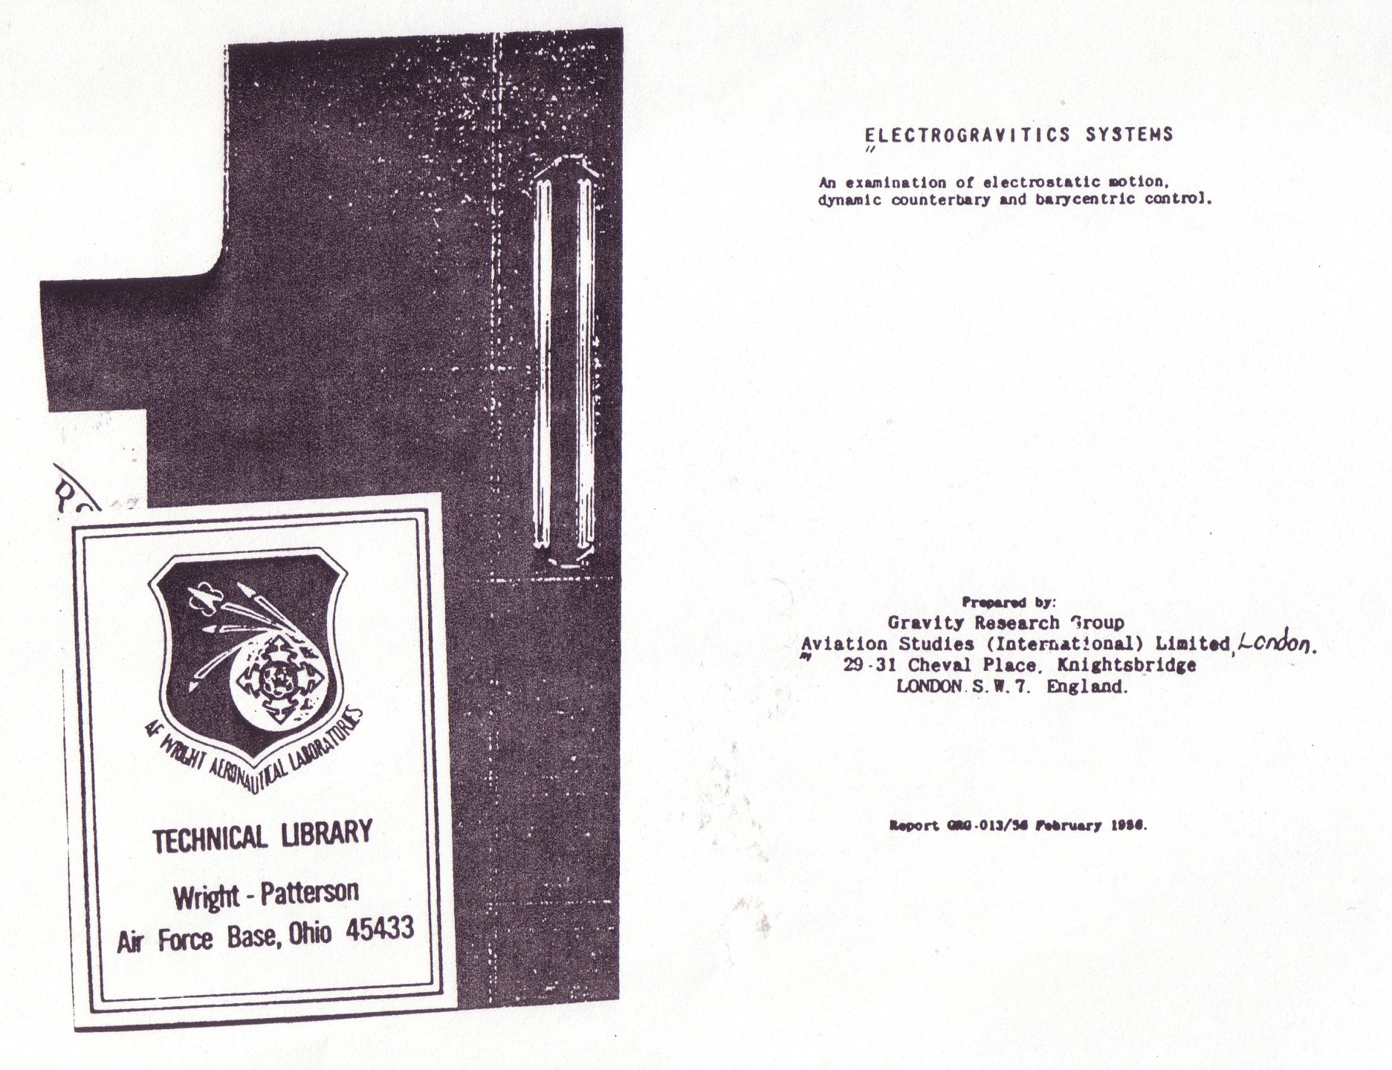
ELECTROGRAVITICS SYSTEMS - 1956
1956

Slide 30
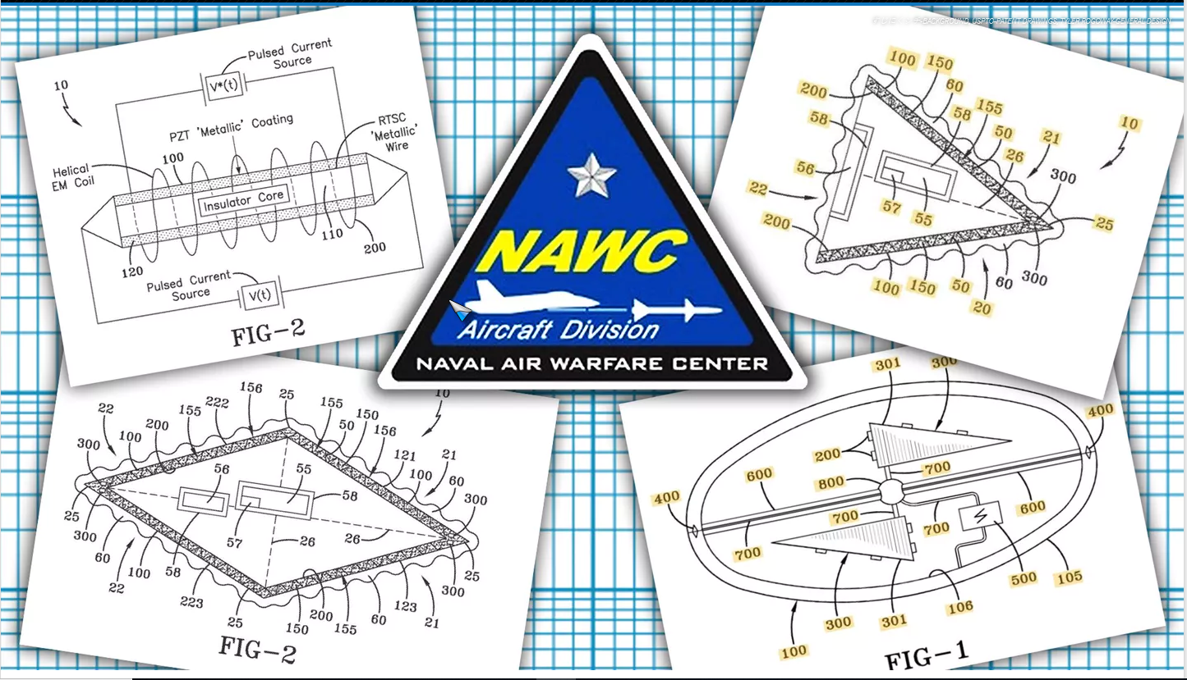
Navy Got 'UFO' Patent Granted By Warning Of Similar Chinese Tech Advances - June 28, 2019
https://www.thedrive.com/the-war-zone/28729/docs-show-navy-got-ufo-patent-granted-by-warning-of-similar-chinese-tech-advances

Slide 31

Project Blue Book – Only Unclassified Cases Were Released
UFOs – Have the 2nd Highest Military and Gov. Classification
Project Blue Book - 1952 to 1970 What??? 1970!!!
Special Report No. 14 – Completed in 1955 1955!!!
RULES
Any cases that could impact “National Security” were omitted
UNKNOWNS
> 21% of the 3,201 Cases Released in the Document
> 60% Observed for more than 1 minute
> 35% Observed for more than 5 minutes
10% Observed for more than 30 minutes
CONCLUSION AFTERWARD
On videotape: “We were paid to lie about this subject…”

Slide 32
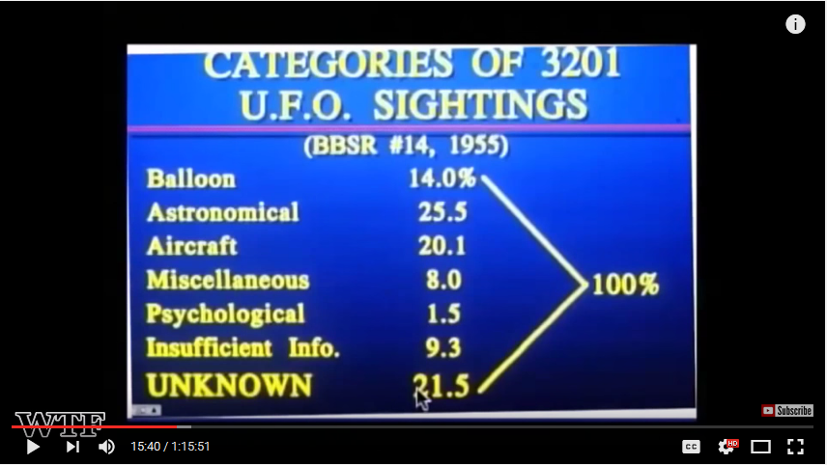
ALIEN LIFE FORMS (EBE) ARE THEY FRIENDS?
OR ENEMY TO THE HUMAN RACE?

Slide 33
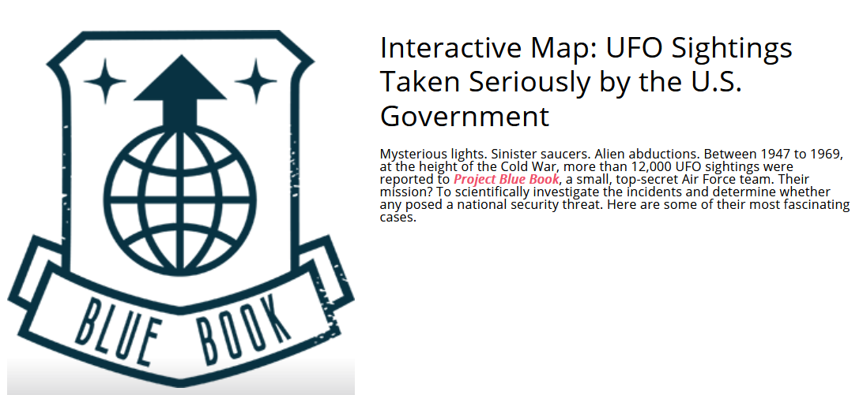
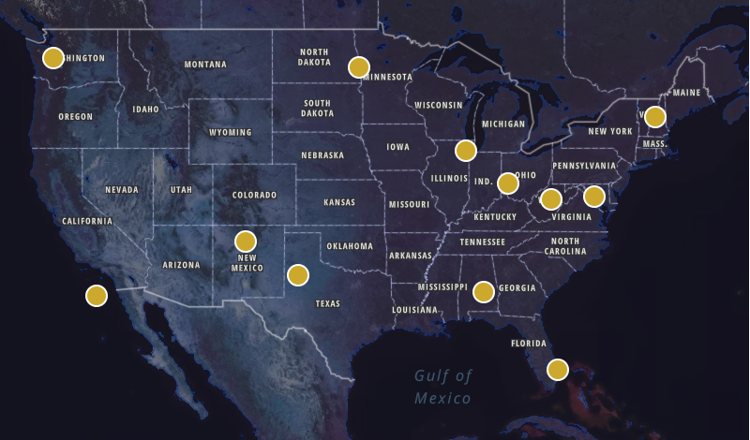
https://www.history.com/shows/project-blue-book/pages/ufo-sightings-location-map

Slide 34
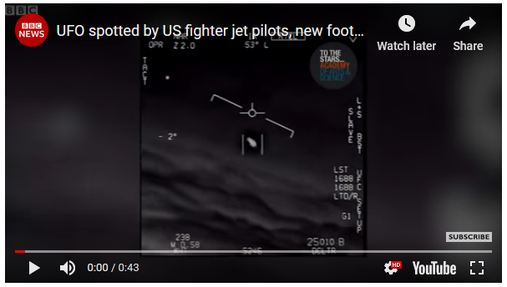
When Navy Top Gun Pilots Tangled with a Tic-Tac-Shaped UFO - November 14, 2004
…described it as about 40 feet long, shaped like a Tic Tac candy and with no obvious means of propulsion:
"It's white. It has no wings. It has no rotors. I go, 'Holy sh*t, what is that?'"
Not a saucer – such as drawn and posted by the lying New York Times
https://www.vice.com/en_us/article/9k8kaz/the-pentagon-released-new-documents-about-the-tic-tac-ufo

Slide 35
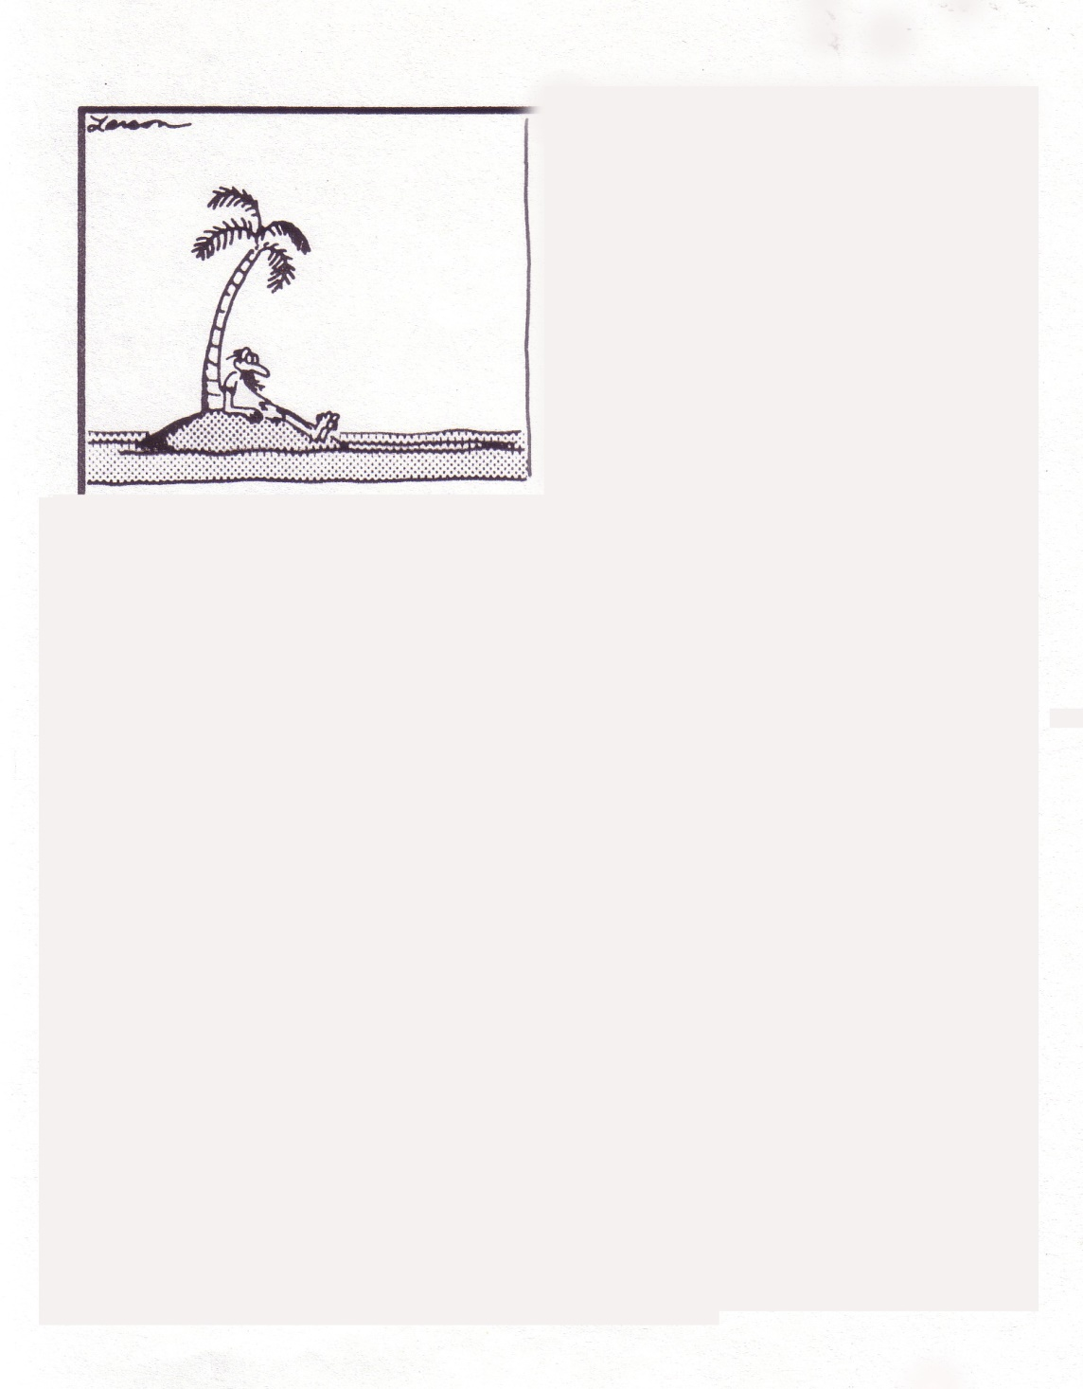
Blank

Slide 36
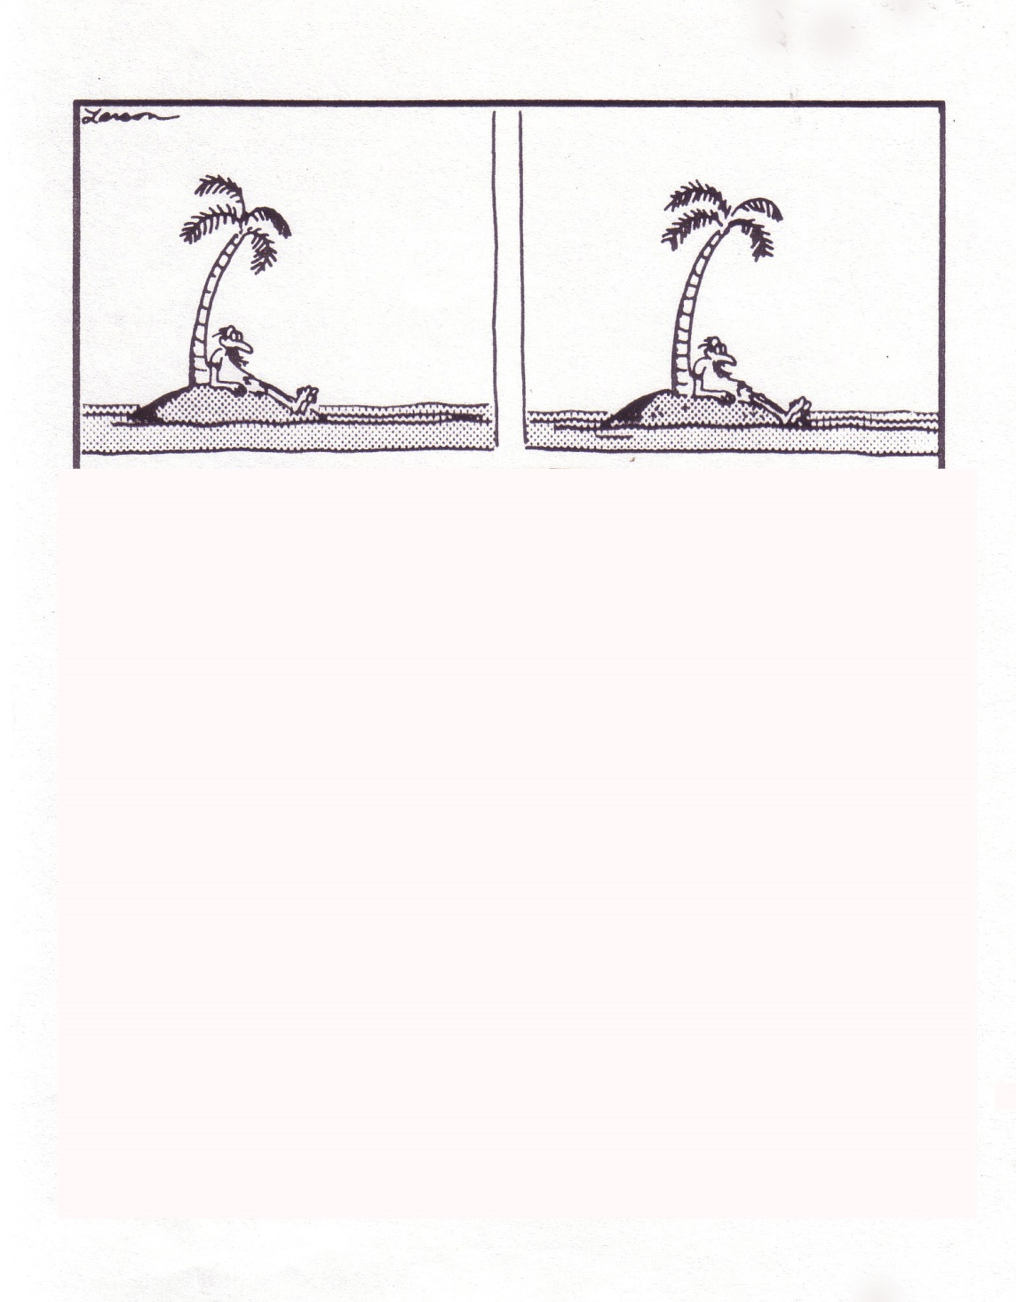
Blank

Slide 37
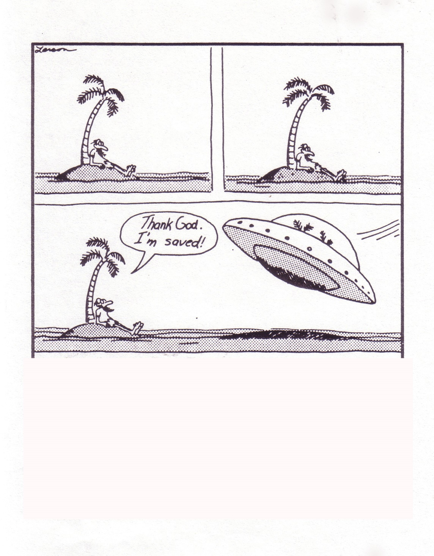
Blank

Slide 38
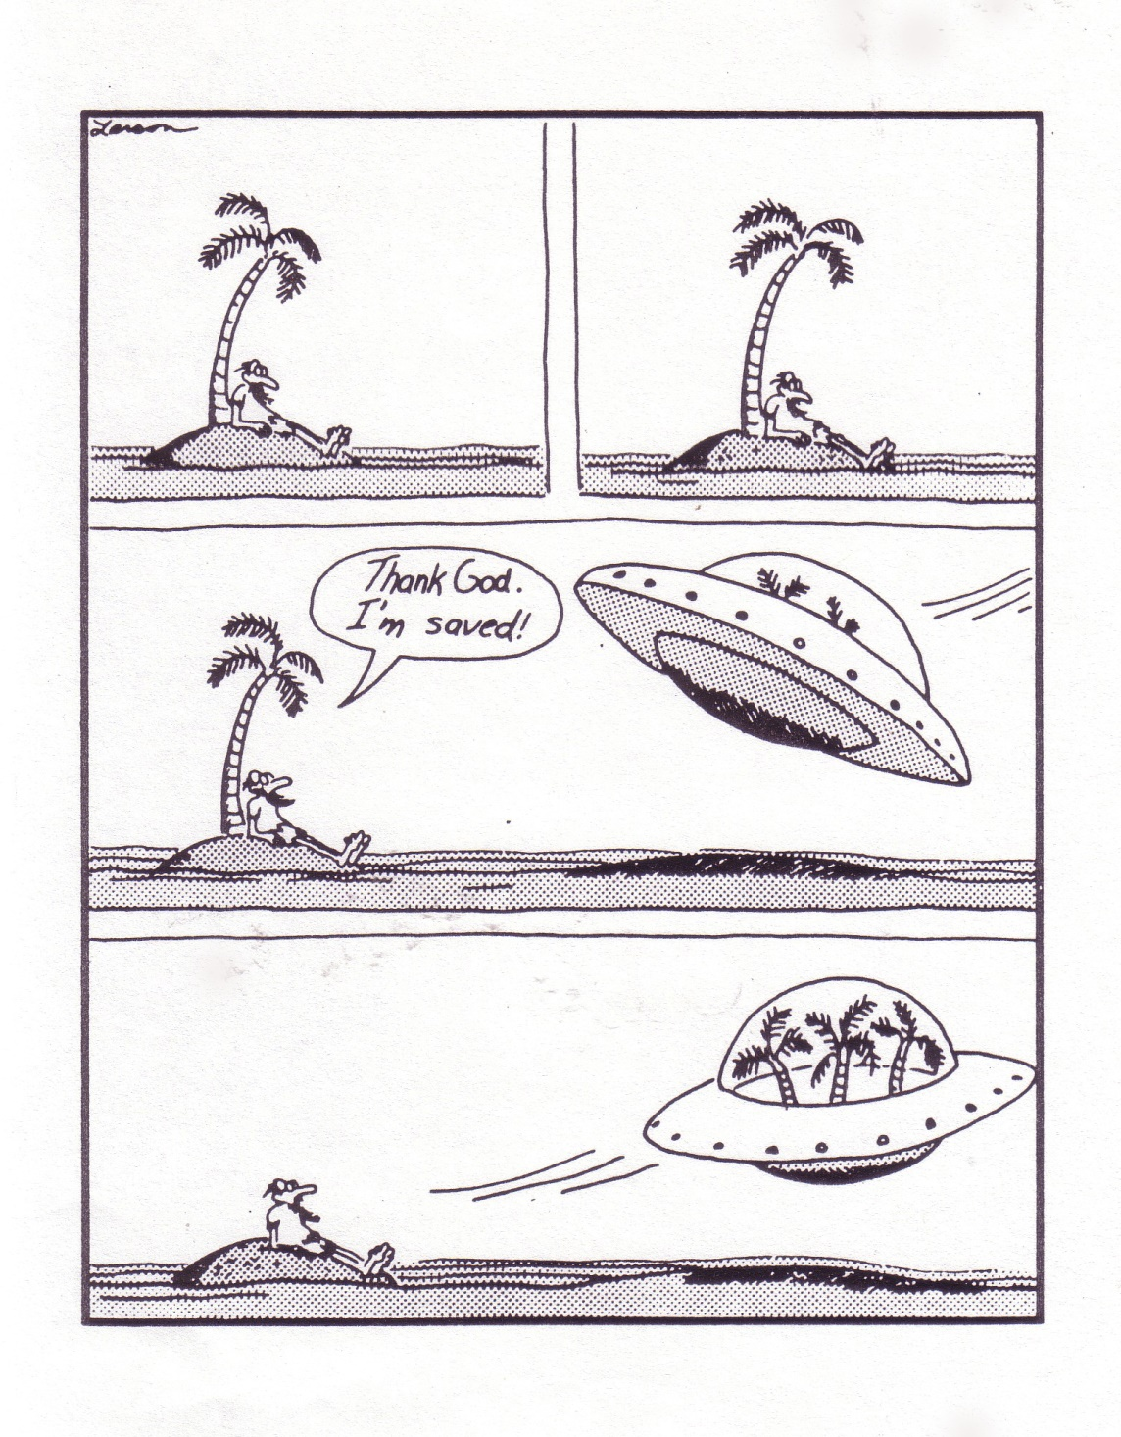
Blank

Slide 39
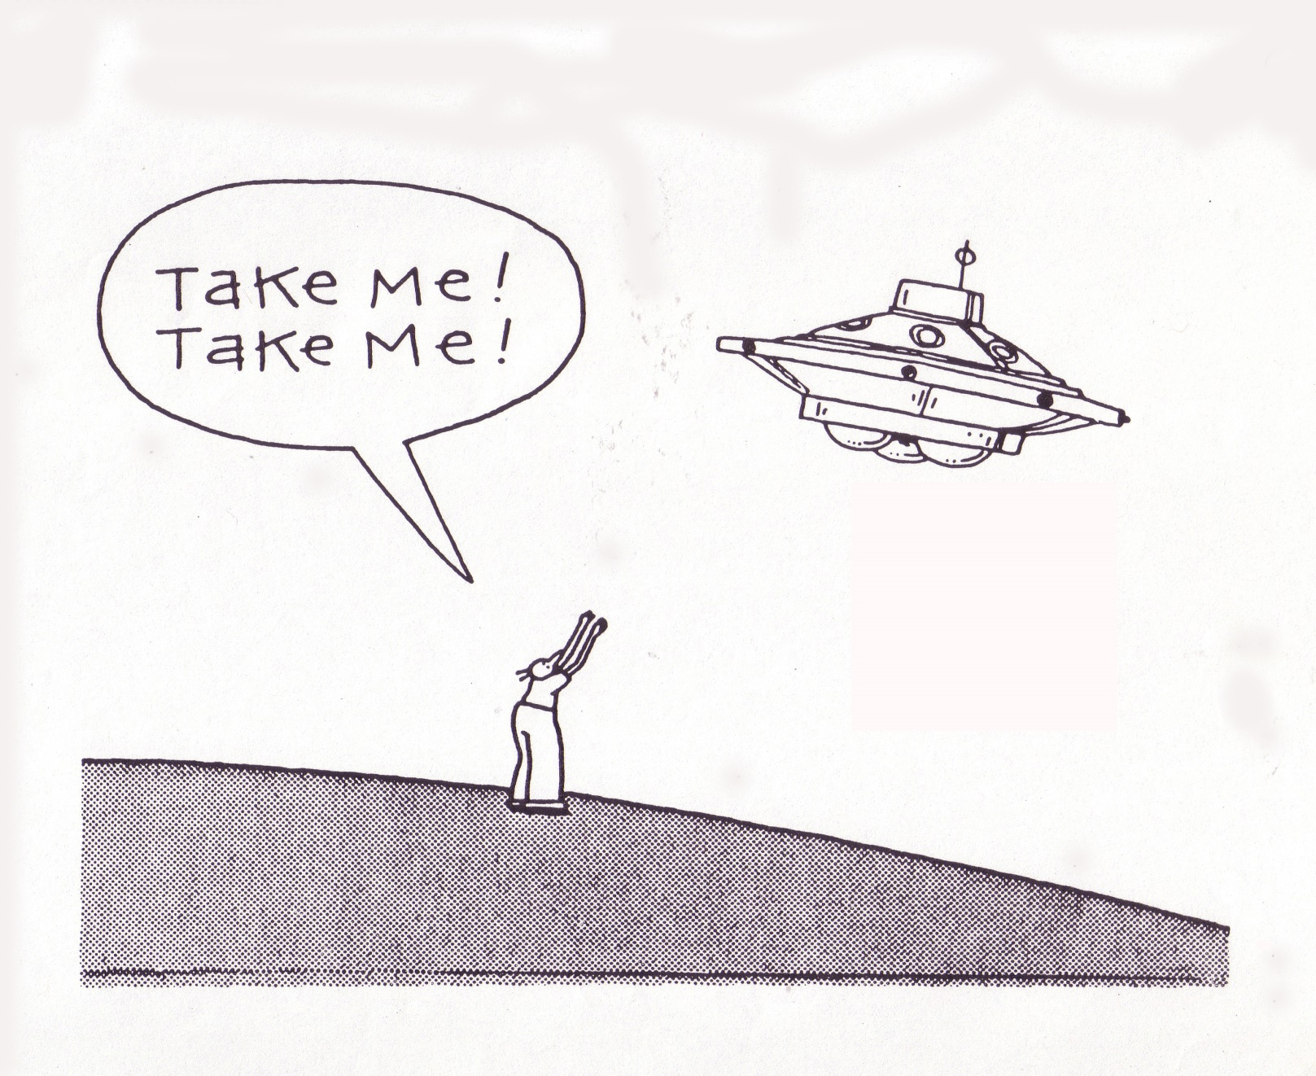
Blank

Slide 40
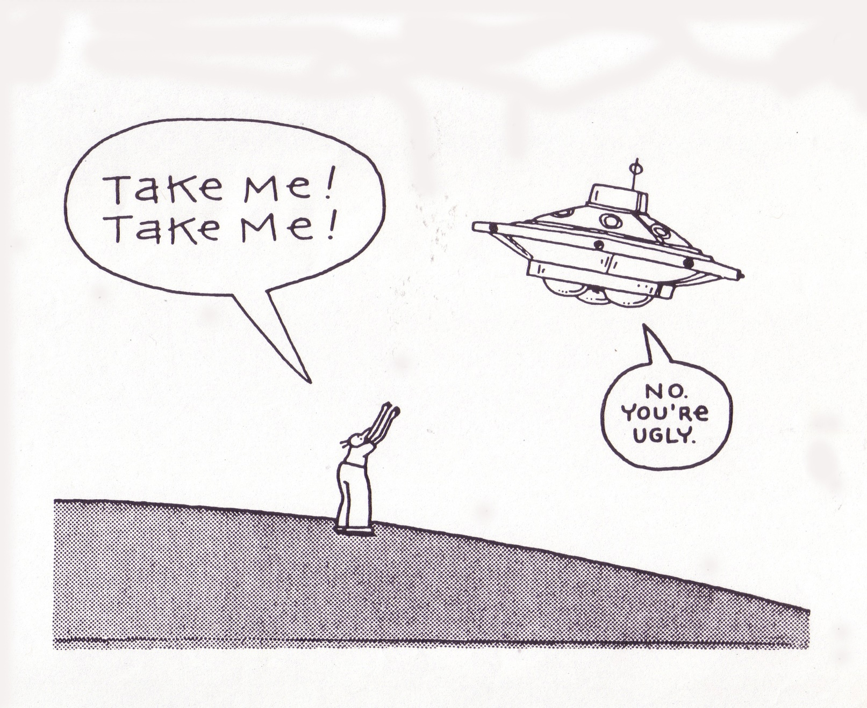
Blank

Slide 41
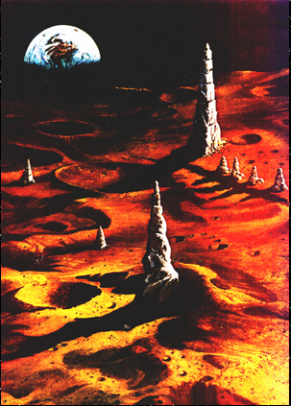
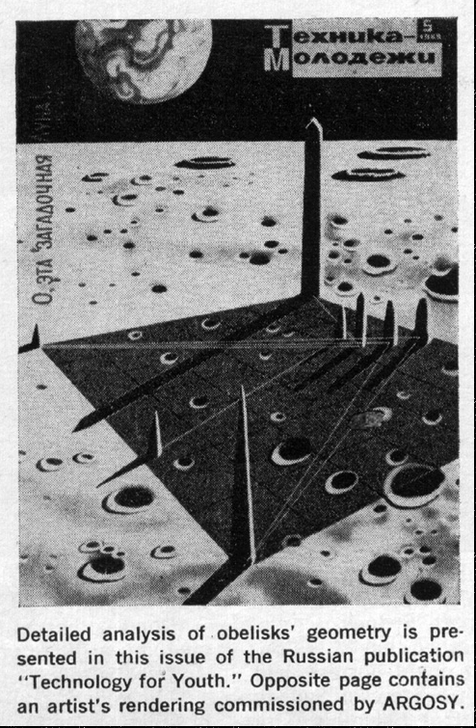
Selected By ETs (Book, c 2015)
Sea of Tranquility (p 417)
http://www.astrosurf.com/lunascan/argosy_cuspids.htm

Slide 42

The Grand Plan (1998)

