Slide 1
Digital Currency
Including OneCoin
Patrick Bailey, PhD
An Independent Marketing Associate for OneLife and OneCoin
Short Videos from the OneLife Company, and
OneCoin Networks
For Educational Purposes Only
Detailed Information At
PADRAK OneCoin
www.padrak.com/onecoin/

Slide 2
Topics
Summary
Digital Currency
Cryptocurrency
Blockchains
History
Bitcoin
Others DCs
OneCoin
Status
Markets
Dangers
Recommendations

Slide 3
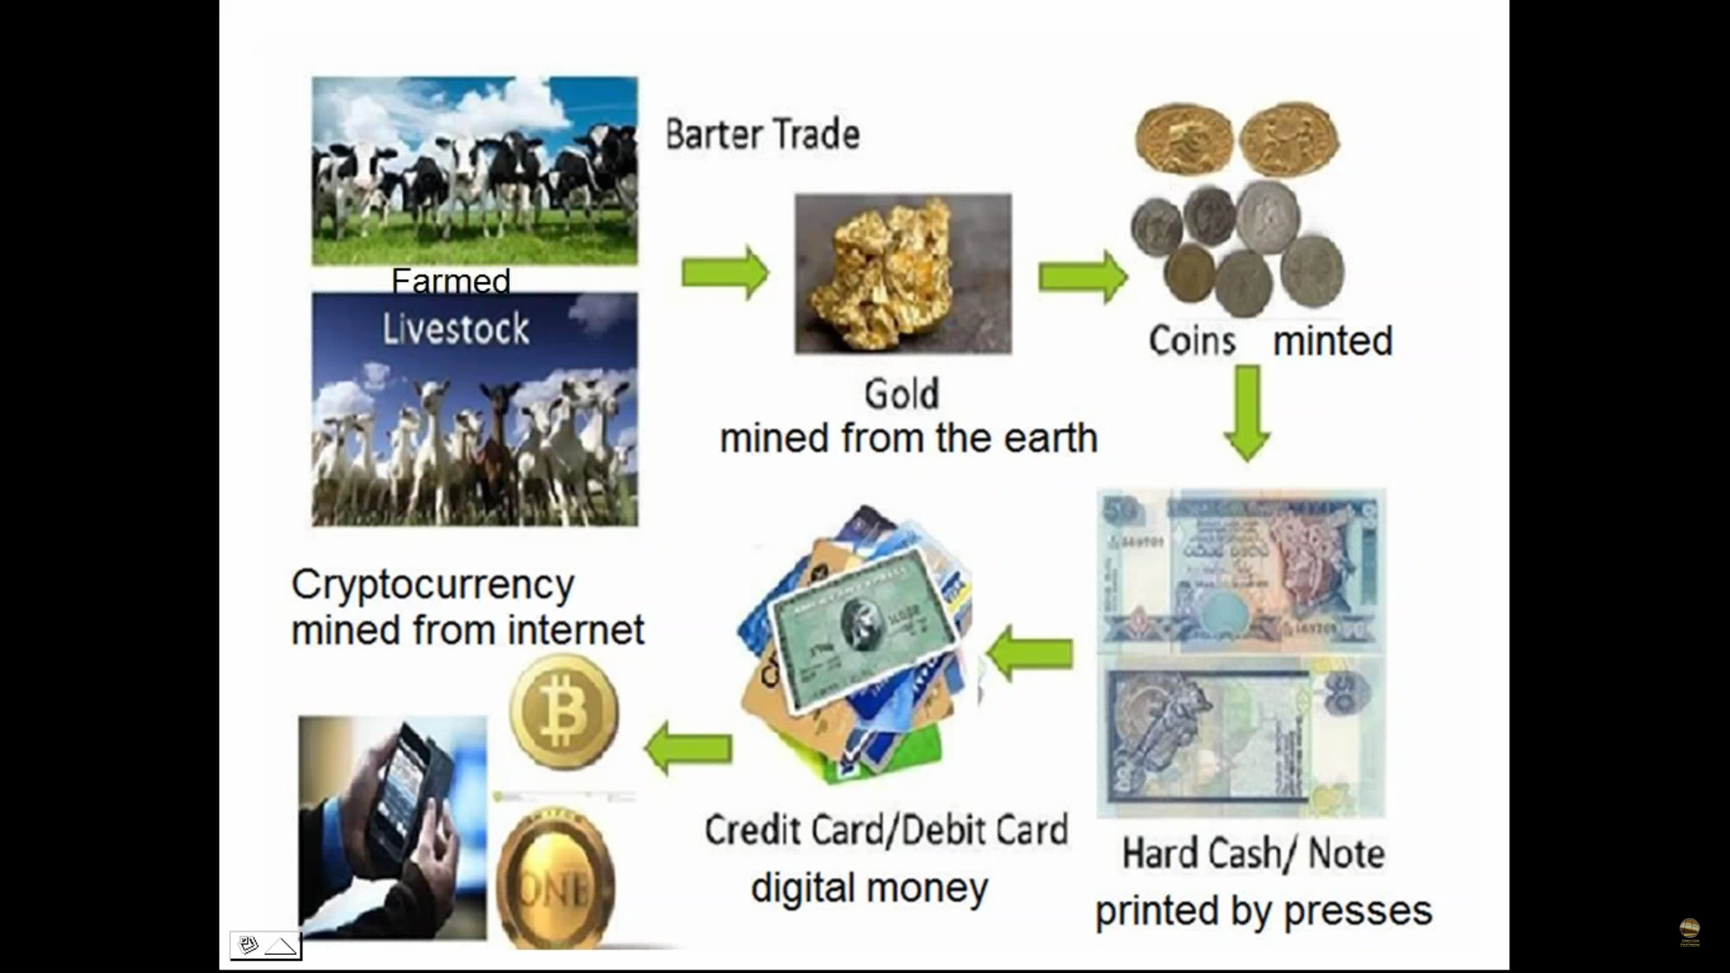
Evolution of Money
From Gold to Digital Money

Slide 4
Digital Currency Summary
Digital Currency “Coins” are like serial numbers on bills.
Computer money.
Wanted by banks and merchants.
Coins are mined and exist electronically.
BitCoin has many big problems.
Over 400 other DCs are now being produced.
Largest are:
BitCoin, OneCoin,
Ethereum, Ripple, LiteCoin, & Steem.
OneCoin is Private (Now).
Designed to fix and replace BitCoin.
Going public on FOREX in January!

Slide 5
What is Digital Currency
OneLife Official Video
July 2016
1:20 minutes
Actually Applies
To All Other Digital
Cryptocurrencies
https://www.onecoin.eu/en/media-galleries#
Scroll down to see the video selections
(Used because it is public domain)

Slide 6
What is the BlockChain
OneLife Official Video
August 2016
1:40 minutes
Actually Applies
To All Other Digital
Cryptocurrencies
https://www.onecoin.eu/en/media-galleries#
Scroll down to see the video selections
(Used because it is public domain)

Slide 7
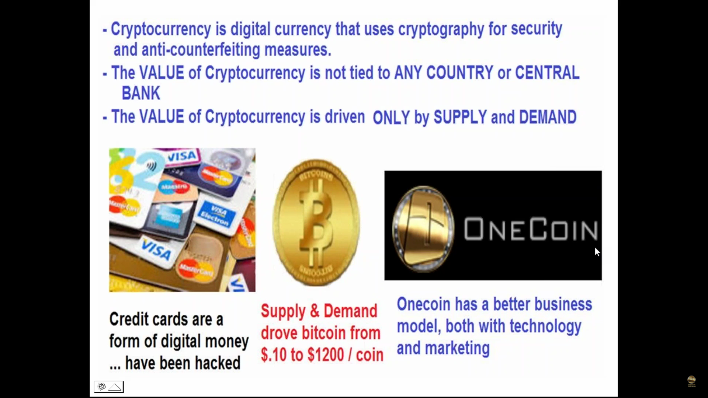
Digital Currency
Not Tied to Any Bank or Country

Slide 8
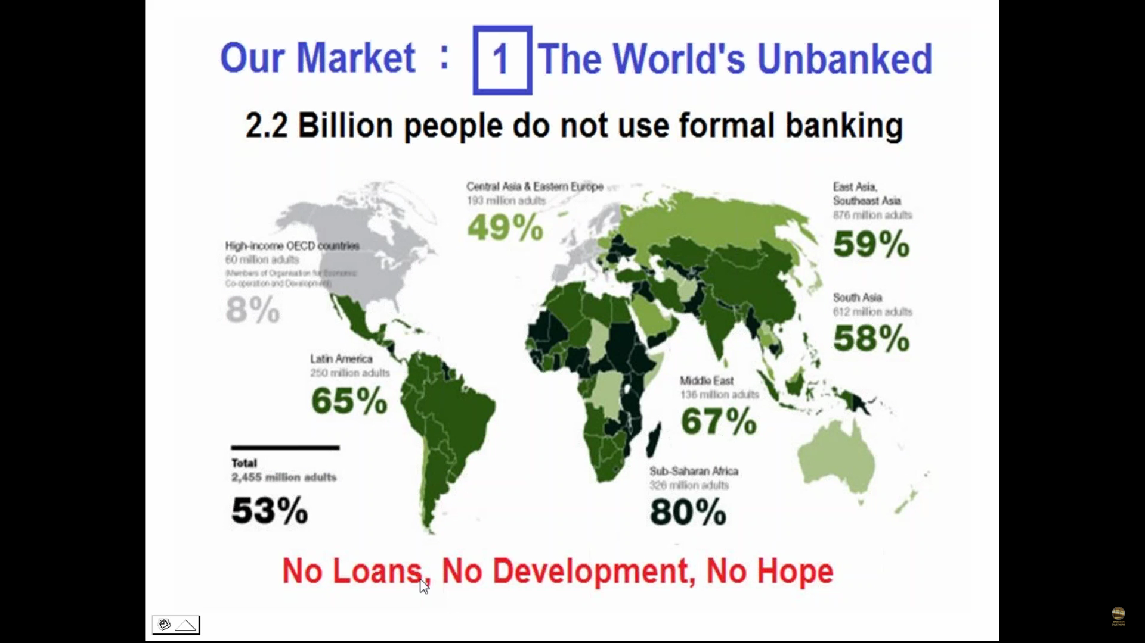
A Market for Digital Currency
2.2 Billion People – The Unbanked

Slide 9
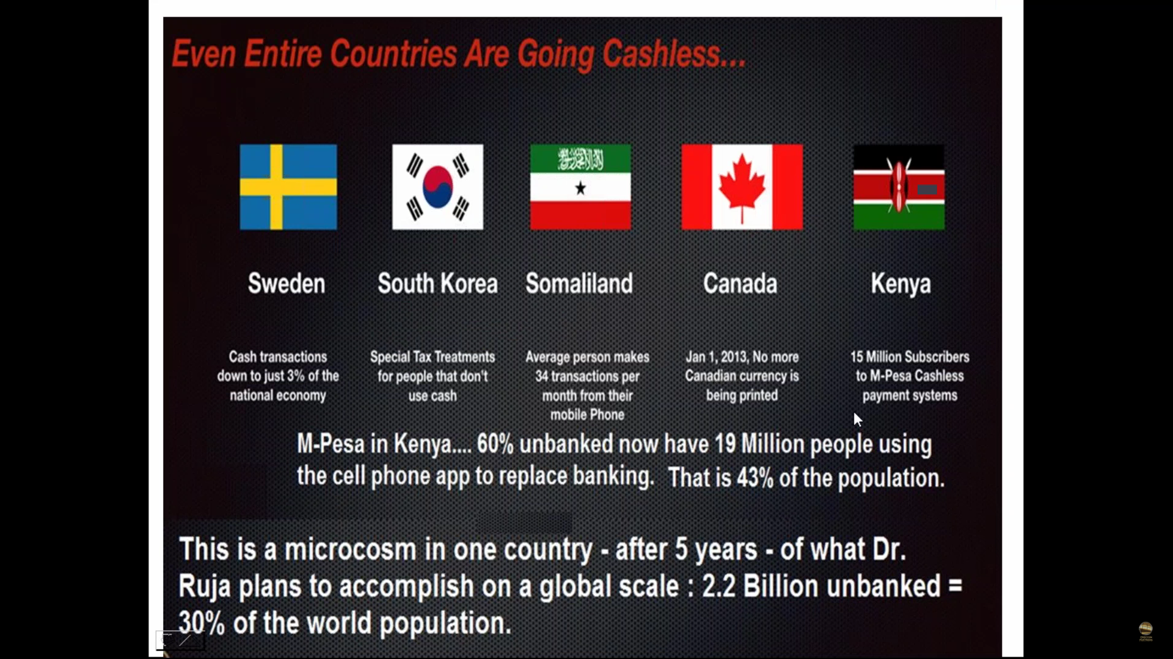
Money Transfers for the Unbanked
30% of the World’s Population

Slide 10
What are the Digital Currencies
There are over 400 of them today!...
All “financially controlled”…
Which do I want to look at?
Which do I want to invest in?...
Go to
www.xcoinx.com
To see them all…
This data was gathered from the internet…
During August 11-15, 2016

Slide 11
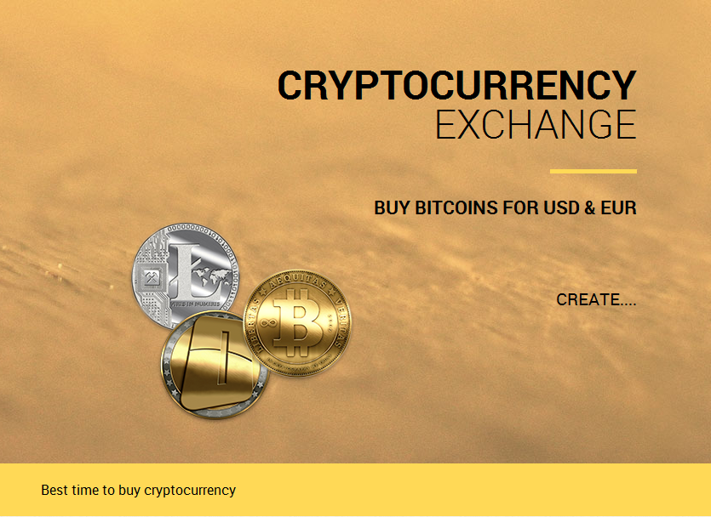
xcoinx.com

Slide 12
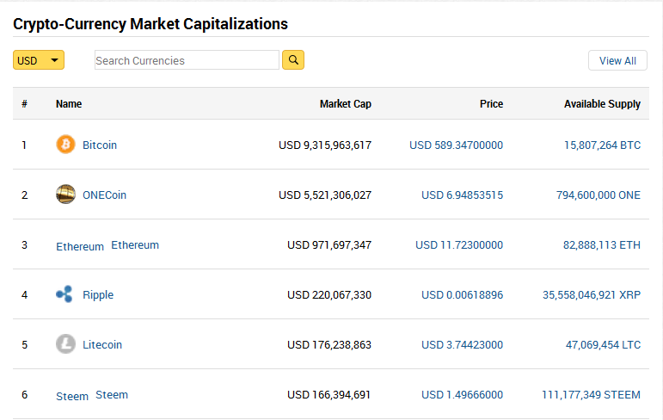
xcoinx.com

Slide 13
Digital Currency Summary
xcoinx.com
Ranked by Market Capitalization
“Coin” $Each Available Supply
BitCoin $589 16 M
OneCoin* $ 7 794 M
Ethereum $ 12 83 M
Ripple $< 0.01 36 B
LiteCoin $ 4 47 M
Steem $ 2 111 M
*OneCoin is a Private Company
To Publically Appear on FOREX January 1, 2017

Slide 14
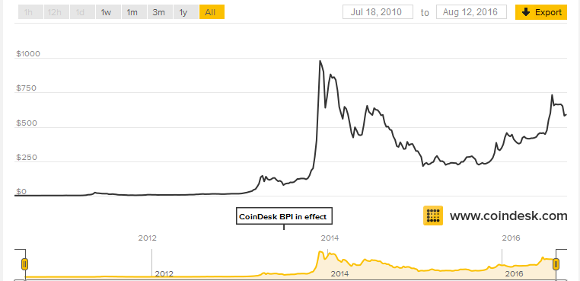
BitCoin
Price Since Inception
$1,000
$500
$ 0

Slide 15
BitCoin
Only 21 million BitCoins will ever (if ever) be produced -
Only 75% mined so far.
Highest Increase Gain in 4 year period! To $980!
Price is now way down to $585 per coin.
Mine them yourself or buy them.
Harder to mine as more are mined!!!
Problems…
Slower Mining…
Your Computers!
Unstable Price!
20% of all BitCoins produced have been lost
or stolen, and their accounts hacked!

Slide 16
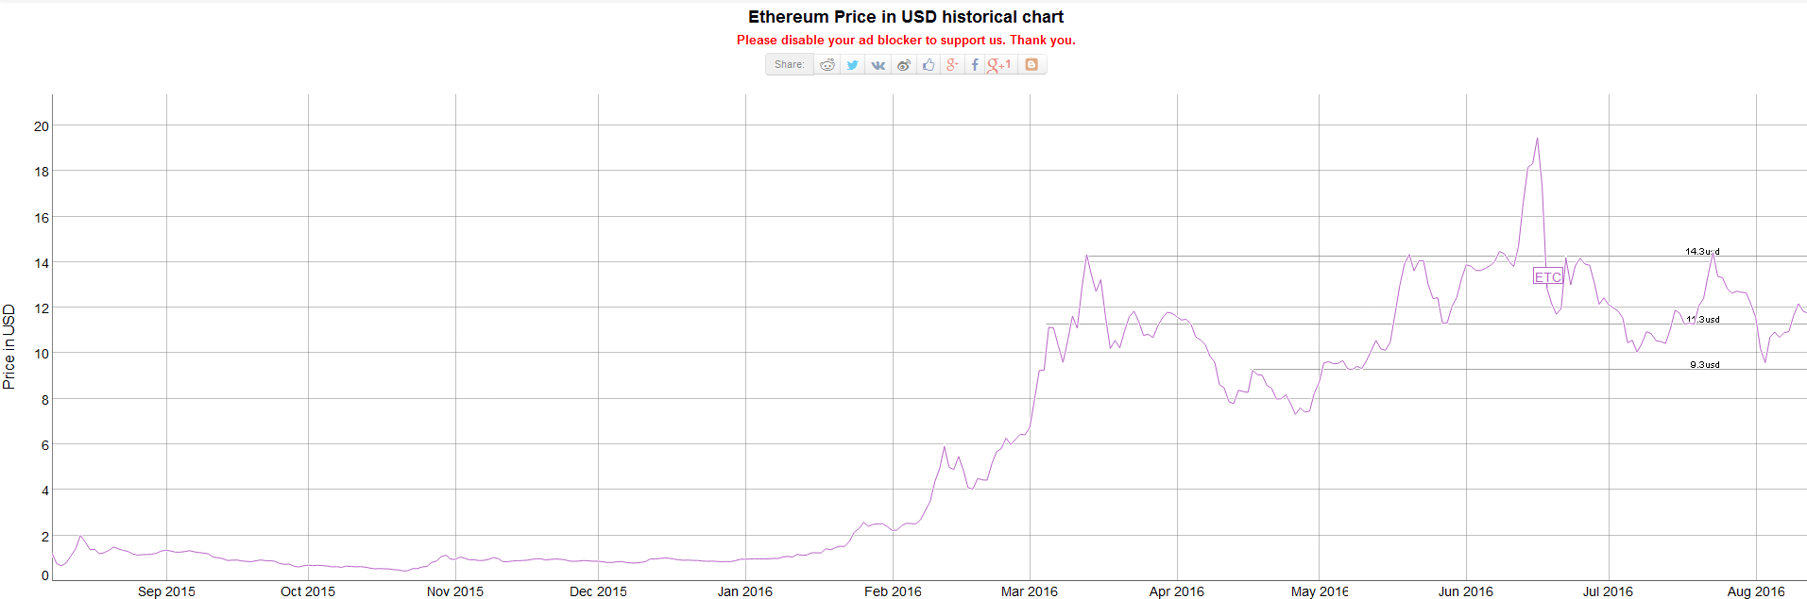
Ethereum
Price Since Inception
$ 14
$ 10
$ 0

Slide 17
Ethereum
Tied to BitCoin.
Unstable Price!
Also Looked Good, but…
Alas, Has Had Major Problems…
Huge Profit Taking – Twice!
$14 to $7, and then
$19 to $9!

Slide 18
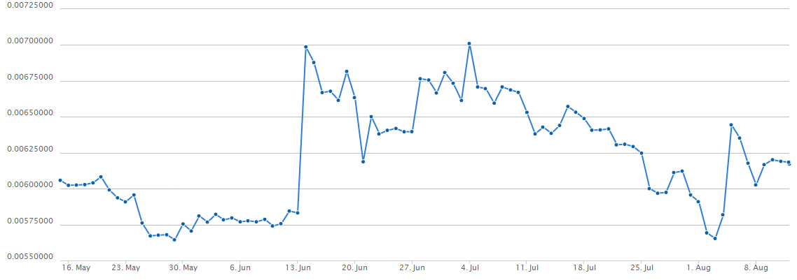
Ripple
Price Since May 2016
$ 0.007
$ 0.006

Slide 19
Ripple
Very Low Price
Very High Total Coins Expected
Market Cap Ranked 4th
Huge Volatility!
0.7 cents to 0.6 cents twice since last May!
Note that OneCoin plans to surpass this
Number of Coins in October 2016

Slide 20
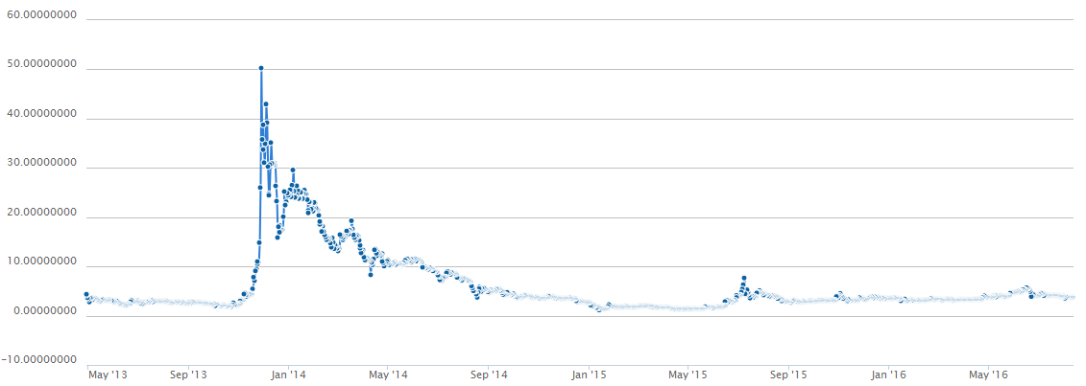
LiteCoin
Price Since Inception
$50
$ 0

Slide 21
LiteCoin
Increased in value like BitCoin!
Dropped from $50 to $10 within 6 Months!
Also exhibited Huge Volatility!
Now at a “stable lower price” of $3.77.

Slide 22
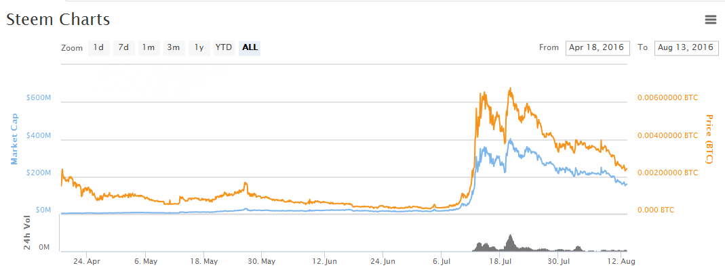
Steem
Price Since April 2016
$ 3
$ 0

Slide 23
Steem
Increased in value along with BitCoin!
Dropped from $4.50 to $1.50 within 1 year!
Also exhibited Huge Volatility!
Now at a “stable lower price” of $1.15.

Slide 24
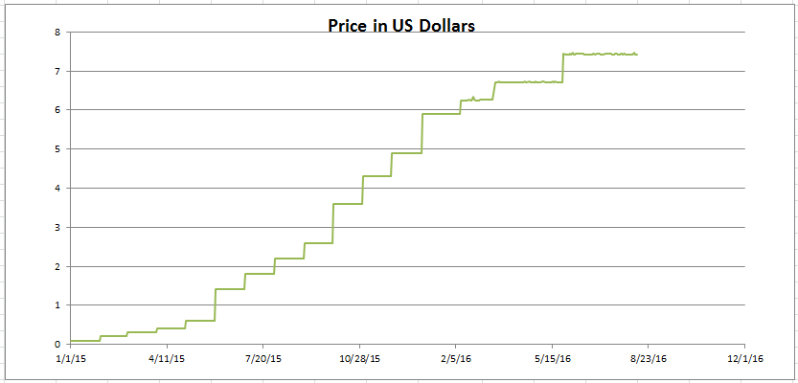
OneCoin
Price Since Inception (my data)

Slide 25
BitCoin
Price Since Inception

Slide 26
OneCoin
Price Since Inception (my data) Avg. 10%/Qtr

Slide 27
OneCoin
Private Company – Now under OneLife
“Going Public” in January 2017
Backed by Gold Deposit in Dubai
Funded by Members
Introduced by Sponsors
Created to Fix
All of the problems with BitCoin
Just Like
Facebook has done with Myspace!
It could be: The Next Big Thing!

Slide 28
OneCoin
Designed to be the One Coin for the Entire World!
100x number of BitCoins
(Soon to be 5700x: Coming in October 2016)
Easy to Join.
All done on your computer with the internet!
Severe Limits on Selling -
5 to 40 coins per day per position max!
Upward Trend expected to continue!
“Profit taking” not expected to decrease
The OneCoin value for a very long time!

Slide 29
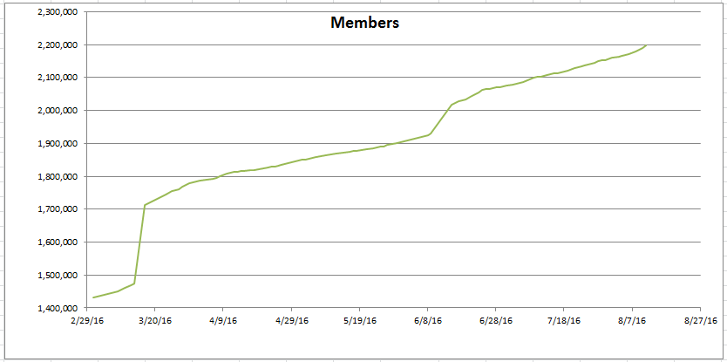
OneCoin
Paid Members Worldwide (my data) Over 240 Countries
Increasing at 4,000 members per DAY! (my data)

Slide 30
Digital Currency
Including OneCoin
Patrick Bailey, PhD
An Independent Marketing Associate for OneLife and OneCoin
Other Data and
Detailed Information At
PADRAK OneCoin
www.padrak.com/onecoin/

Slide 31
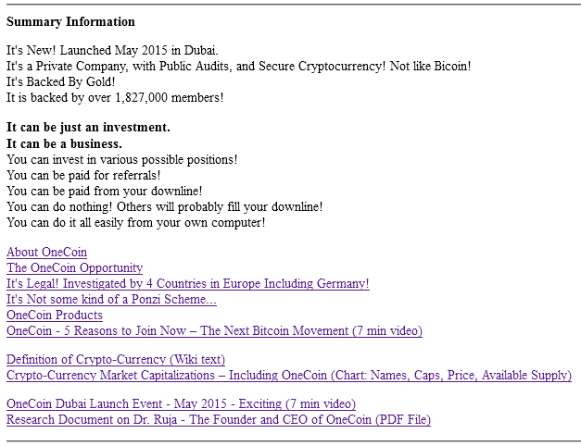
PADRAK OneCoin Website
http://www.padrak.com/onecoin/

Slide 32

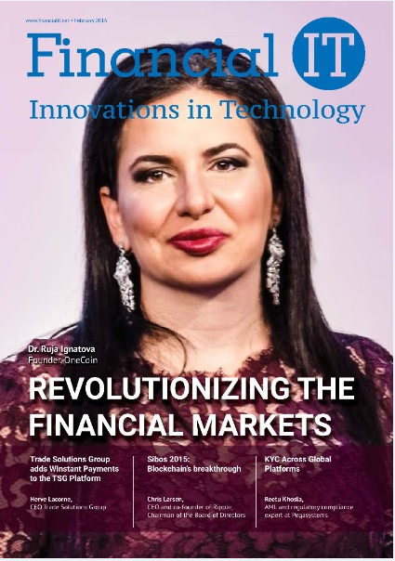
Founder of OneCoin
Founded in January 2015 by
Dr. Ruja Ignatova (Bulgaria) - 2 Books on Cryptocurrency
Twice Voted Business Woman of the Year!
Cover of Forbes Magazine (Paid)
IT Cover February 2016 (Invited)

Slide 33
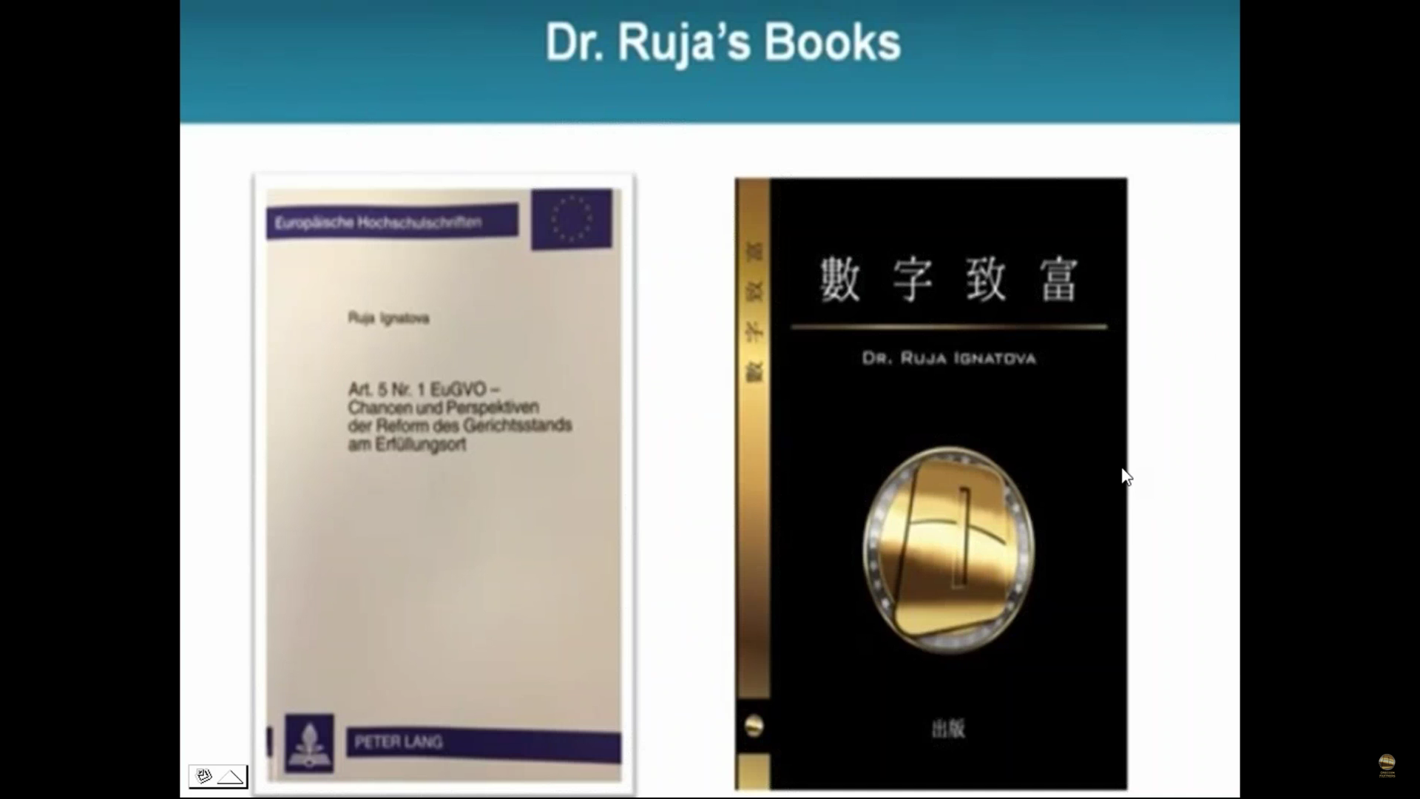
Dr. Ruja’s Books
On Digital Money
“Cryptocurrency”

Slide 34
Regarding Possible Fraud
All digital currencies are regulated by law.
Only OneCoin is publically audited each month!
The OneCoin Company has also been
Legally Investigated in 4 Different Countries!
and Legally Approved By:
Germany (Most Strict Laws)
Finland
Vietnam
Sweden
Thailand
Etc…

Slide 35
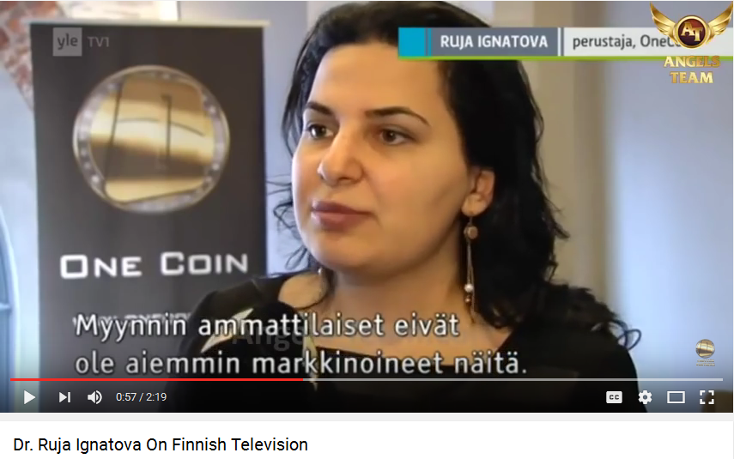
Finland Decides OneCoin is a Legal as Any Other Investment
Dr. Ruja Ignatova On Finnish Television 11/27/15 (2:19)
She Speaks in English.

Slide 36
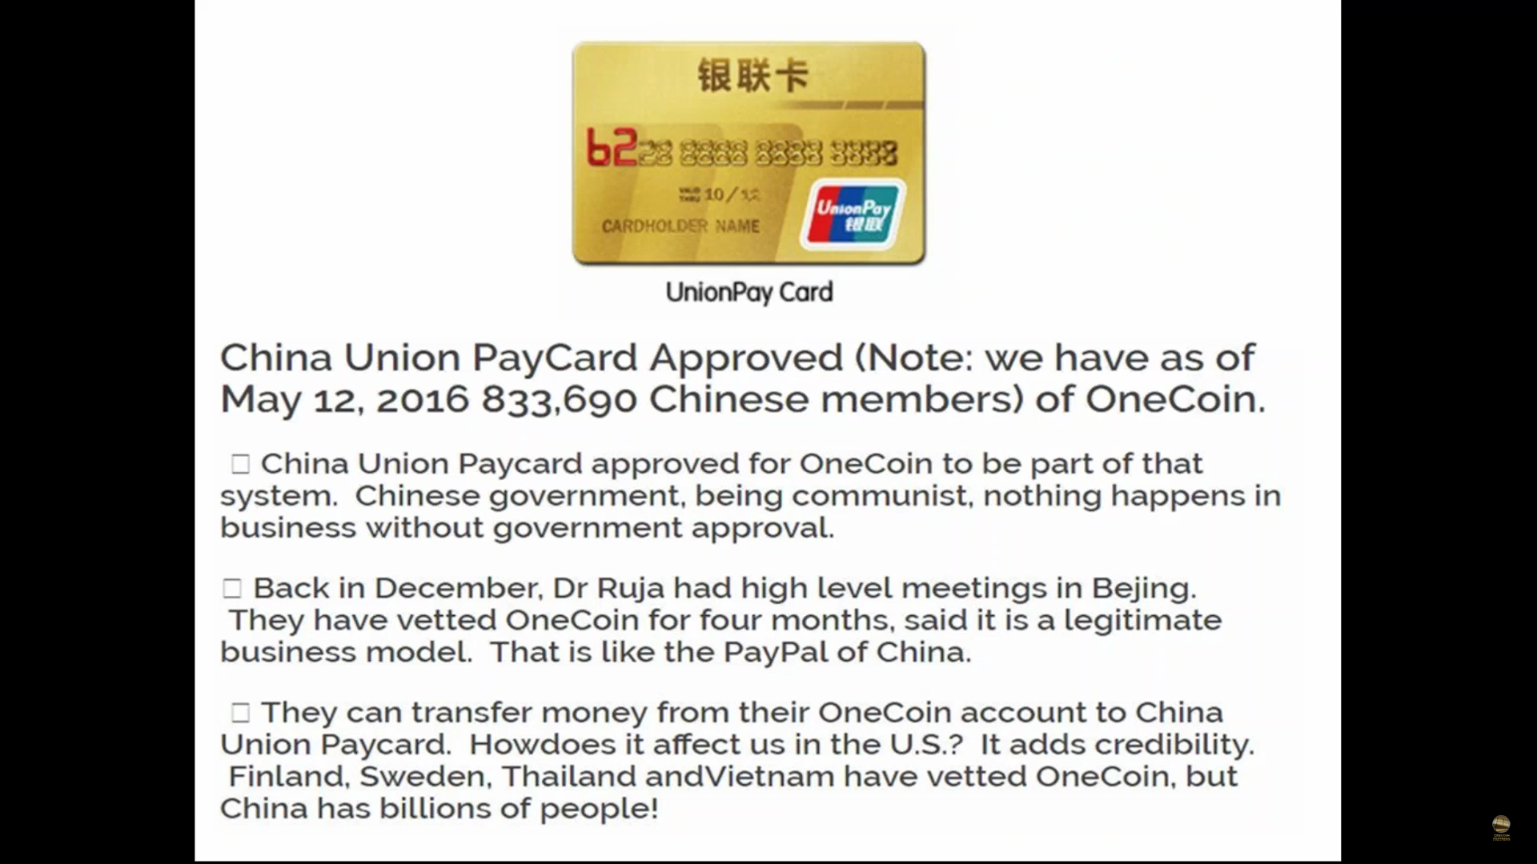
China Approves PayCard
Approved for OneCoin

Slide 37
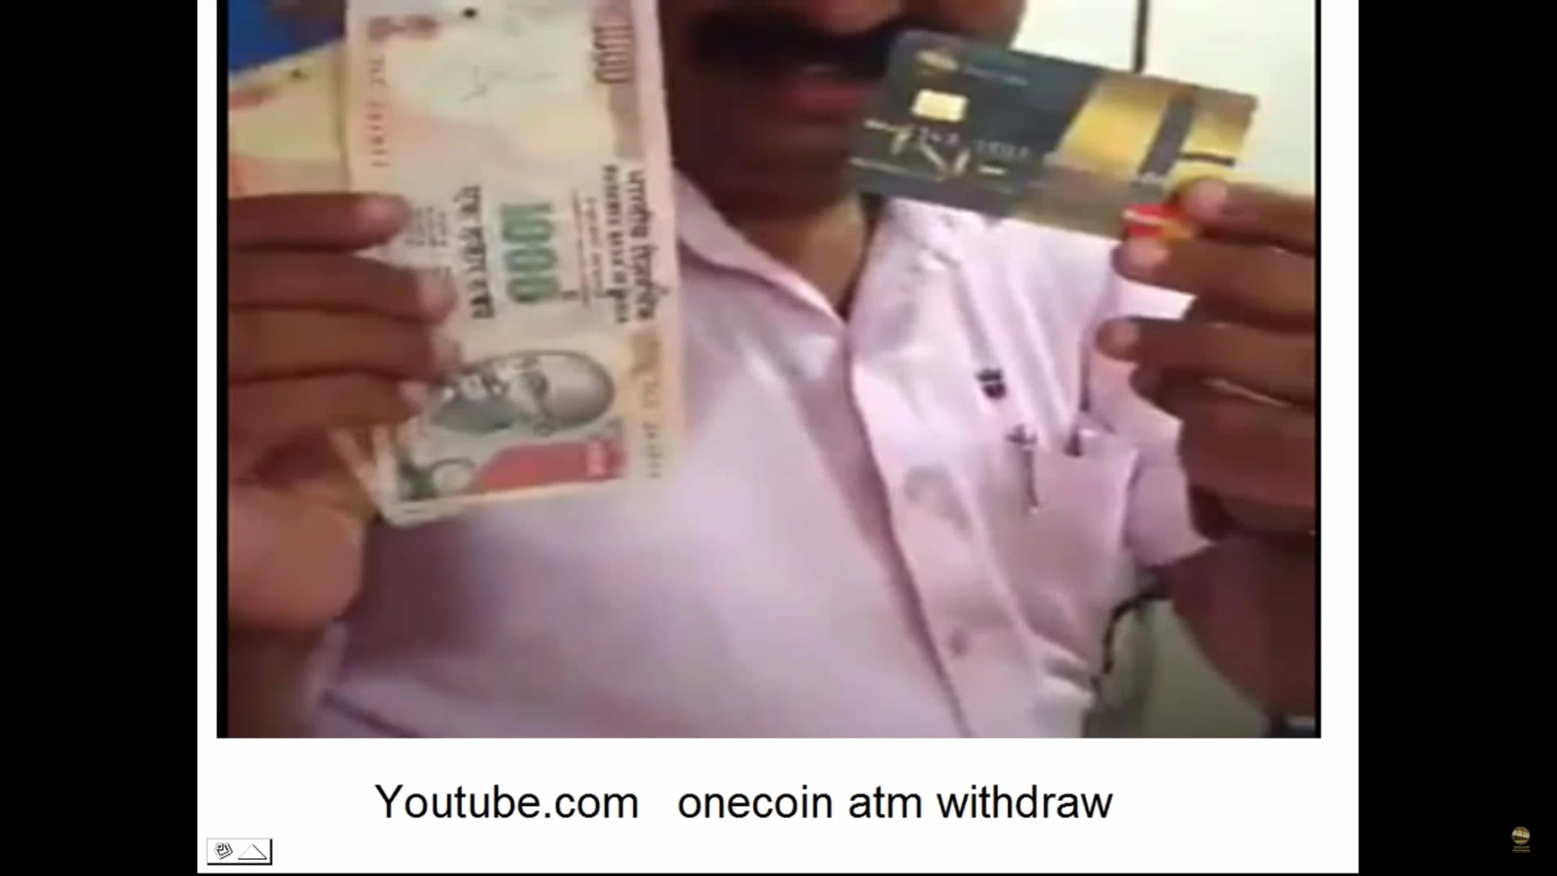
OneCoin Linked to Credit Cards
Withdraw Cash from your OneCoin Computer Account

Slide 38
Opening of OneCoin Offices
Sophia, Bulgaria
May 15, 2016
OneLife Video
2:55 minutes
https://www.youtube.com/watch?v=xrdecL9AGRk
As released by the OneLife Company

Slide 39
OneCoin Advantages
International.
They are Mining! - No Travel – No Meetings
No Marketing Required!
Proved “Not A Scam” in All Countries in Operation.
Done by Computer and Internet.
Very Popular in China (An outside investment!).
Value Increasing about 10% every 3 Months. *
Value expected to at Least Double by December 2017. *
Sponsors and Members (Binary Tree).
Purchase Educational Packages - Several Membership Levels.
Member Login and Dashboard Screens.
Has been working great since June 2015!
* Past performance is no guarantee of future results.

Slide 40
OneCoin Conference History
Organized - January 2015
Dubai Launch Event - May 2015
Chinese TV Programs – Nov 2015
On MSN TV Program– Dec 2015
Sophia Main Office Grand Opening - April 2016
London CoinRush Event - June 2016
Convention in Malaysia - June 2016
Convention Tokyo - July 2016
Planned Major Event – Oct 2016
Coin Doubling, and
Coin Limit Expansion (57x)
Public FOREX Event – January 2017
OneCoin Goes Public!

Slide 41
Alternative Investments
Stocks (Profit on Puts: When Goes Down…)
Bonds (Inverse to Stocks)
Precious Metals (Controlled)
All controlled by the futures put/call derivatives market!
Paper Gold (Is it real? Diluted?)
Paper Commodities (Same…)
Paper Money (The new bills: 20s, 50s, 100s)
Or:
Pre-IPOs
Real Estate
Marriage into the Business
Well they “used to work…”

Slide 42
Alternative Investments
What to do?
Investment Companies Charge %s.
Sales are dropping.
Real Estate is Topping Out.
Banks are staring to charge negative interest!
Note:
INCOME Tax is 30-50%.
Digital Coin Gains is Capital Gains – Much Less Tax!

Slide 43
OneCoin
Paid Members Worldwide (my data)
Increasing at 4,000 members per DAY Avg.!

Slide 44
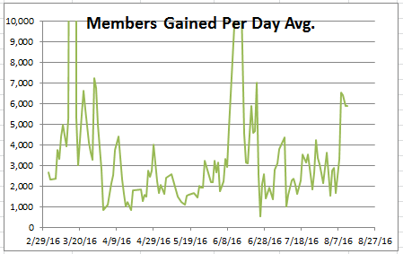
OneCoin
Paid Members Worldwide – GAINS (my data)
Increasing at Average of 4,000 Members per DAY!

Slide 45
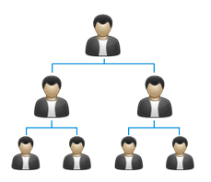
OneCoin Binary Downline
A Sponsor enrolls Members.
Anyone can enroll as many times as they want.
You can also “upgrade” your own position.
You do not have to market anything!
No inventory. No products. No selling!
Can be just an investment!

Slide 46
OneCoin Binary Downline
A Sponsor enrolls Members.
Anyone can enroll as many times as they want.
You can also “upgrade” your own position.
Total Number would be by Powers of 2
Total Number = 2 ^{Downline Levels}
Total Number = 2.2 Million (On August 12, 2016)
So:
Downline Levels (Filled) = Only 21 !
Lots of Room to Expand!
OneCoin has a 5 year plan through 2021!

Slide 47
OneCoin Binary Downline
Formed in Bulgaria
Official Launch in Dubai
Very Popular in China
London CoinRush June 2016
2.2 Million Members Worldwide
Only 10,000 – 20,000 Members in the USA!
Hello!!!...

Slide 48
OneCoin How It Works
Everyone has a Sponsor.
Sponsor helps you to enroll.
Payment made to receive a Gift Code -
Made to a sponsor, the company, or a trusted up-line.
Sponsor creates your network position.
You choose your unique User ID and Password.
You get your account Dashboard by email.
You enter your gift code to activate your account.
All at your computer – at home!
Sponsors are there to help you and assist!

Slide 49
OneCoin How to Get the Coins
Everyone has a Sponsor.
You Purchase an Educational Package.
(Starter, Trader, Pro Trader, Tycoon, etc…)
Get Your Gift Code.
Get Your Dashboard Account:
Insert Gift Code – Get Your Tokens.
Tokens Can Split! (Double!) -
About every 3 months – To the max number of splits.
Insert Tokens into mining.
After mined: Coins = Tokens/Diff
Diff and Value of Coins Increase over Time
(Both currently increasing at 10% every 3 months)
As more coins are mined, Diff goes up…

Slide 50
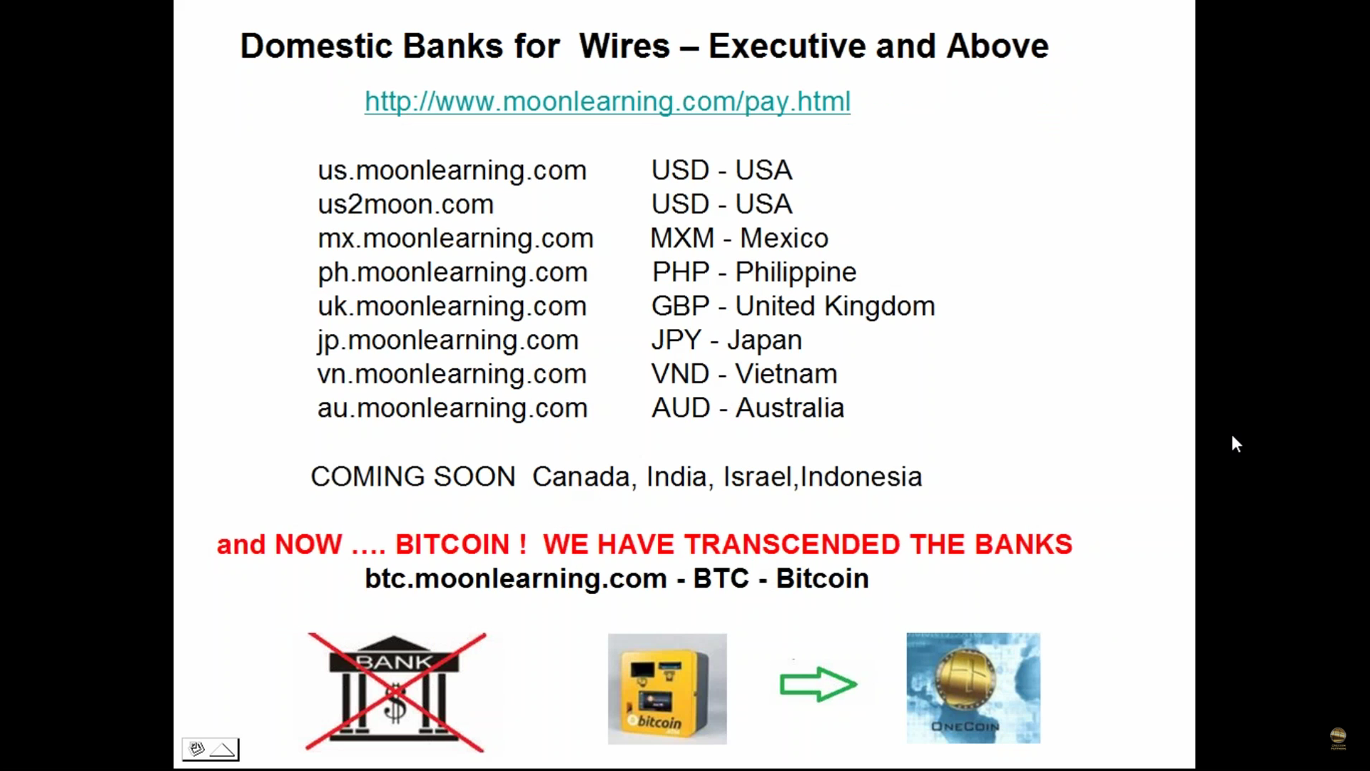
Wire Transfers
Available in Many Countries

Slide 51
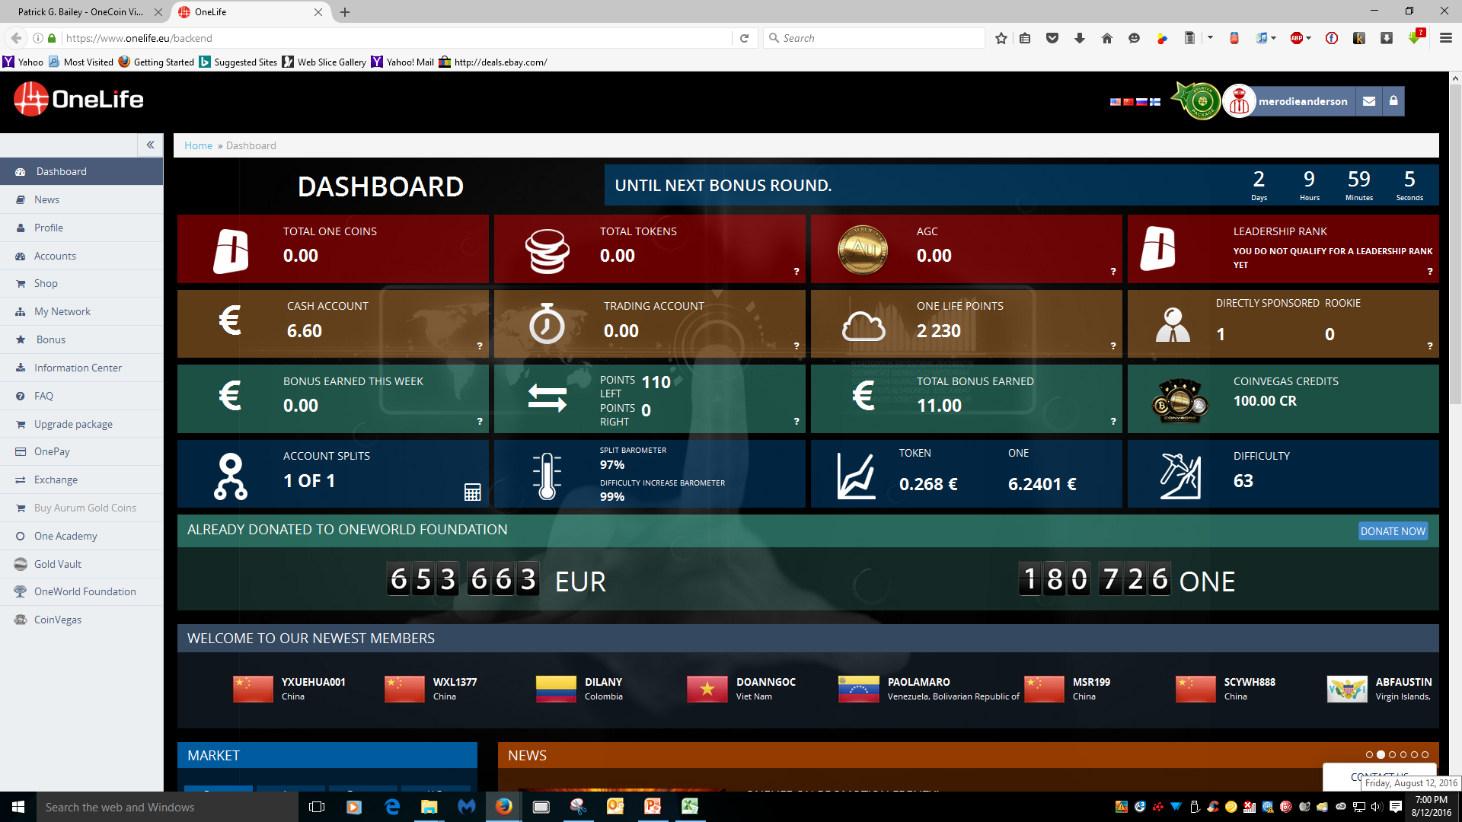
Starter Position Full Page Dashboard

Slide 52
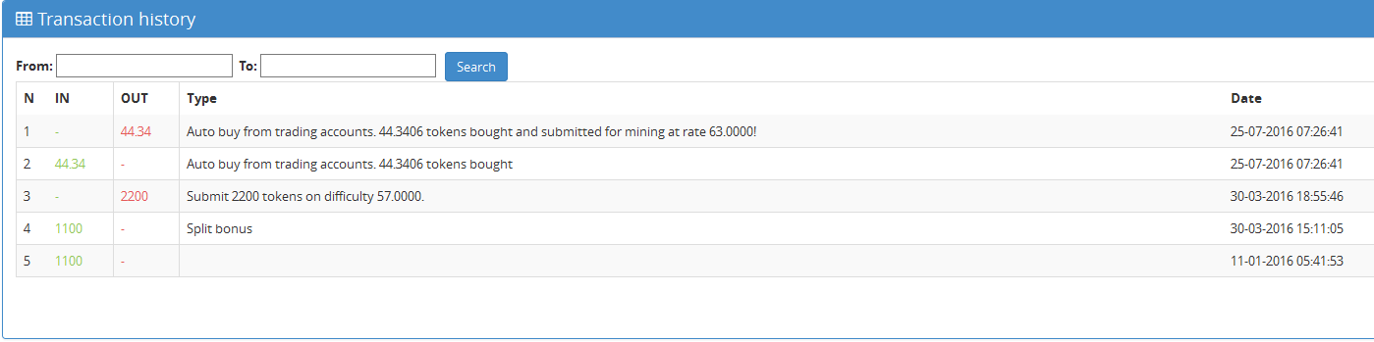
Starter Position – Account/Tokens
Example:
Started with 1,100 Tokens (1/11/16)
Split Once (3/30/16)
2,200 Tokens at Diff of 57
Will get 38.6 OneCoins
At $7.42 ea (8/12/16)
Returns $286.00

Slide 53
OneCoin 3 Ways to Participate
1. Invest in the Coins for Value.
Done.
No Marketing Necessary.
- - - - - - -
2. Share with Your Friends.
Signup Rewards (Cash and Tokens).
- - - - - - -
3. Join an Active Marketing Group (Free).
Signup Rewards (Cash and Tokens).
Support for Questions.
Newsletters.
Videos.
- - - - - - -

Slide 54
OneCoin One World Video
OneCoin The Global Payment Solution Of The Future
2:55 minutes
https://www.onecoin.eu/en/media-galleries#
Scroll down to see the video selections

Slide 55
OneCoin Summary Video
What is OneCoin
2:00 minutes
https://www.onecoin.eu/en/media-galleries#
Scroll down to see the video selections

Slide 56
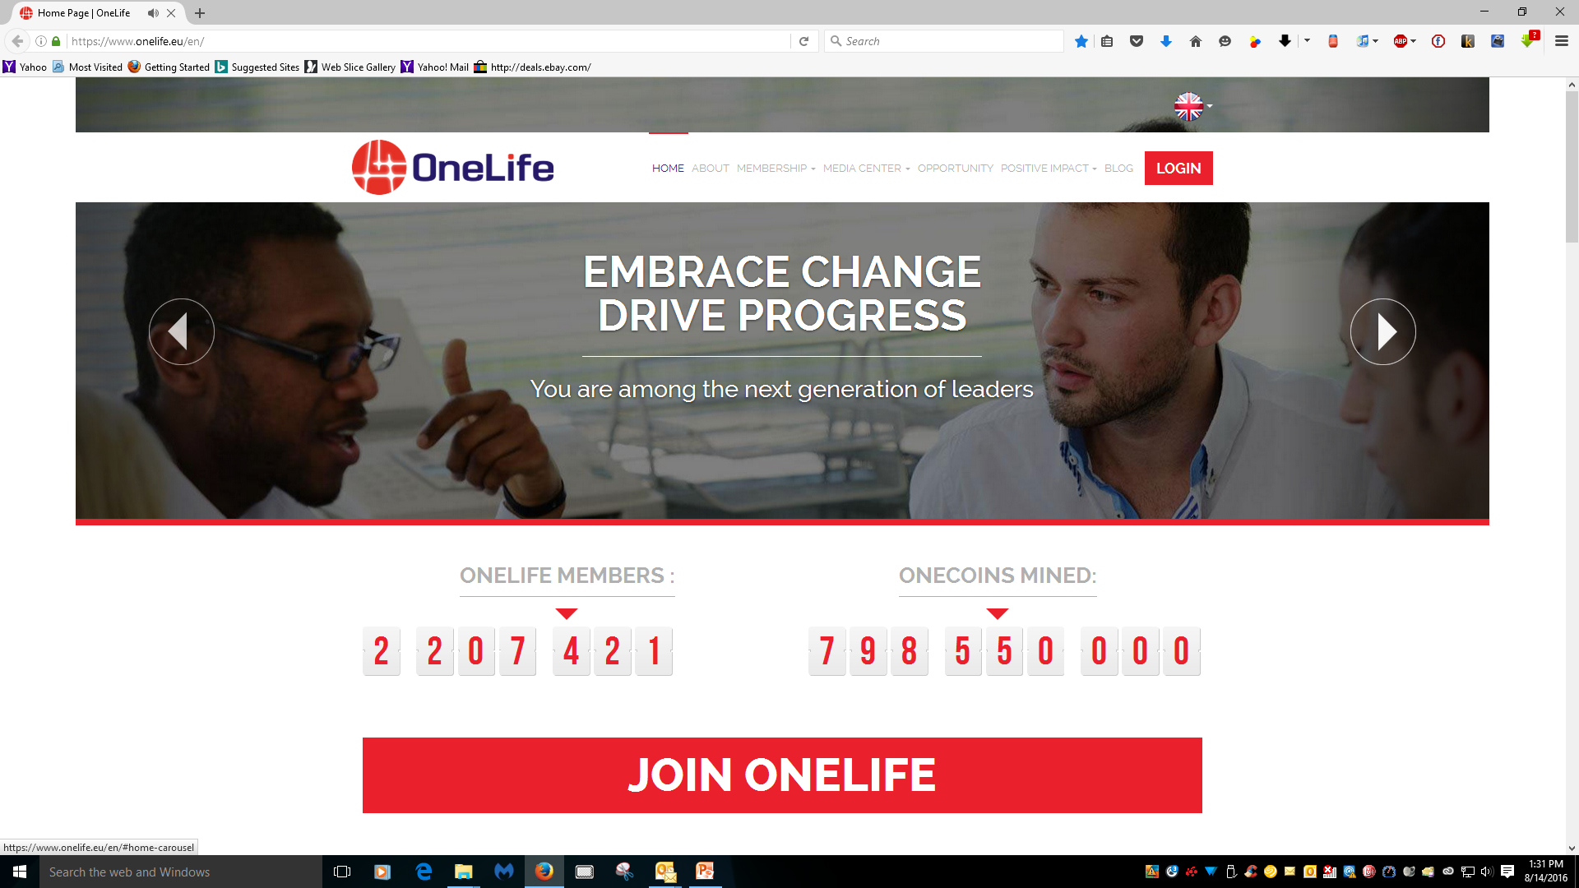
OneLife Company
Now Includes OneCoin

Slide 57
OneLife – Together For More
The OneLife Exclusive Club
1:33 minutes
https://www.youtube.com/watch?v=-RvZG9lNYNA
One Life Company Video

Slide 58
One Life and OneCoin
Summary Points
New
Legal, KYC “Know Your Customer”
Private Digital Currency Mining Company
Public Monthly Audits
Going Public In January 2017
Easy to Join
All from Your Computer and the Internet
Investment
Marketing Not Required (And Is Allowed)
Nothing Else to Buy or Sell
A Possible Investment
For Your Future

Slide 59
Digital Currency
Including OneCoin
Patrick Bailey, PhD
An Independent Marketing Associate for OneLife and OneCoin
Recommendations and
Detailed Information At
PADRAK OneCoin
www.padrak.com/onecoin/

