Slide 1
Free Energy Devices and UFOs:
Status and In Depth Reviews
Dr. Patrick Bailey
90 minute PowerPoint Presentation
Foundation for Mind-Being Research
Invited Presentation
June 24, 2016
Palo Alto, CA

Slide 2
Free Energy Devices and UFOs:
Status and In Depth Reviews
Dr. Patrick Bailey
Nuclear and Electronics Engineer, and Researcher
Tired, Retired, and Re-Hired (Hopefully)
Free Energy Devices
UFOs
AG Platforms
ETs
Politics
Religion
Situation in the USA Today

Slide 3
The Plan
90 Minute Lecture (or less)
No Interruptions or Questions
We are Going to Go Fast for Lots of Info!
4 Parts: Intro / FE / UFOs / PR
30 Minute Q & A After
Limit 1 minute per person per Q and A
All Data from Public Sources
No Insider Information
No Proprietary Information
No Classified Information
For Educational and Entertainment Purposes Only! (See the Legal Notice)
Copies of Presentation Available w/o Video Clips

Slide 4
My Plan
To give you new information
To open your eyes
And maybe
To upset everyone watching
At least once
About something…

Slide 5
Dedicated To
All Truth Seekers Everywhere
Nickola Tesla
My Parents
The Family of Light Network
Spring Board Divers
Gymnasts
Rugby Players
Spiritual Seekers
The Masons
All Alphabet Organizations (ONR, FBI, CIA, DHS, etc…)
Sloopy (Gavegin Videos)
and Kurt (The FMBR Camera Man)

Slide 6
Legal Notice
Information contained in this World News Daily Report website is for information and entertainment purposes only. The website and the information (including changes to the terms herein) may be changed or updated from time to time without notice. In consideration for using this website, the visitor agrees to hold WNDR and its directors, officers, members, employees and agents harmless against any claims for damages or costs or any loss of any kind arising out of the access to or use of this website or any information contained in or obtained through this website.
Certain links in the website connect to other sites maintained by third parties that may or may not be presented within a frame on the website. World News Daily Report has not verified the contents of such third party sites and does not endorse, warrant, promote or recommend any services or products, that may be provided or accessed through them or any person or body which may provide them. WNDR has not issued or caused to be issued any advertisements which may appear on these websites and therefore accepts no responsibility for such content.

Slide 7
Disclaimer
The nature of Internet communications means that your communications may be susceptible to data corruption, unauthorized access, interception and delays. This website may include incomplete information, inaccuracies or typographical errors. World News Daily Report, and any other persons involved in the management of this website, may make changes in the information and content included in this website at any time without notice.
WNDR shall not be responsible for any incorrect or inaccurate information, whether caused by website users or by any of the equipment or programming associated with or utilized in this website or by any technical or human error which may occur.
WNDR assumes however all responsibility for the satirical nature of its articles and for the fictional nature of their content. All characters appearing in the articles in this website – even those based on real people – are entirely fictional and any resemblance between them and any persons, living, dead, or undead is purely a miracle.

Slide 8
Thank you to:
“World News Daily Report is an American Jewish Zionist newspaper
based in Tel Aviv and dedicated on covering biblical archeology news and other mysteries around the Globe.”
http://worldnewsdailyreport.com/about-us/

Slide 9
The Mission: The FMBR Mission
Our mission is to expand the context for scientific exploration to include our interconnectedness with the universe.
Our purpose is to lead people to self-empowerment in order to create positive change for themselves and the planet.
In our research programs we explore a more encompassing view of the nature of the universe — one that includes both the physical and non-physical aspects.
In our educational programs we share this expanded world view with our membership and the community: locally via the institute, and worldwide via the internet.
We create partnerships that foster innovative solutions for the challenges that are facing our world today.
http://fmbr.org/fmbr-mission-statement/

Slide 10
The Problem: Expanding Your Mind
The Problem of the 9 Dots
If you have seen this before –
Please
Do not give this away! Quiet!...
This is a very powerful exercise for those that see it for the first time!
Quiet!
Listen Very Carefully to the Rules!
Quiet!

Slide 11

The Problem of the 9 Dots
“Here are 9 dots.”
“Connect all 9 dots with four straight lines
Without lifting the pencil.”
“No tricks.”
Just do it!

Slide 12
The Problem of the 9 Dots – Go!

Slide 13
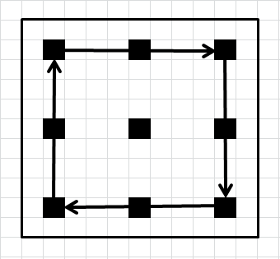
The Problem of the 9 Dots – Try 1

Slide 14
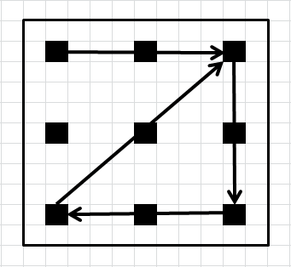
The Problem of the 9 Dots – Try 2

Slide 15
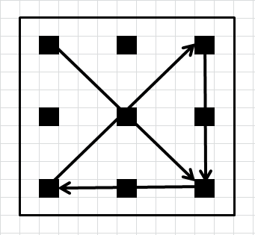
The Problem of the 9 Dots – Try 3

Slide 16
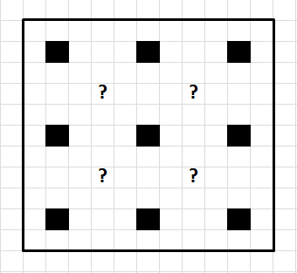
The Problem of the 9 Dots – Try What?...

Slide 17
The Problem of the 9 Dots – GIVE UP?

Slide 18
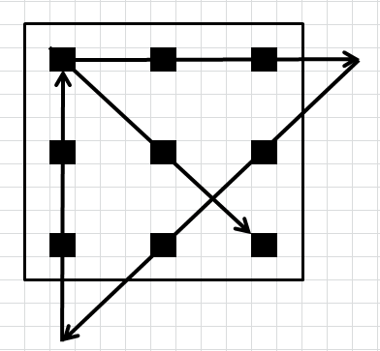
The Problem of the 9 Dots – Obvious Solution!

Slide 19
The Problem of the 9 Dots
Nobody said anything about any box or the size of the box!
You created the box boundaries!
You set the rules!
Get out of Your Self-Imposed Box!
Expand Your Mind!
So - Now…
Get Ready To…

Slide 20
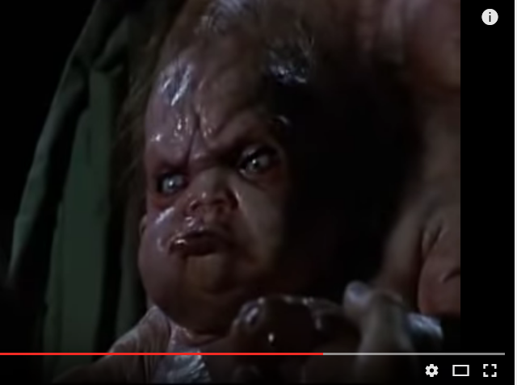
Open Your Mind
From the movie Total Recall (1990 with Arnold)

Slide 21
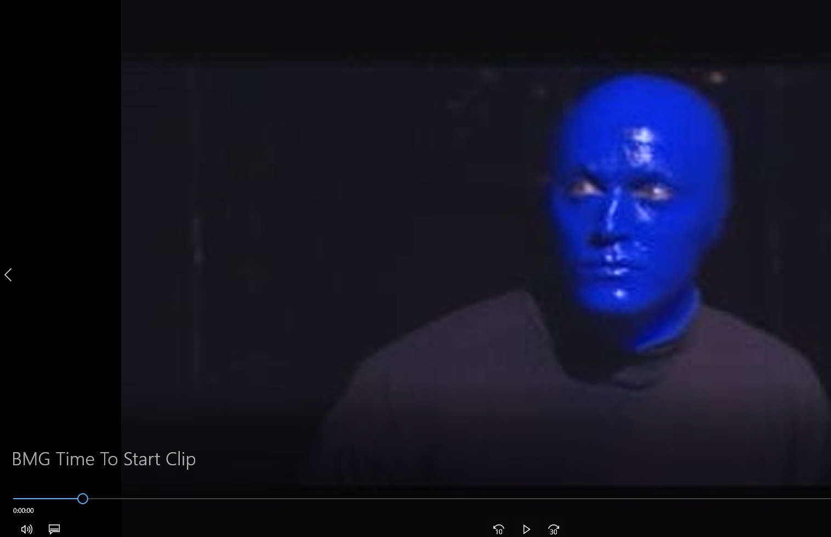
Video Clip
It’s Time To Start

Slide 22
Lecture Summary
Read This and - Then You Can Go Home Early…
Free Energy and Over Unity Devices Exist
There is no such thing as Perpetual Motion.
There are MANY examples of very long-lasting motion and
Working advanced energy conversion devices that are old and new.
UFOs are Real
Flying saucers, discs, cigars, triangles, mother ships, and platforms
Have all been recorded throughout history, and are here now.
Many hints and some photos point to a deep space ONR Navy.
Who: ETs (Great Grandparents, Diff. Types, White Hats & Black Hats)
What: Alien Built Alien Flown, AB Earth F, EBA Designed and EBEF.
Why: It is time for us to grow up and wisely choose a side.
The US Government is Classified
The “United States of America, Inc.” corp. went Bankrupt in 1933.
War Powers Act of 1933 = We are Still Now in a “State of National Emergency”.
Vested Interests are Still Winning!

Slide 23
WHAT IS TRUTH?
“But what is Truth?
Is Truth Unchanging Law?
We both have Truths…
Are mine the same as yours?”
Pilate to JC
Jesus Christ Superstar – Production

Slide 24
“Can You Handle The Truth?”
Answer the Question!

Slide 25
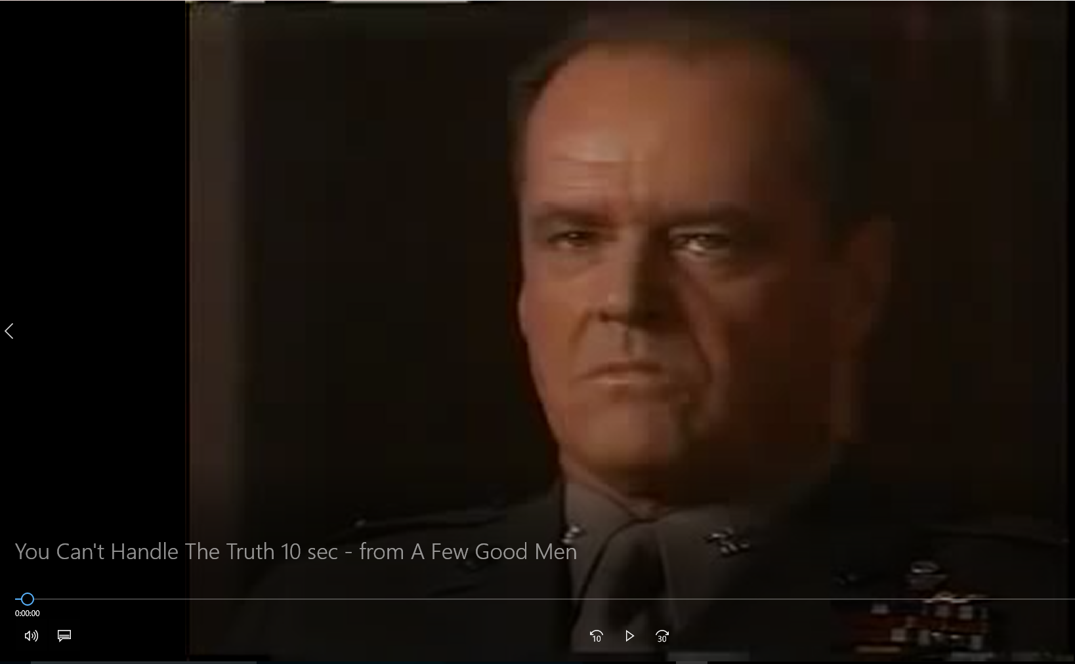
Blank

Slide 26
The TRUTH Tree
The Unknowable Real Truth
The Proven Truth that You Can Finally See -
Repeatable with Real Facts
The Unproven Truth that You Can Only Derive -
Not Repeatable, with some Facts
The Unproven Truth that You Can Only Guess At –
Not Repeatable, with No Facts (e.g. TV)
The Statements and The Lies
Public Releases
False Flag Announcements
Reports

Slide 27
PADRAK
Personal Assistance and Development
Through
Research and Acquired Knowledge
Technical Applications Worldwide
Dr. Patrick G. Bailey, President
[Also Gaelic for Patrick]
www.padrak.com
Lots of Interesting Material!

Slide 28
Free Energy Devices
Over Unity Machines
New Forms of Potential Energy
New Advanced Physics!

Slide 29
Free Energy Devices
Over Unity Machines
New Forms of Potential Energy
New Advanced Physics!
Being NEW, it means that:
OF COURSE YOU WILL NOT UNDERSTAND IT!
BY DEFINITION!

Slide 30
Free Energy Devices
Over Unity Machines
New Forms of Potential Energy
New Advanced Physics!
Being NEW, it means that:
OF COURSE YOU WILL NOT UNDERSTAND IT!
BY DEFINITION!
HINTS:
It is not on TV.
It is not in the university books.
It sounds impossible!
It just can’t be!
Yet it seems to work! Damn!...
It is NOT “Impossible” …
It should rather be “Interesting” !

Slide 31
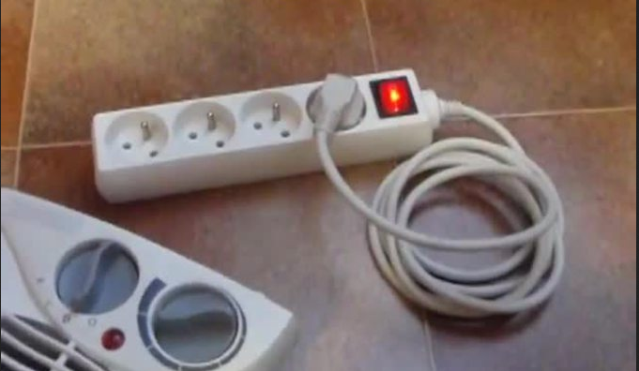
Free Energy Devices
Over Unity Machines
New Forms of Potential Energy
LOOK – It’s On The Internet!!!
NOT!

Slide 32
Institute for New Energy Main Website
http://www.padrak.com/ine/
Note: Each file link below opens a new window.
[Computer Currents Interactive Link Award, Nov. 11, 1996.]
Last updated with non-technical information: September 19, 2006
Last updated with any technical information: December 13, 2003
(The signing date of The Patriot Act II; after the signing of The Patriot Act I)
[We will get to why later…]

Slide 33
Institute for New Energy Fabulous Facts Page
http://www.padrak.com/ine/FABFACTS.html
"There is nothing more difficult to plan, more doubtful of success, nor more dangerous to manage than the creation of a new system.
For the initiator has the enmity of all who would profit by the preservation of the old system and merely lukewarm defenders
in those who would gain by the new one."
- Machiavelli 1513.
"... after a few more flashes in the pan, we shall hear very little more of Edison or his electric lamp - Observed 1879.
"Heavier- than- air flying machines are impossible."
- Lord Kelvin, President, Royal Society, 1895.
"Professor Goddard ... does not know the relation of action to reaction ... he only seems to lack the knowledge ladled out daily in our high schools."
- New York Times, January 13, 1920.

Slide 34
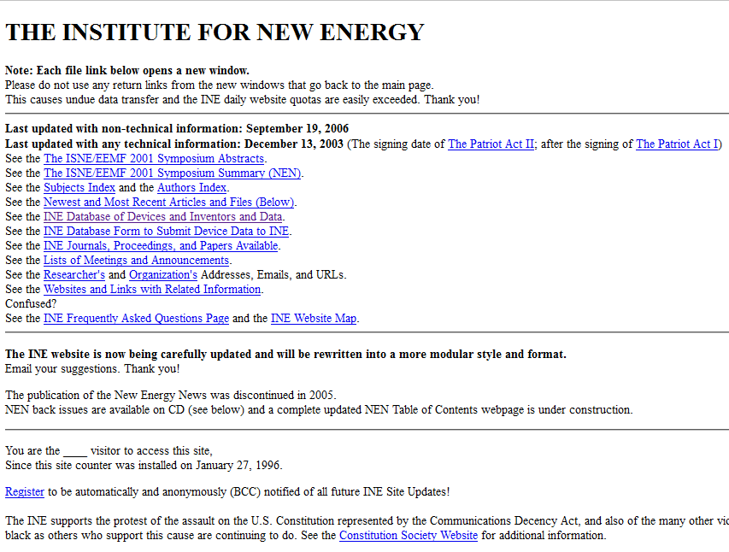
a

Slide 35
Institute for New Energy Database Guide Page
www.padrak.com/ine/DBGUIDE.html
INE DATABASE GUIDE
All Database Files Last Updated: January 25, 2003
From the Institute for New Energy Web Site at: www.padrak.com/ine/
Device Listings Are Given By:
Device Name
Inventor's Name
Interest Criteria
and
Commercialization Criteria
[So what!...]

Slide 36
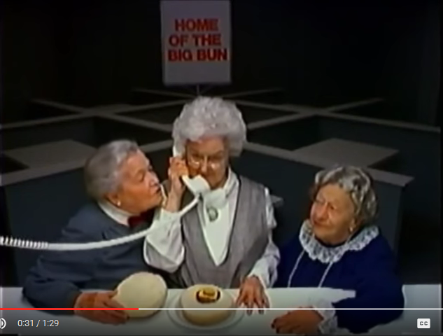
WHERE’S THE BEEF?

Slide 37
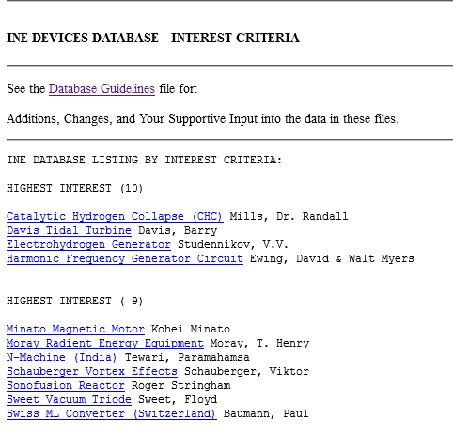
Institute for New Energy Database - Interest
http://www.padrak.com/ine/db/DEVICES_I.html

Slide 38
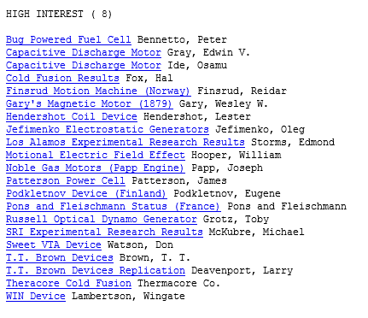
Institute for New Energy Database - Interest
http://www.padrak.com/ine/db/DEVICES_I.html

Slide 39
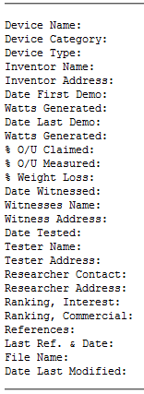
INE Database – Template File
http://www.padrak.com/ine/DBTEMPLATE.html
Listed for each Device – Linked – ALL of the Available Data for:

Slide 40
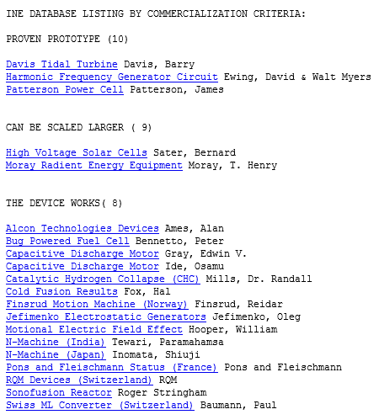
Institute for New Energy Database - Commercialization
http://www.padrak.com/ine/db/DEVICES_C.html

Slide 41
Institute for New Energy Database – The Winners
Davis Tidal Turbine – Ocean Vertical Turbine
Harmonic Frequency Generator Circuit - Resonance
Patterson Power Cell – Cold Fusion
High Voltage Solar Cells – Higher Efficiency
Moray Radiant Energy Equipment – Isotope Resonance
Paul Brown Beta Cell Battery - Isotope Resonance
Bug Powered Fuel Cell – Biological Energy Conversion
Capacitive Discharge Motor - Gray
Capacitive Discharge Motor - Ide
Catalytic Hydrogen Collapse (CHC) – Small Bubbles Convert Energy
Finsrud Motion Machine (Norway) – Circular Non-Stop Motion
Jefimenko Electrostatic Generators – 0.5 kw from the Air
Motional Electric Field Effect – Earth EM Grid Extraction
New Machine (India) - Tewari, Paramahamsa – Rotating Magnets
Pons and Fleischmann Status (France) Pons and Fleischmann
RQM Devices (Switzerland) – Batteries, Maybe
Sonofusion Reactor – Small Bubbles
Swiss ML Converter (Switzerland) - Films, Absolutely – EM Rotation

Slide 42
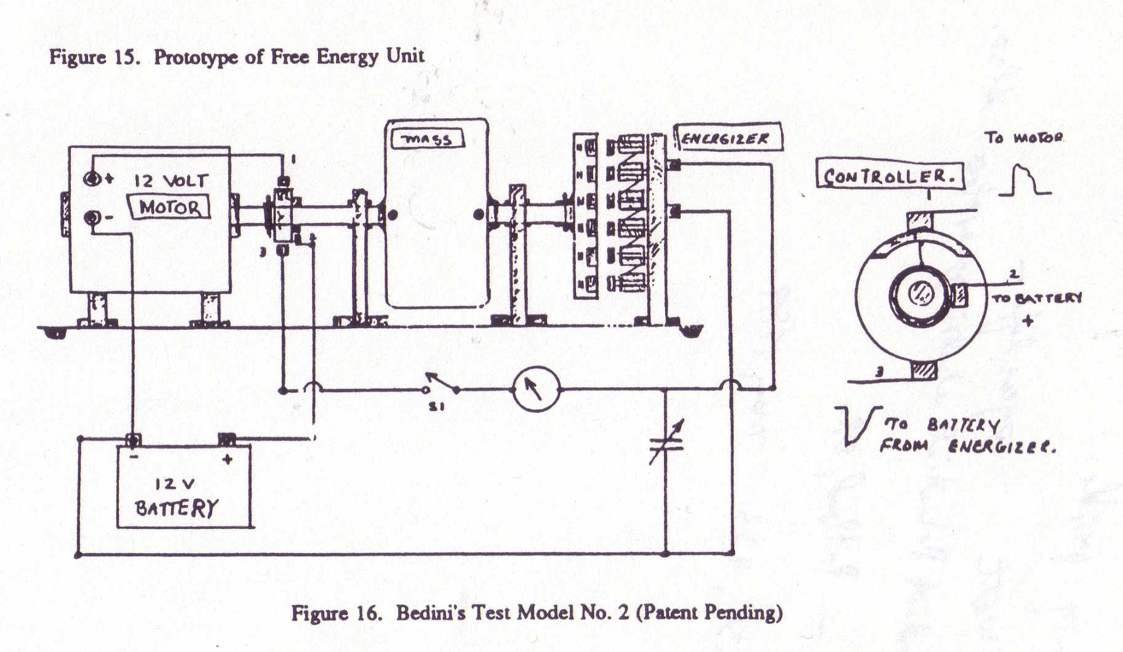
Bedini “Free Energy” Generator
Just Recharges Batteries via an EM Flywheel…
So Batteries Last Longer!

Slide 43
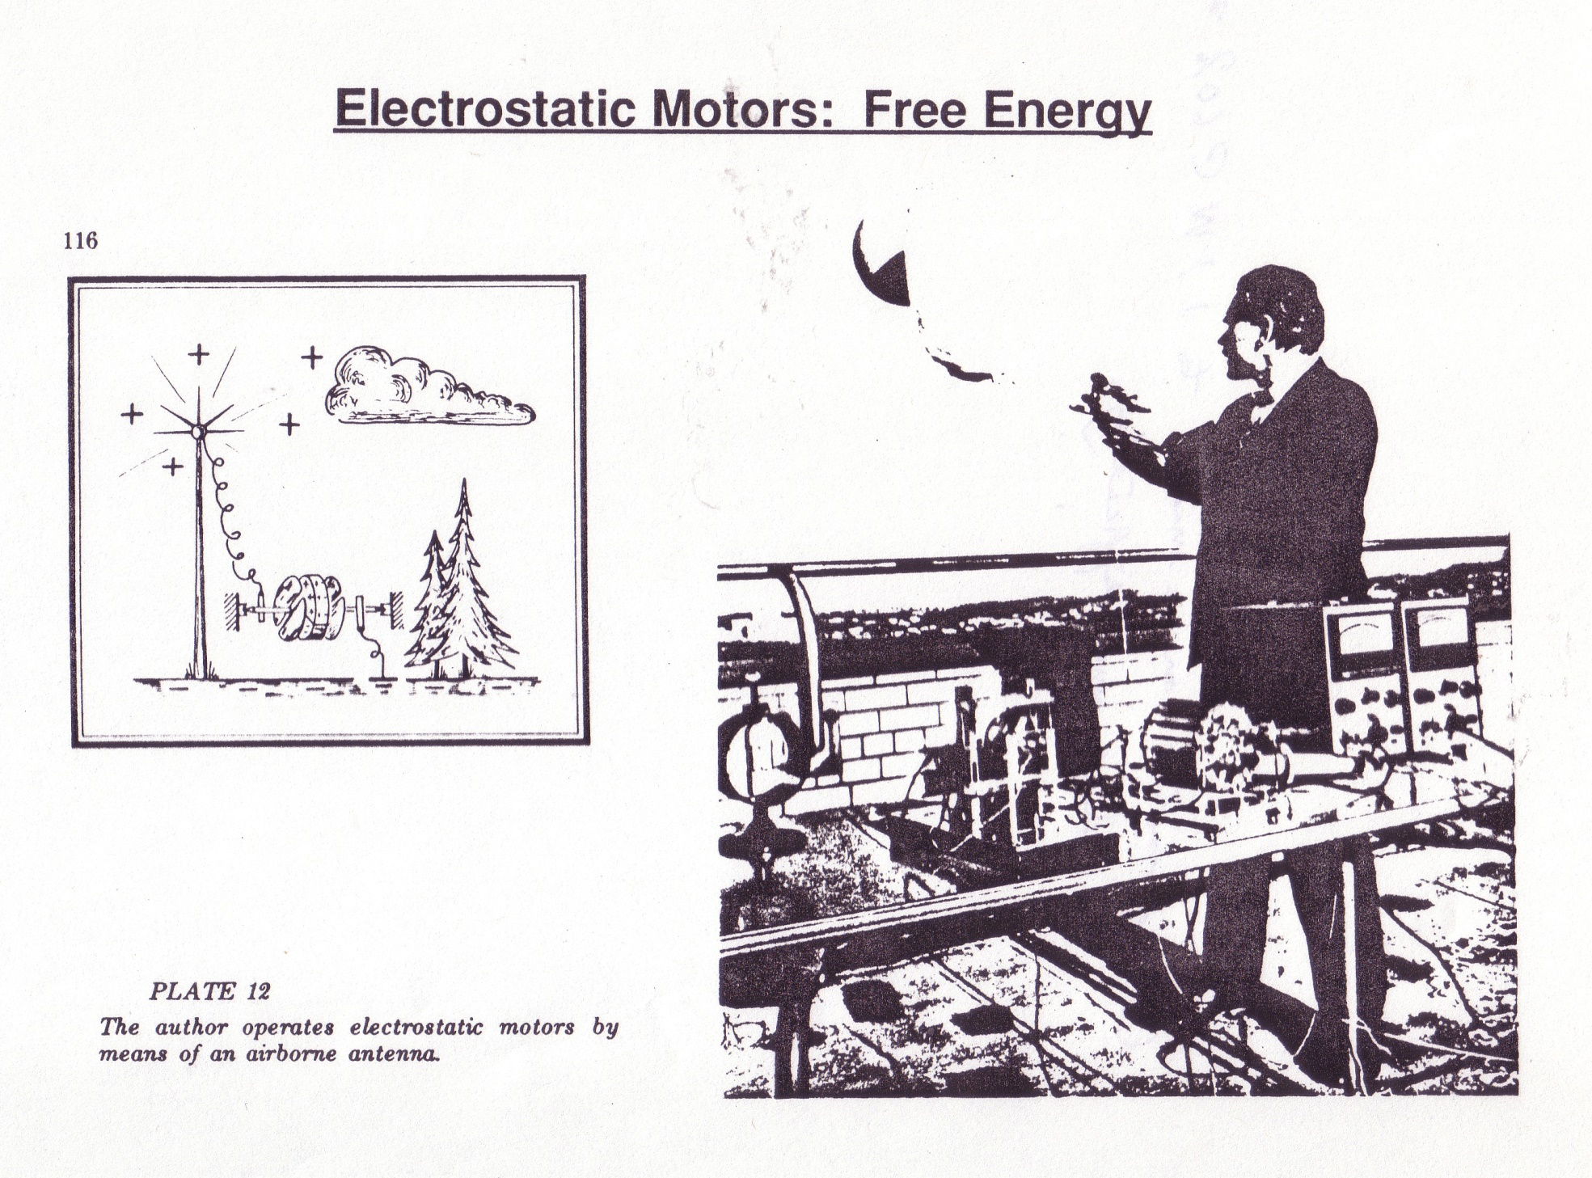

Slide 44
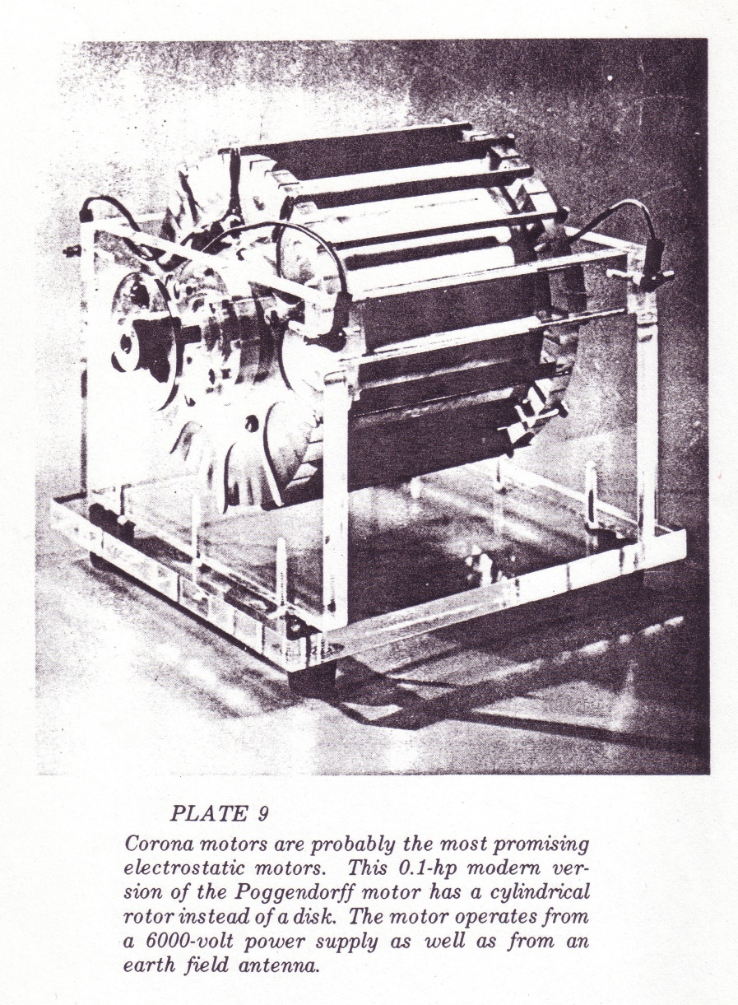
Poggendorff Electrostatic Motors (0.1 HP shown)

Slide 45
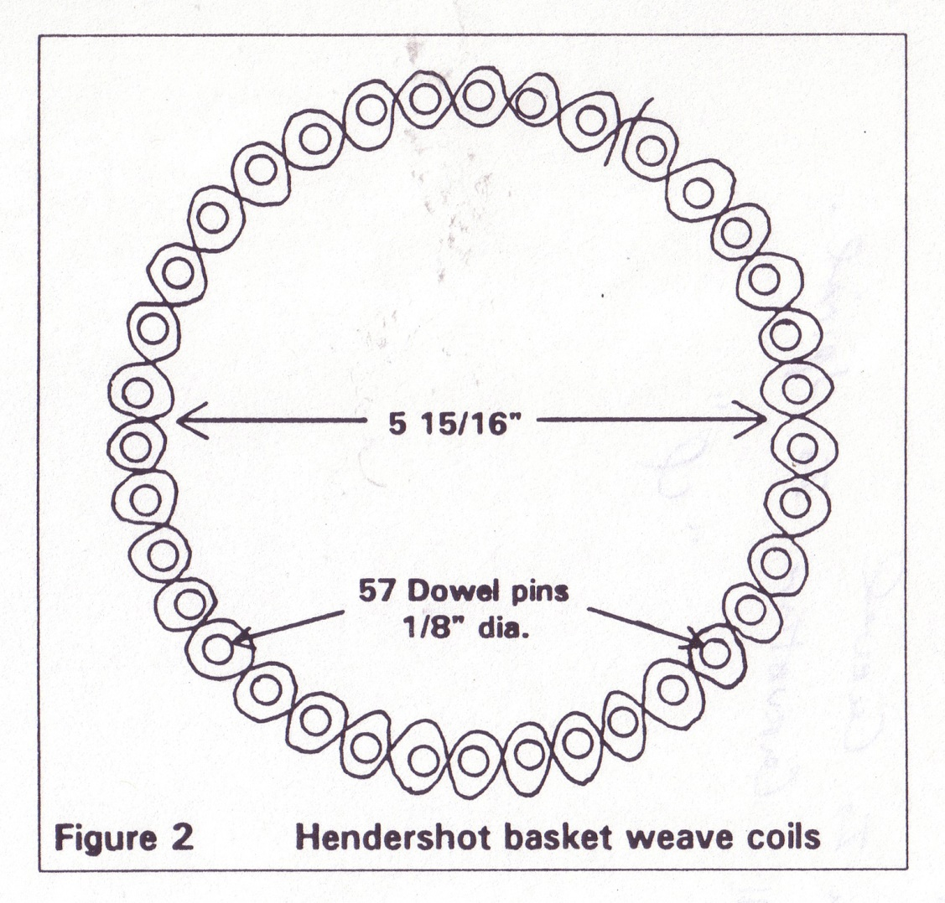
Hendershot – Earth EM Resonance
Note: No Inductance!

Slide 46
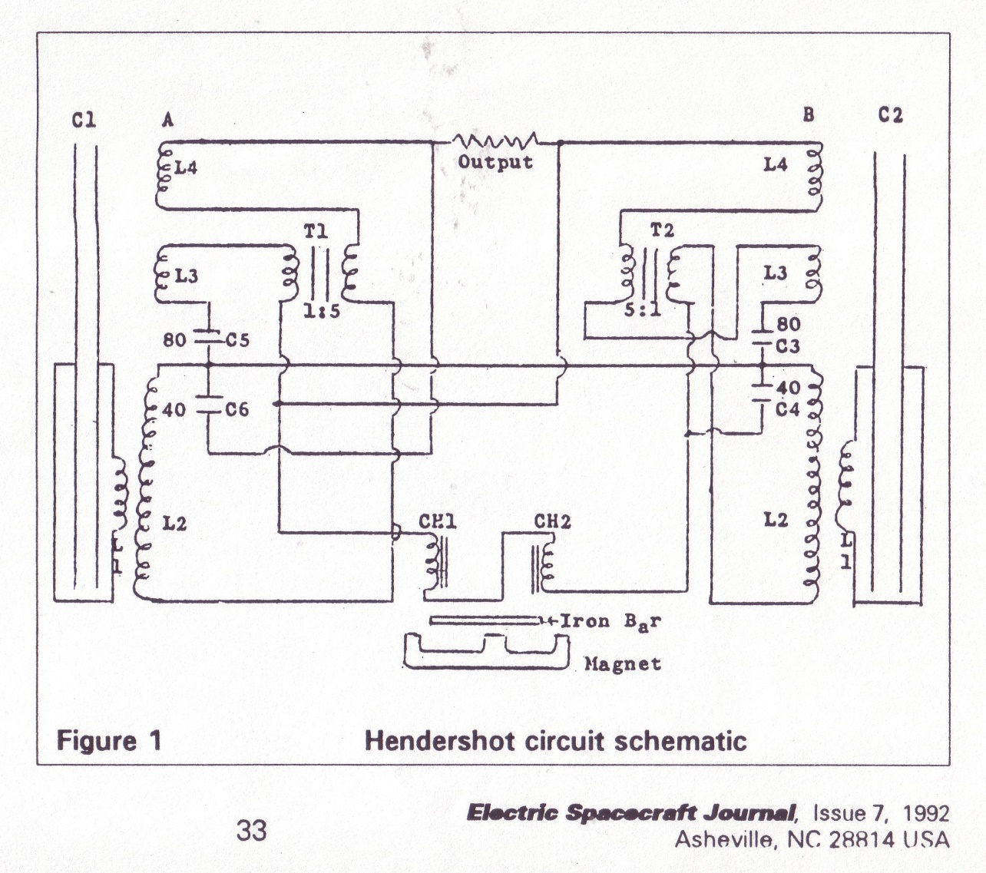
Hendershot – Earth EM Resonance
Note: No Inductance!

Slide 47
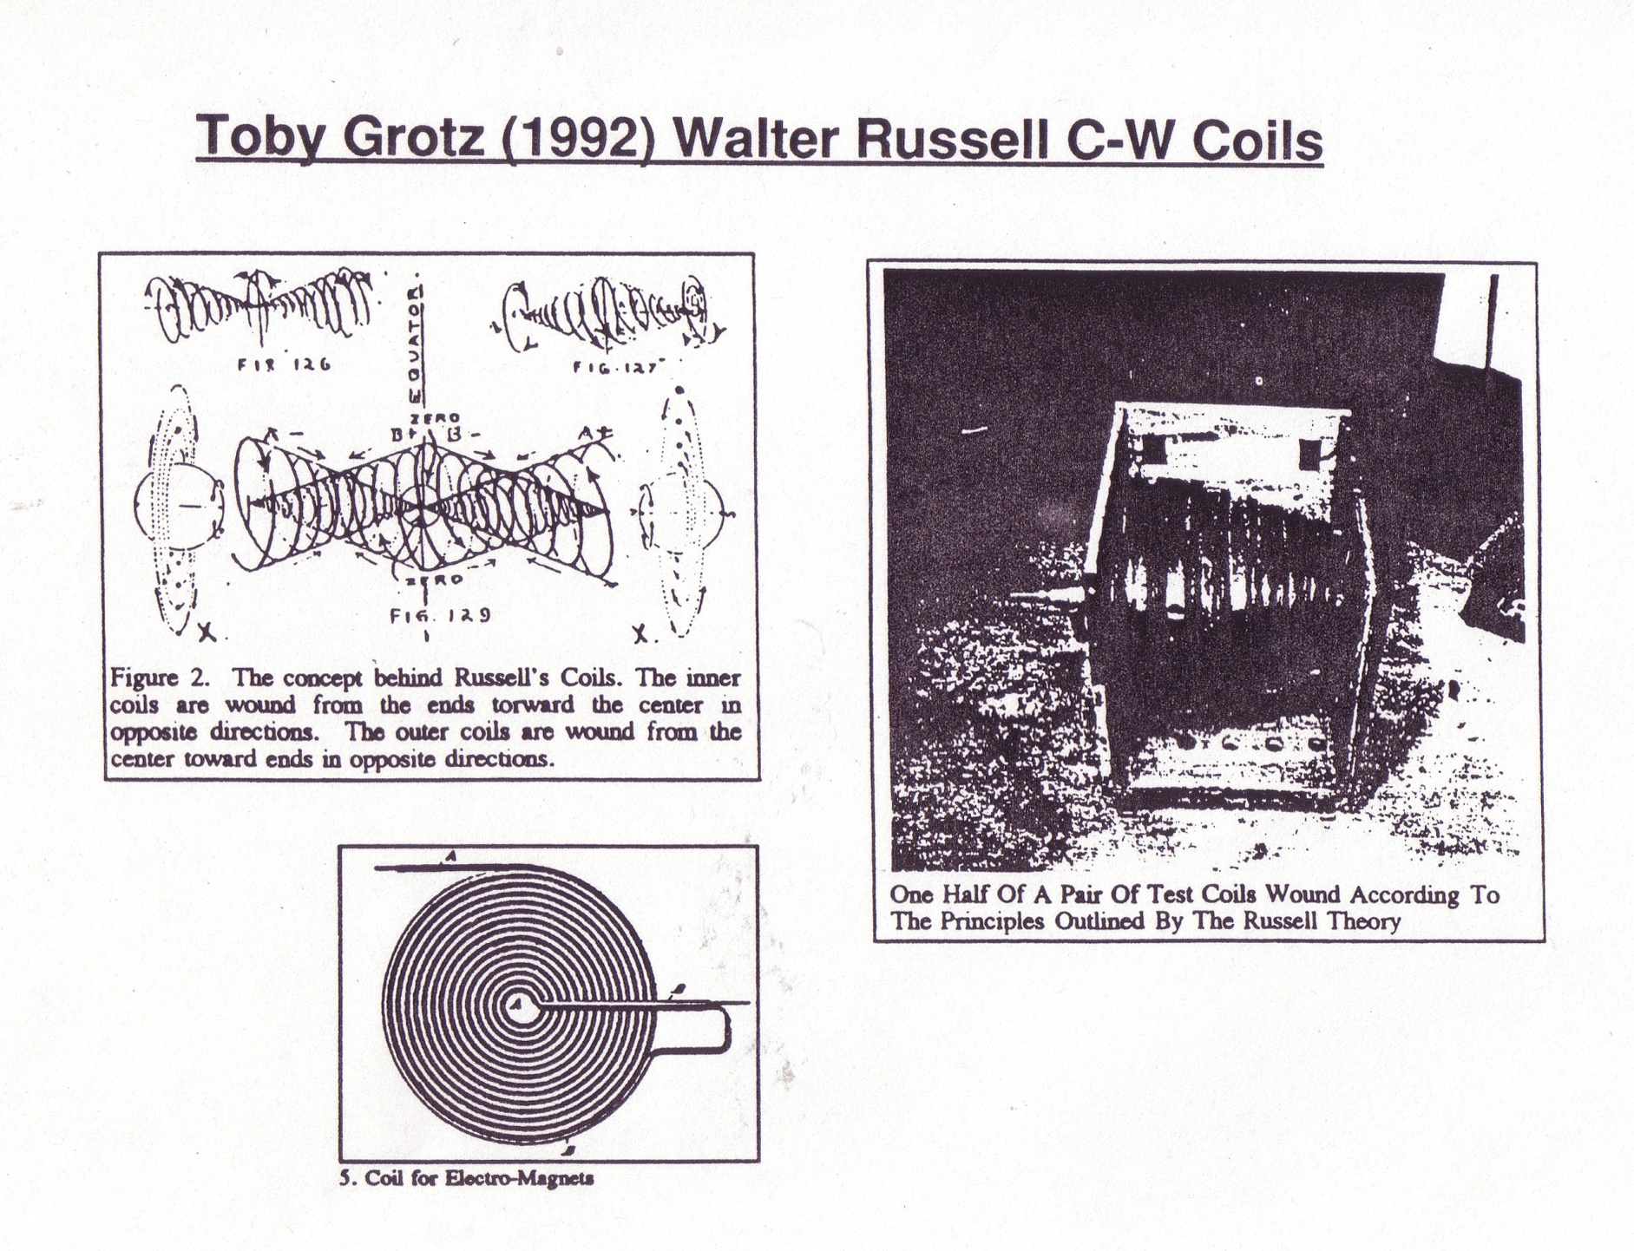
Counter-Wound Coils
Note: No Inductance!

Slide 48
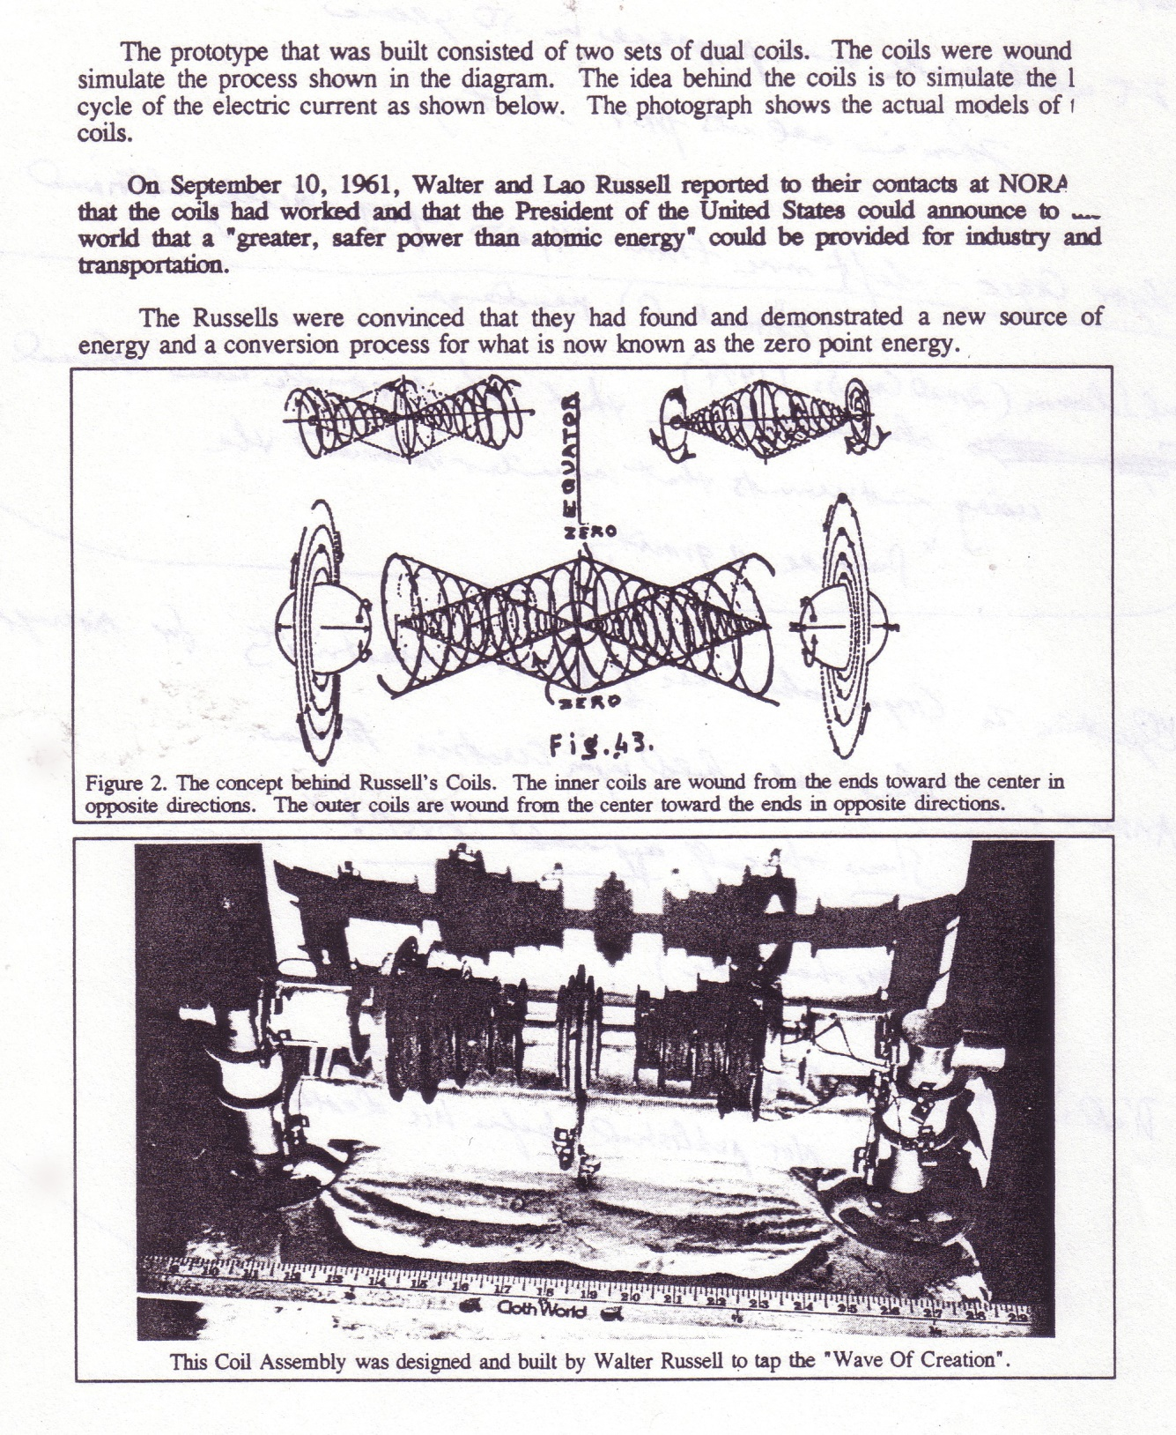
Walter Russel (1961)

Slide 49
Also See: KEELYNET (with Jerry Decker in MX)
http://www.keelynet.com/
Very Good Sources of Information

Slide 50

T

Slide 51
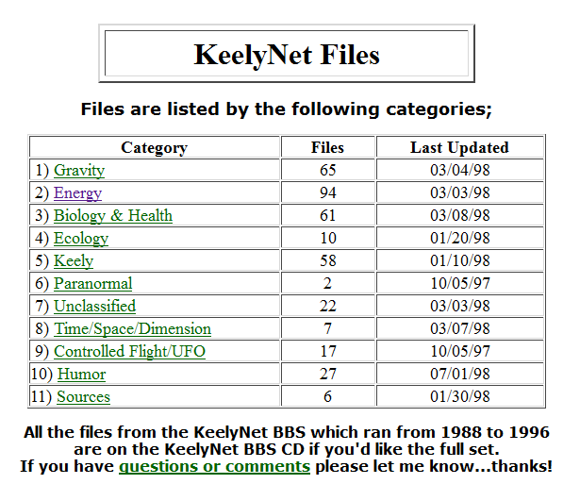
Also: KEELYNET (with Jerry Decker in MX)

Slide 52
New Physics
New Instruments, New Measurements, New Results
Energy Conversion
New Potential Energy Discoveries via New Transducers
The Earth is Not Flat –
Space is Not Empty – It is a Flowing Plasma (“The EM Universe”)
Michelson–Morley Experiment (1887) – No Results Observed!
Added the Lorentz Transformation to “Make it work.”
I say: Yes, of course you can go faster than the speed of light -
The Lorentz Transformation can be derived using sound waves
as well as light waves! It is a mathematical fraud!
What is the velocity of oil on a spinning axle?
Zero!
Boundary Layer theory! Also so with the Ether!
We are still being taught 1930s physics and nuclear physics!
Why?
[“Sheep” may leave now…]
[“Responsible Persons” may Stayed Tuned…]

Slide 53
New Physics - Thoughts
The cross bow was initially banned by the Knights
As it gave to much power to the ”unworthy”.
Is it proper to give too much power to those that do not care?
Or to those that seek to lie and suppress us and use us as their slaves?
However…
We already have the atomic bomb.
We have operating nuclear reactors.
We have the global internet with global GPS.
We have secret spacecraft.
We have crooks running many gov. agencies for their own interests.
Are we really ready to have Free Energy and possibly AG?
If we can have government that cares about its people, and
The health and quality of life of its people, and
The growth of the future, under a solid Republic,
Then I would say YES!
It is time to pick a side.

Slide 54

Important Book
Winged Pharaoh (1937 – Most Popular Book)

Slide 55

Bessler’s Wheel (1712) “Did Not Stop Turning!”
GRAVITY POWER
A study of the life and work of Johann Bessler (aka Orffyreus)who claimed that he had perfected a Perpetual Motion machine in 1712. The evidence for his claims is examined and proof of his sincerity is discussed. The previously unknown existence of a coded message is revealed and described and the possible way in which the machine was constructed is examined.
Gravity Power! (1939)

Slide 56
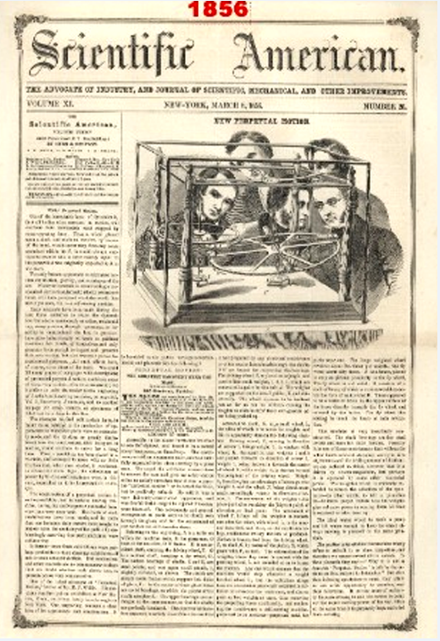
T

Slide 57
William Skinner - Gravity Power! (1939)
https://www.youtube.com/watch?v=rxIRaJlTD4Y (1:01)
Rotating Weights – Off Center
“… required a 23.5 degree tilt to self run and
by setting at 23 or 24 degrees, it would stop!”
And
Simple explanation and demo of Skinner Gravity Power device x264
https://www.youtube.com/watch?v=pw3lpFvuzps (5:46)
Replication by Aaron Murakami (2012-2013)
https://www.youtube.com/watch?v=JolNozy8UEY (41:47)

Slide 58
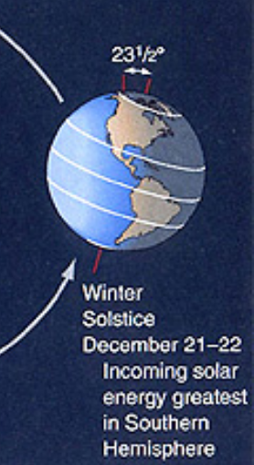
William Skinner - Gravity Power! (1939)
“… required a 23.5 degree tilt to self run…”

Slide 59
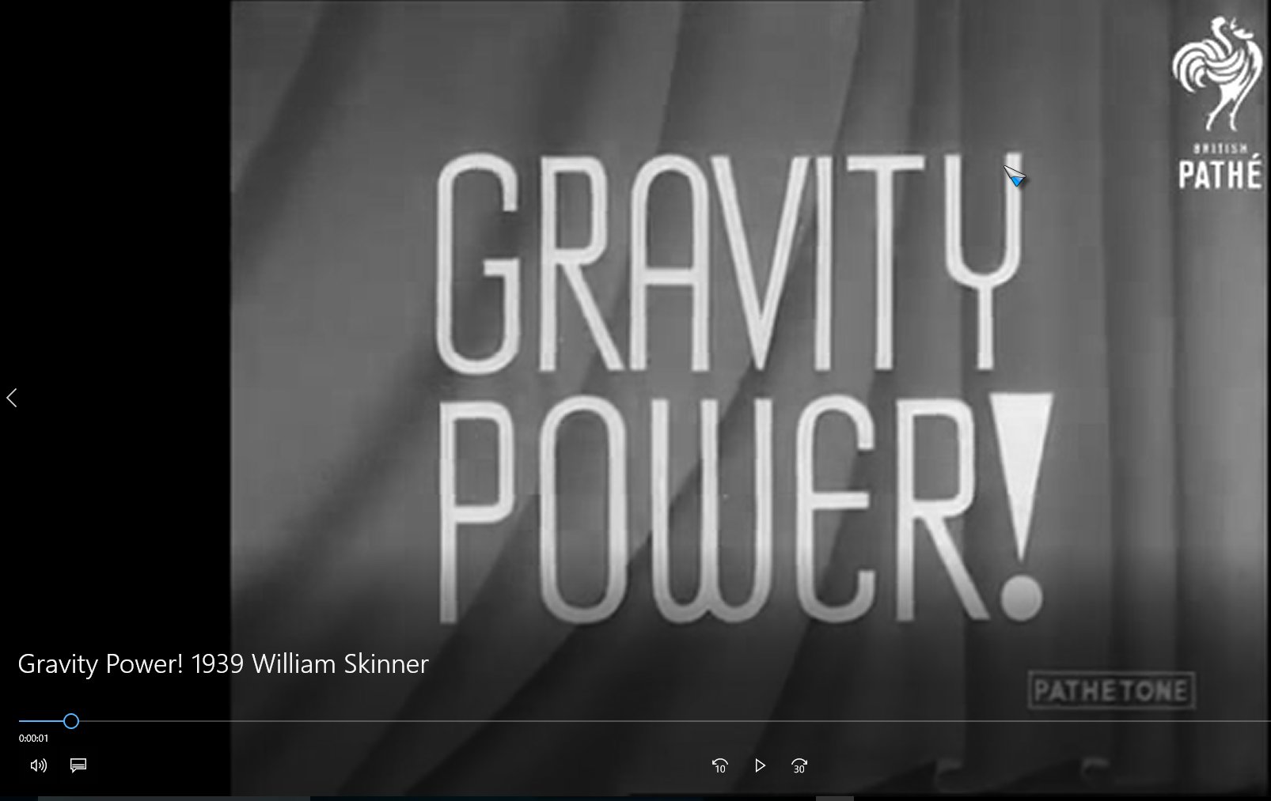
Blank

Slide 60
Of Interest – Results Not Yet In
Perpetual Energy [?] Machine (1:38)
https://www.youtube.com/watch?v=m8-Kek8Halc

Slide 61
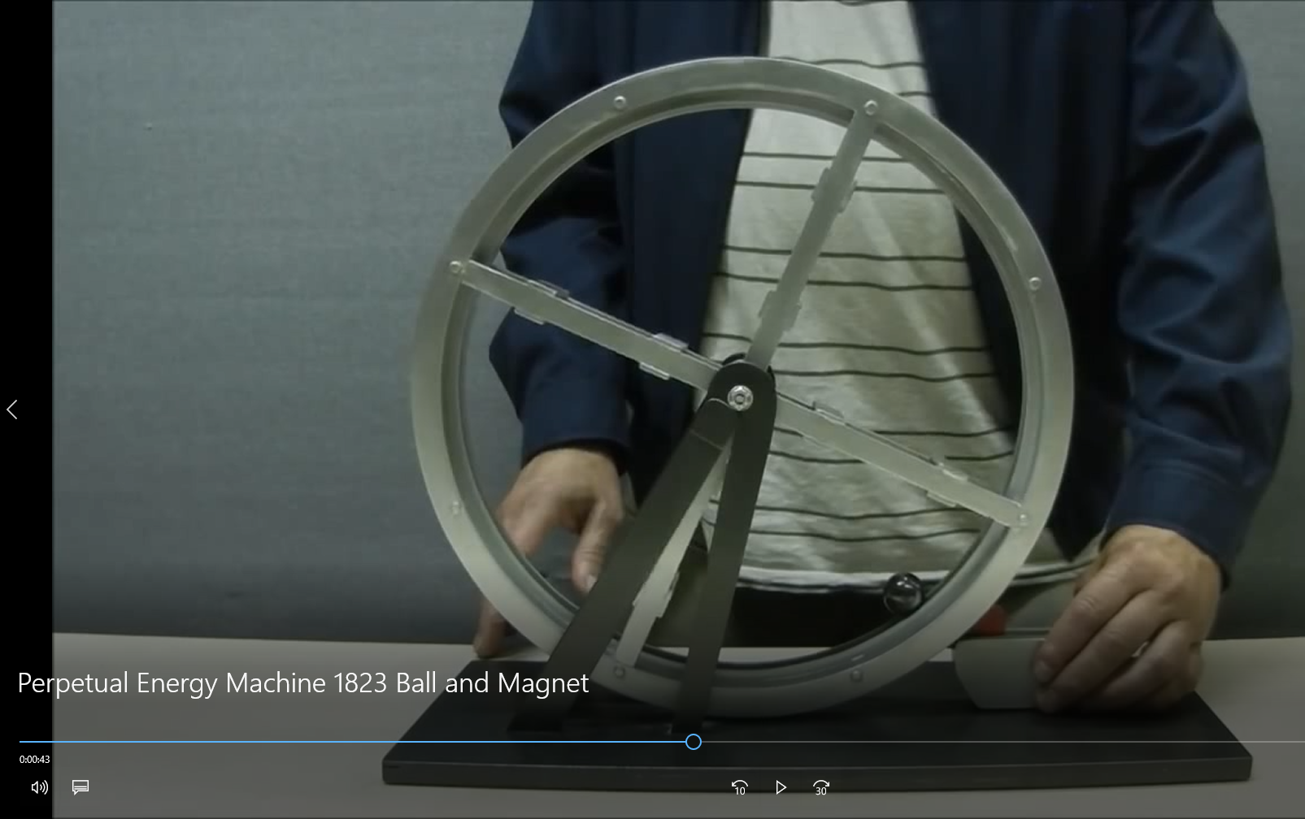
Blank

Slide 62
Of Interest – Results Not Yet In
Bhaskara Wheel & Overbalanced Chain (2:55)
https://www.youtube.com/watch?v=7KqOwJKWIAw

Slide 63
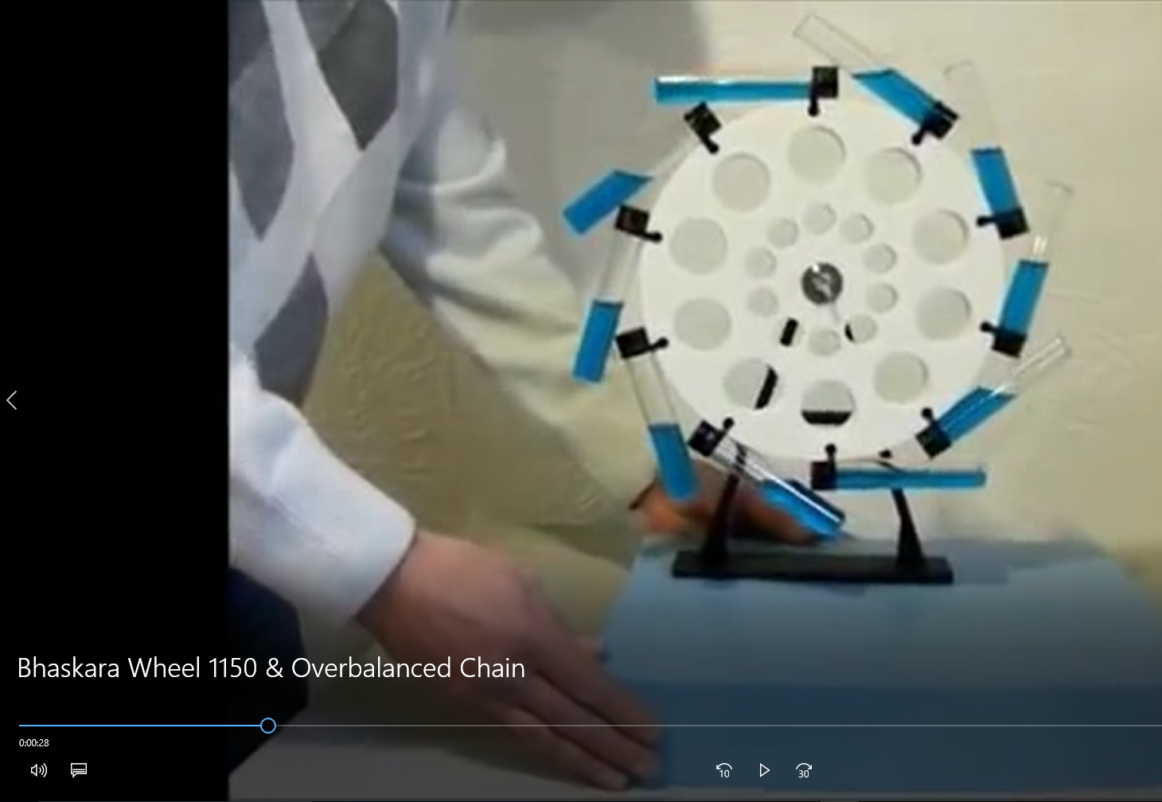
Blank

Slide 64
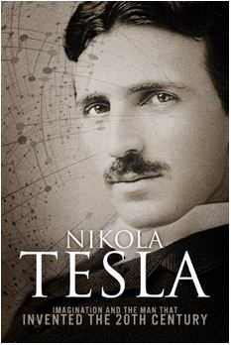
Dr. Nikola Tesla – Inventor of Alternating Current!

Slide 65
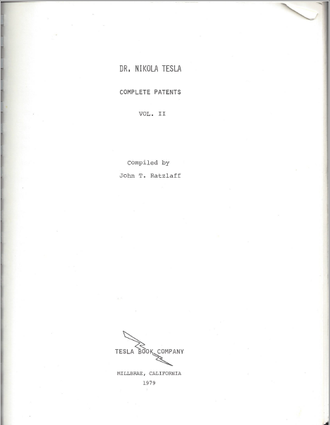
Dr. Nikola Tesla – Complete Patents

Slide 66
Dr. Nikola Tesla – Complete Patents

Slide 67
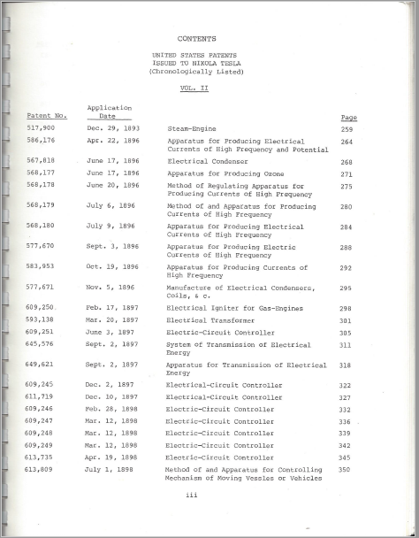
Dr. Nikola Tesla – Complete Patents

Slide 68
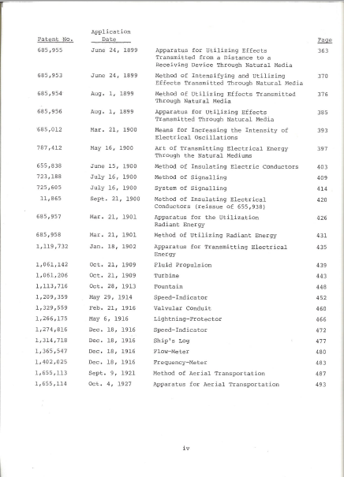
Dr. Nikola Tesla – Complete Patents

Slide 69

D

Slide 70
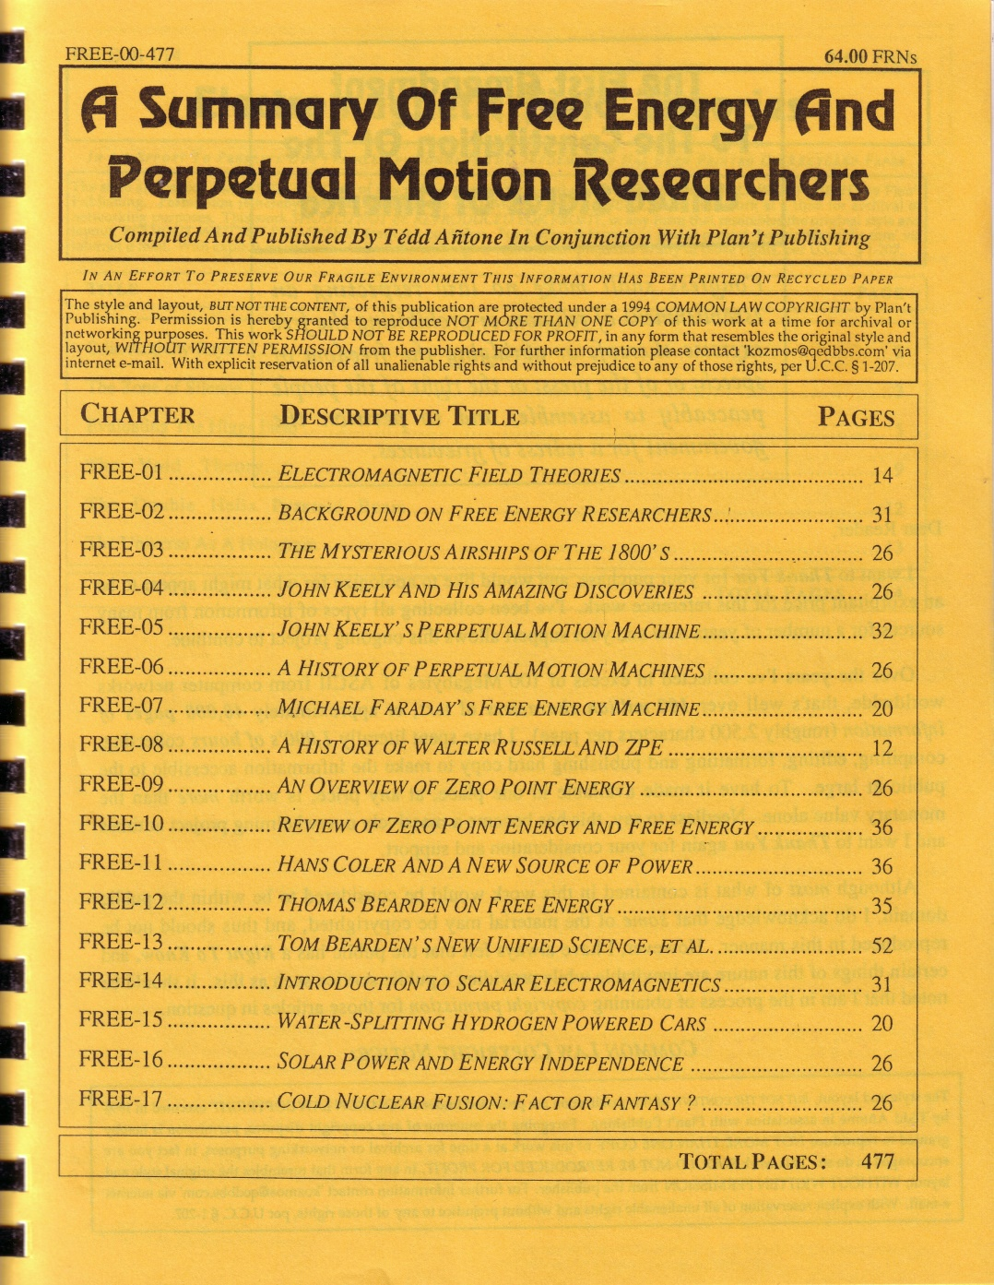
D

Slide 71
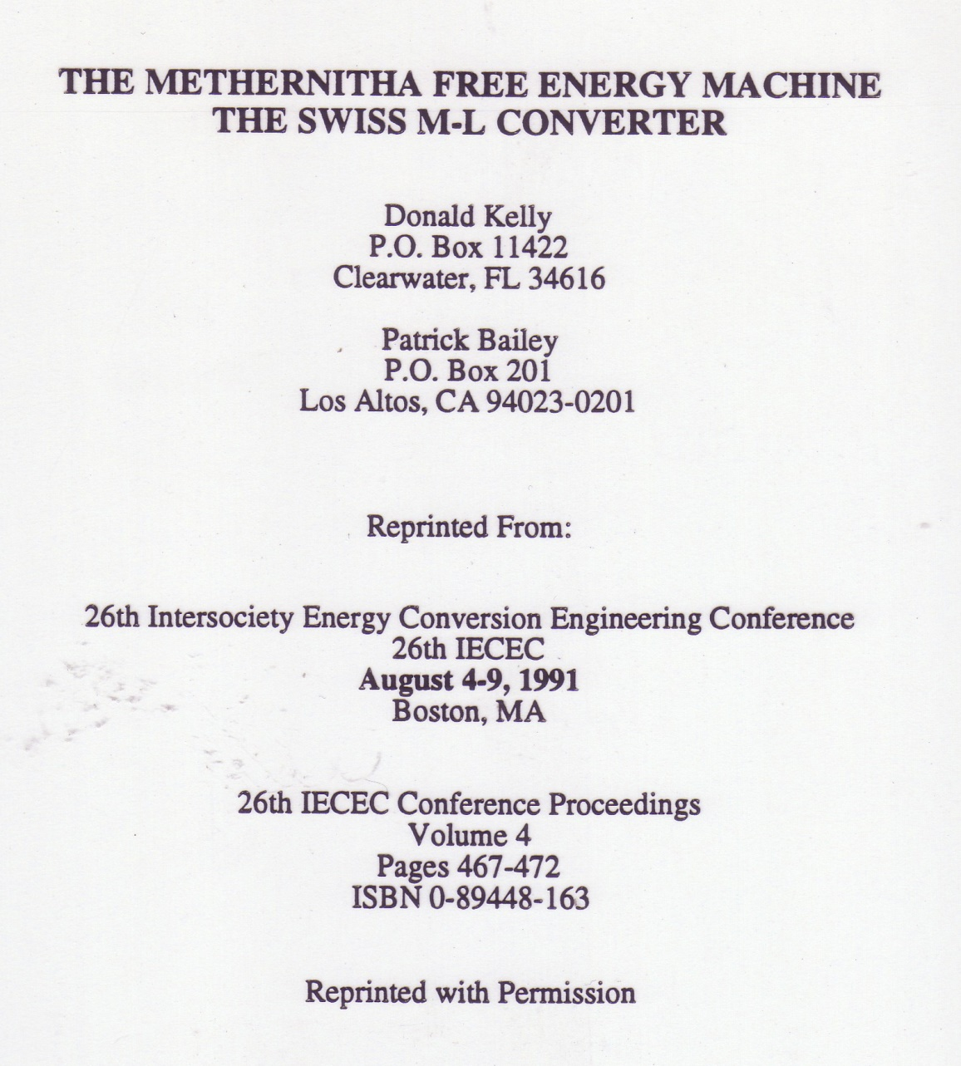
Blank

Slide 72
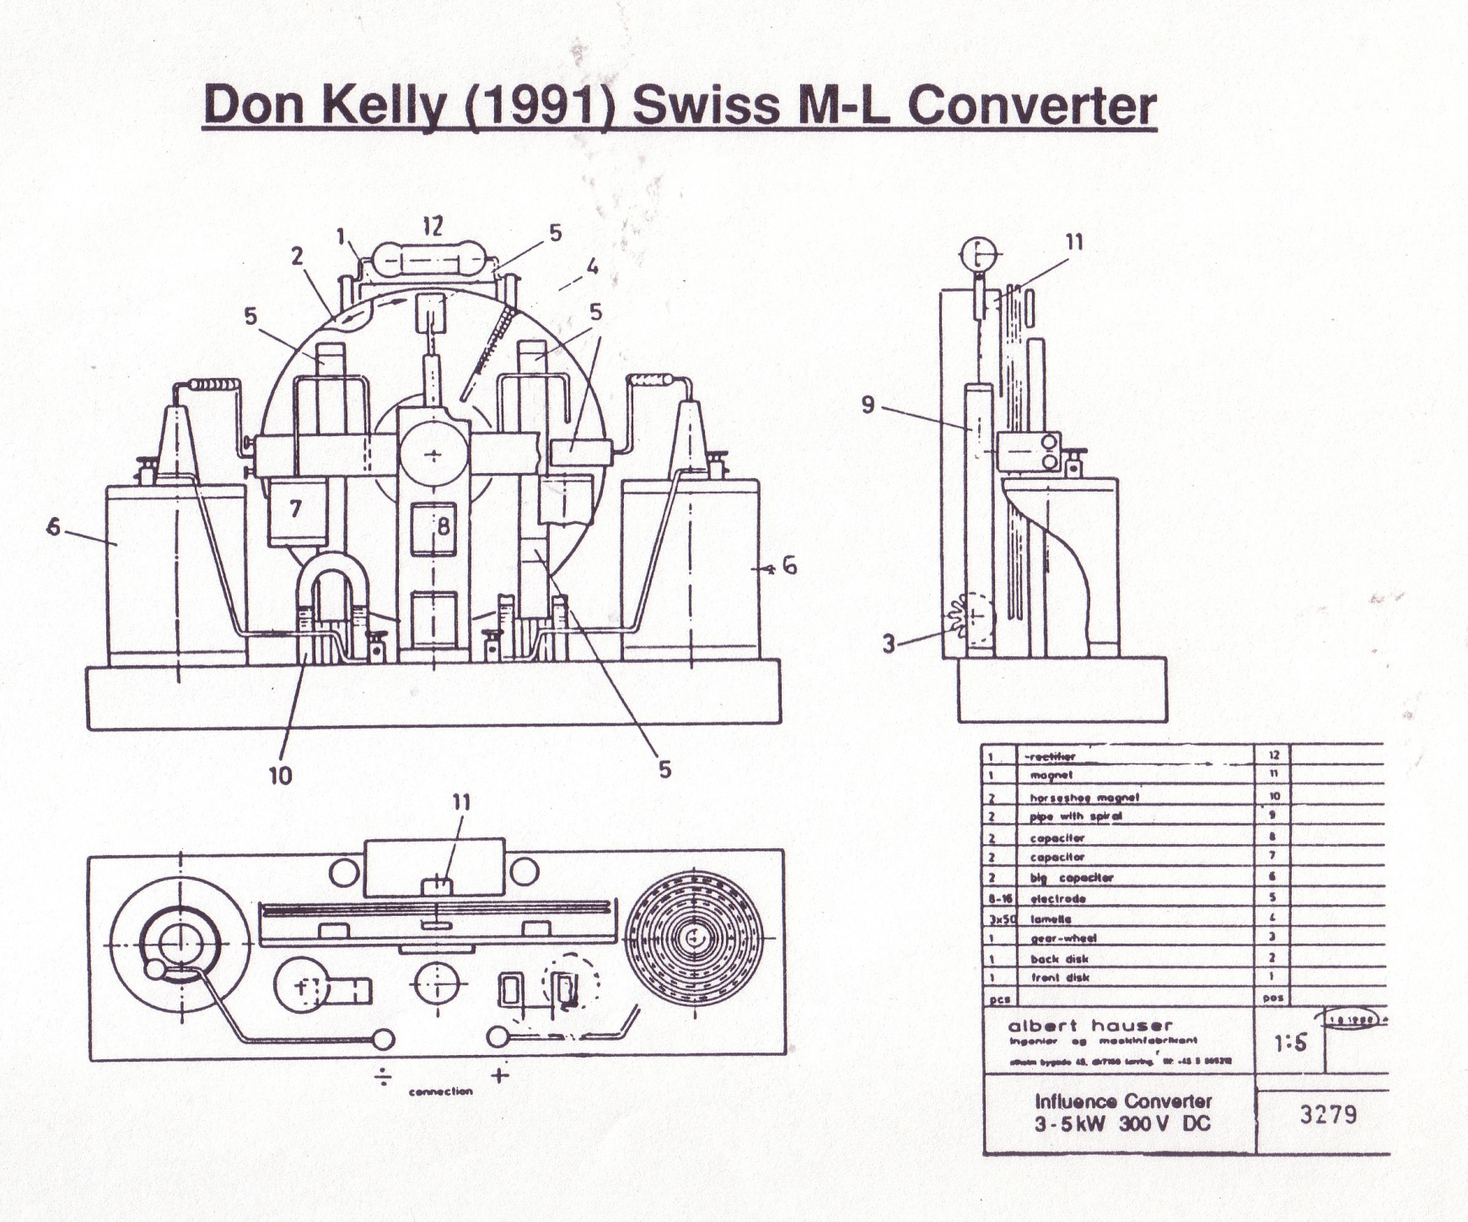
Blank

Slide 73
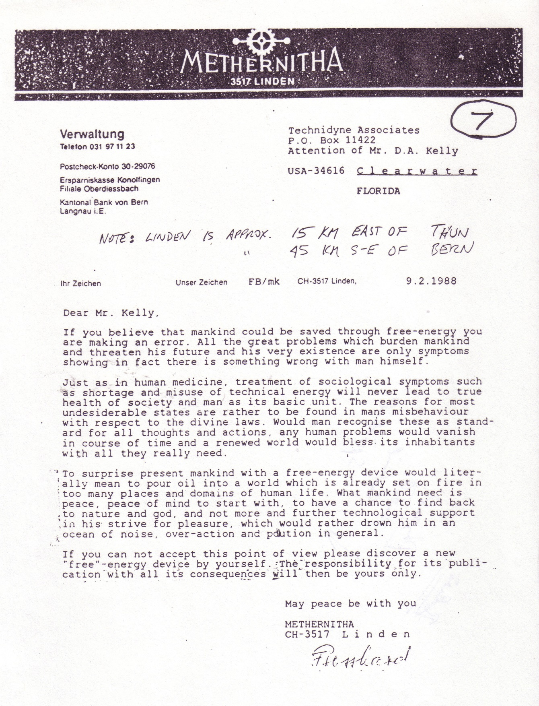
Blank

Slide 74
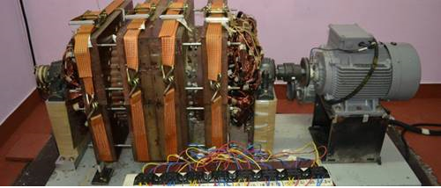
INDIA WON’T SUPPRESS TEWARI’S FREE ENERGY GENERATOR
April 16, 2015
A Reactionless AC Synchronous Generator (RLG) has been invented by Paramahamsa Tewari, electrical engineer and former Executive Director of Nuclear Power Corporation of India. His background includes engineering project management for construction of nuclear power stations. The efficiency of models he has built, which have also been independently built and tested, is as high as 250%.

Slide 75
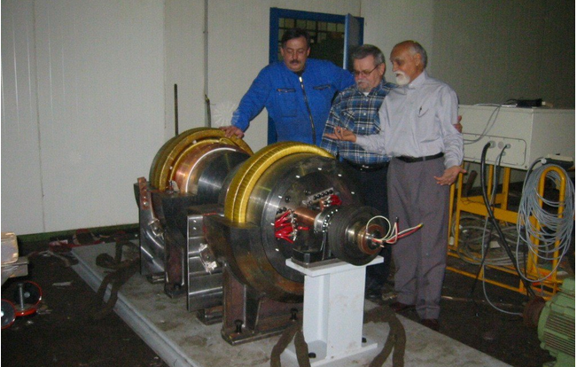
“Tewari devised a method to cancel the back torque in a generator produced due to Lenz’s Law. Once he did that efficiency went past 1.0.”
Possible use of non-inductive coils - “A” Field Only – No Counter EMF!
http://myeclinik.com/india-wont-suppress-tewaris-free-energy-generator/#more-5577

Slide 76
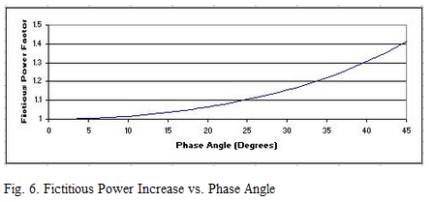
Regarding Machines with Rotating Magnets
“DANGERS IN MEASURING THE POWER OF AC DEVICES WITH METERS”
http://www.padrak.com/ine/DANGERSPOWER.html
Simple mathematical analyses confirm that power levels calculated with such "AC meter" measurements can vastly over-predict the real power produced in such devices, and that almost any AC device can be tuned-up and shown to be a "over-unity device" or a "free-energy machine" using such simplistic meter measurements and math.

Slide 77
Magnets Within Electrical Circuits
What???... Resonance!!!
Declassified British Intelligence Objectives Subcommittee (BIOS)
Final Report #1043, Item #32
"The Invention of Hans Coler Relating to an Alleged New Source of Power"
Magnetstromapparat [Magnet Current Apparatus]...
With this device, consisting only of permanent magnets, copper coils and condensers in a static arrangement, he showed that he could obtain a tension of 0.45 Volts for several hours
Coler also invented another device called the Stromzeuger.
He claimed that, "with an input of a few watts from a dry battery
an output of 6 kW could be obtained indefinitely.“
[…Supposedly used to power Nazi submarines…]

Slide 78
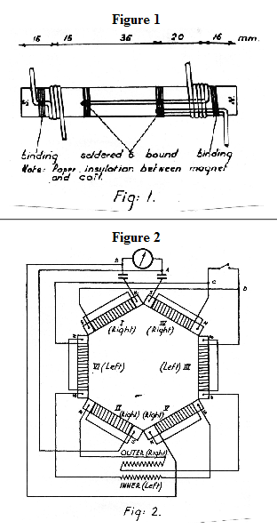
Stromzeuger http://rexresearch.com/coler/coler2.htm

Slide 79
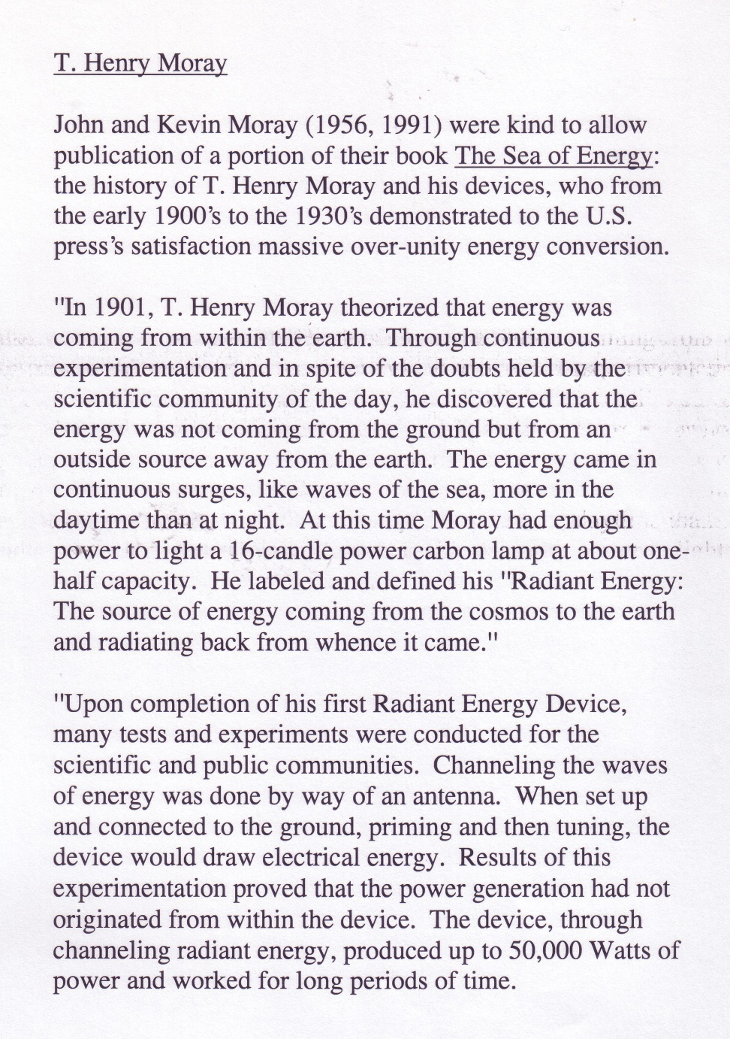
Blank

Slide 80
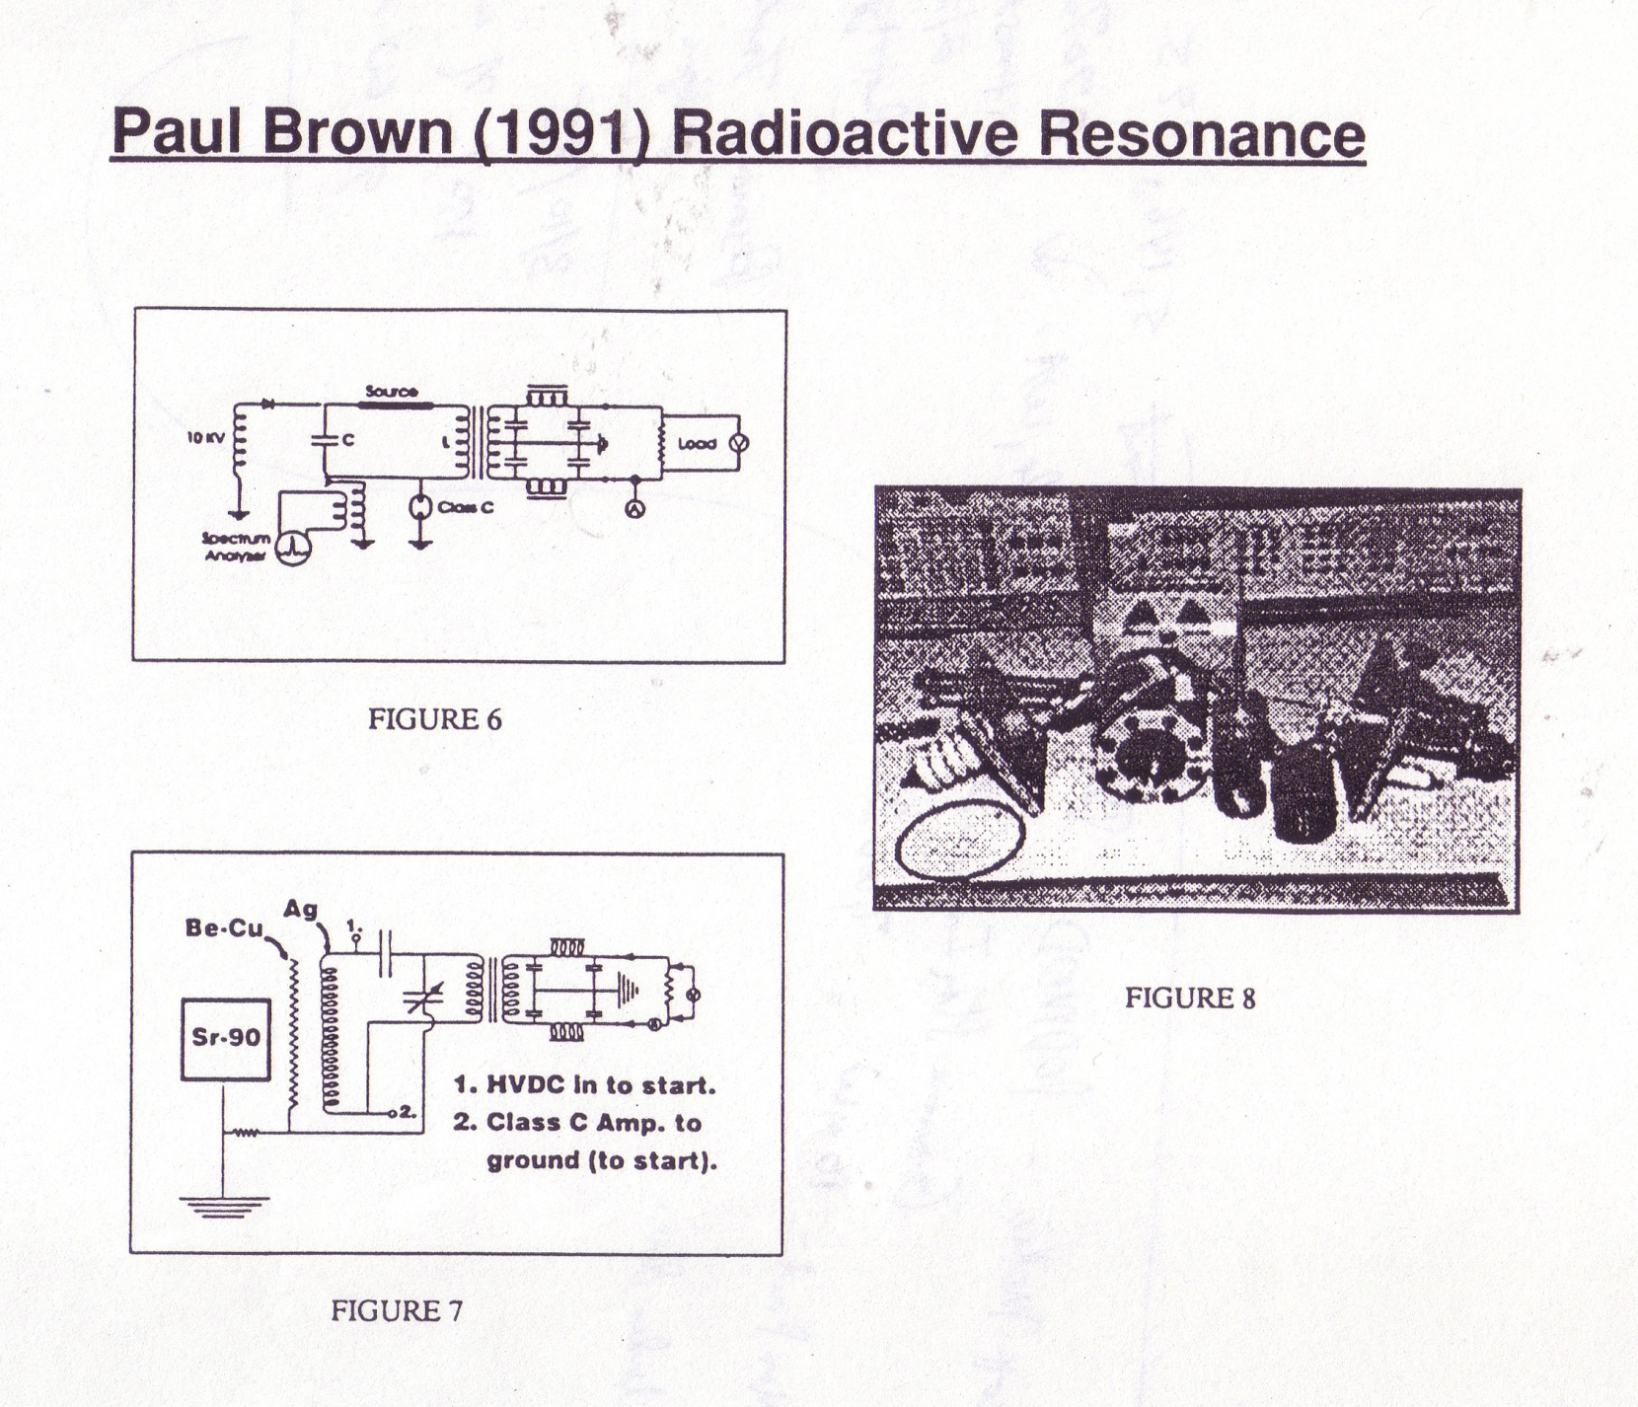
Paul Brown – Radioactive Resonance (1991 IECEC)

Slide 81
Well!
What About COLD FUSION???

Slide 82
Well!
What About COLD FUSION???
Interagency Energy Conversion Engineering Conference
IECEC
Topical Area Program Director
Technical Program Chair 1984 & 1991

Slide 83
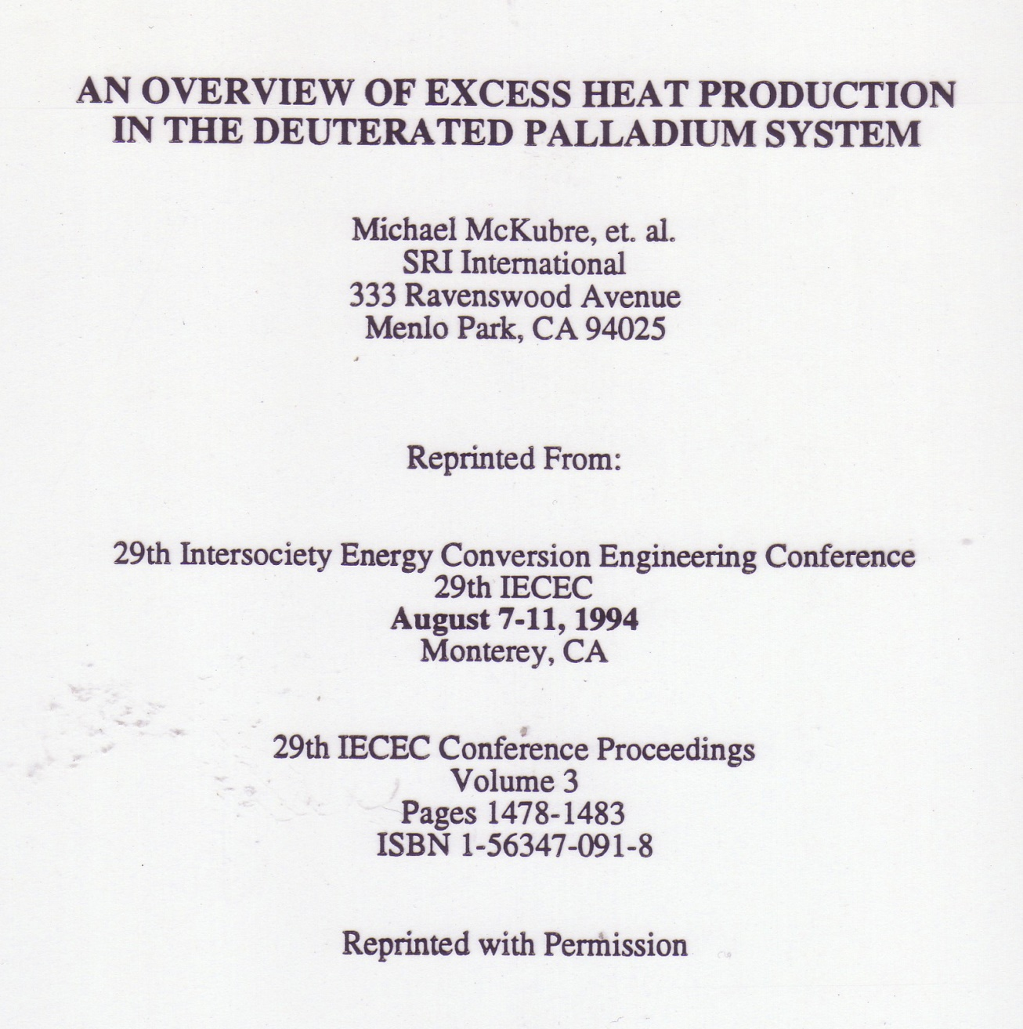

Slide 84
Well!
What About COLD FUSION???
Interagency Energy Conversion Engineering Conference
IECEC
Topical Area Program Director
Technical Program Chair 1984 & 1991
Why did anything happen?
Because I said so!

Slide 85
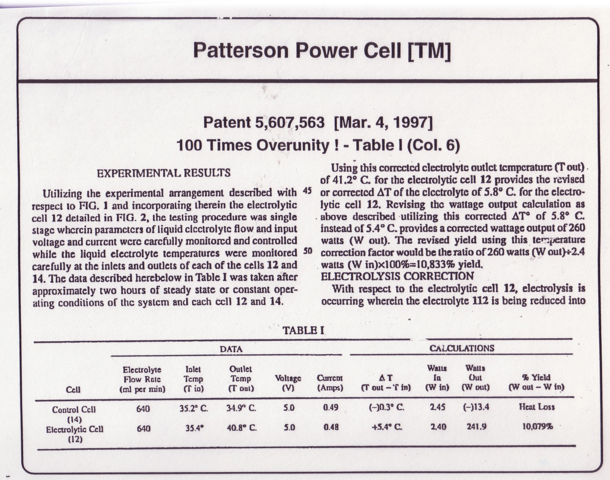
Blank

Slide 86
US Inventors and US Patents
Get an Idea!
Design and Build the Device.
Test and Modify… Until -
It works!
Get support!
Obtain financial support…
Apply for a US Patent!
Uh Oh…

Slide 87
US Inventors and US Patents
The US Patent Officer Receives the Patent Application
Mails an Application Received Letter to the Applicant
NEXT: A Formal Review under a US Military Patent Review Panel…
If ANYONE wants it for their military use –
Then it becomes CLASSIFIED!
THOUSANDS of such patents are CLASSIFIED!
The Inventor Gets a Cease, Stop, and Send It All In Right Now
SECRECY ORDER
(Title 35, United States Code (1952), sections 181-188)
http://www.padrak.com/ine/INE13.html
Want to see it?...

Slide 88
SECRECY ORDER [Copy/Pasted:]
(Title 35, United States Code (1952), sections 181-188)
NOTICE: To the applicant above named, his heirs, and any and all of his assignees, attorneys and agents, hereinafter designated principals:
You are hereby notified that your application as above identified has been found to contain subject matter, the unauthorized disclosure of which might be detrimental to the national security, and you are ordered in nowise to publish or disclose the invention or any material information with respect thereto, including hitherto unpublished details of the subject matter of said application, in any way to any person not cognizant of the invention prior to the date of the order, including any employee of the principals, but to keep the same secret except by written consent first obtained of the Commissioner of Patents, under the penalties of 35 U.S.C. (1952) 182, 186. [More…]
This order should not be construed in any way to mean that the Government has adopted or contemplates adoption of the alleged invention disclosed in this application; nor is it any indication of the value of such invention.
For the country? - NO! - For the FED!

Slide 89
Status - Free Energy Devices
They are New.
Need New Physics!
Some are Working.
Some are Lies.
Some are Investments Frauds.
Tewari’s in India Looks Real Good!
Older German Designs Look Very Interesting!
The USA (FED) Has Imposed Homeland Security Issues!
SO:
Invent Yours In Private.
Patent Somewhere Else First and Distribute There!
(Canada, Iceland, Saudi, ???)
Ask! Are Such Inventions to be Used to Better Society?...
Or To Suppress You and Make Things Worse?
It is time to chose a side.

Slide 90
Oh Yeah… The Political Barriers to Advanced Energy Use
Lake Elsinore, CA: State incentive programs- via Solar City:
But things quickly went south when the panels were finally installed
in accordance with the terms and it was realized that the Hall residence would now be producing about 28 percent more energy than it would use, an apparent no-no under state law.
According to Southern California Edison, the Halls' local energy provider,
any home that produces more solar energy than it can use
might turn around and try to sell that energy, making it an energy provider
subject to commercial business regulations.
http://www.naturalnews.com/054371_solar_panels_Southern_California_green_energy.html
Etc… Etc… Etc…

Slide 91
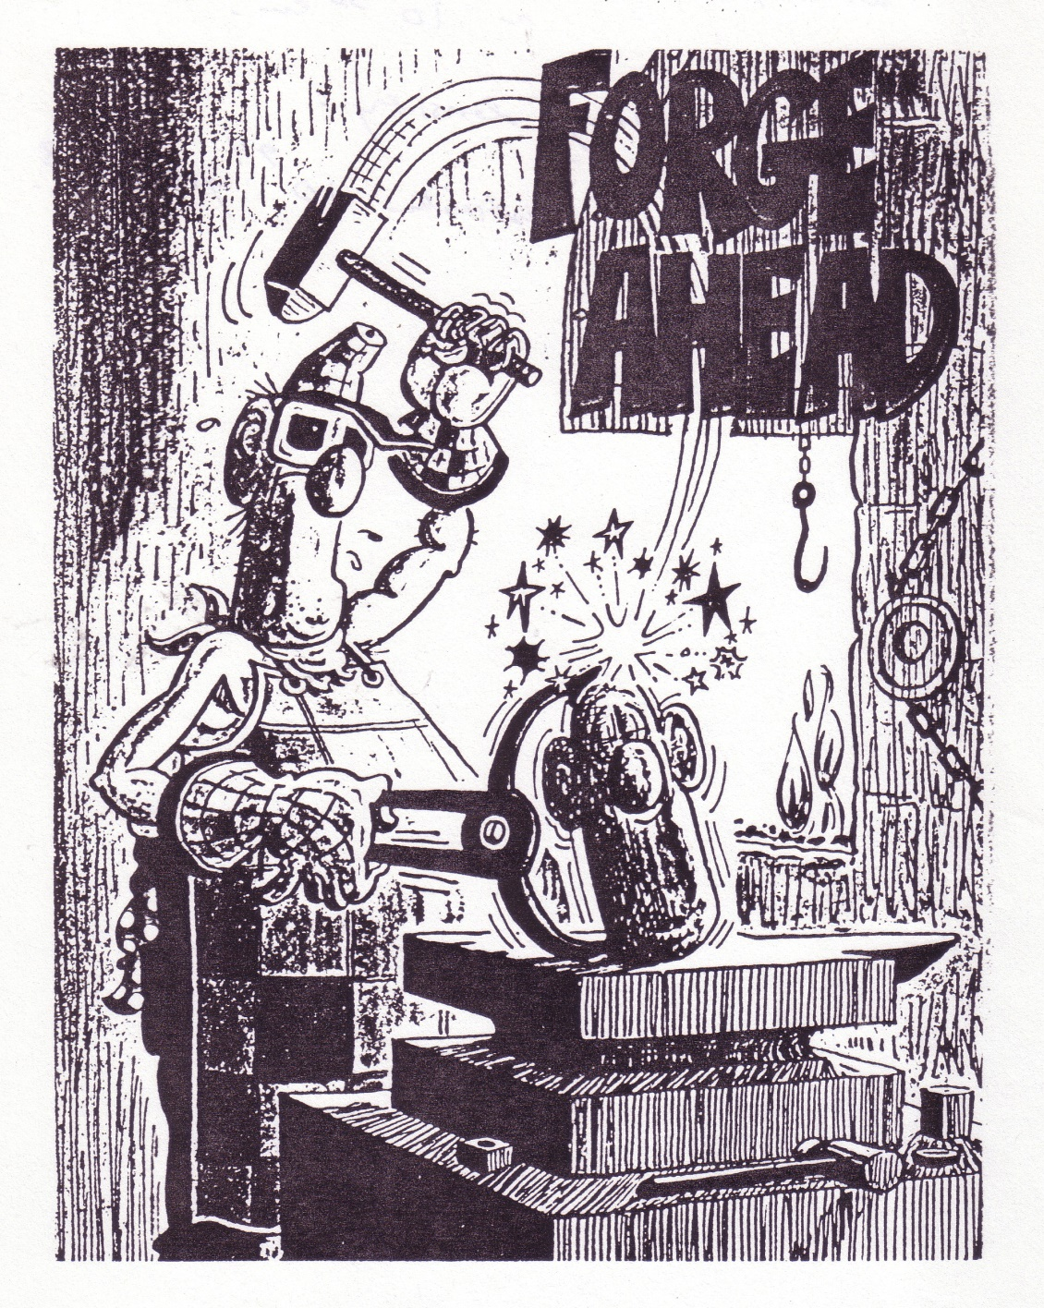
Blank

Slide 92
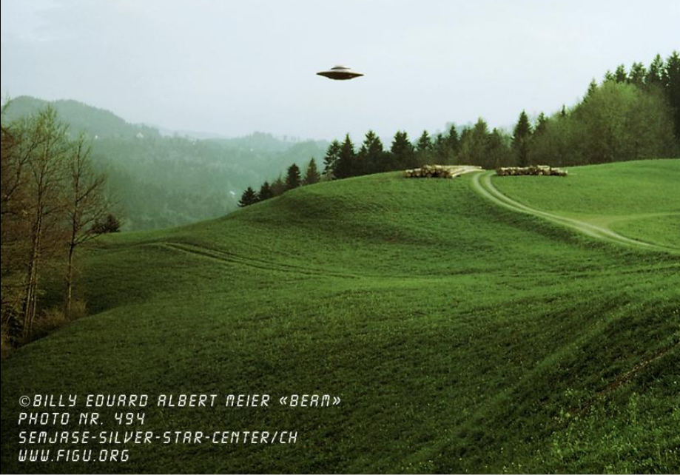
Moving Right Along… UFOs

Slide 93
UFOs - Recent Movie One Liners – For the Masses
“The universe grows smaller every day, and the threat of aggression by any group, anywhere, can no longer be tolerated.
There must be security for all, or no one is secure.“ (1951) [TDTESS]
“But like you, the Krell forgot one deadly danger –
their own subconscious hate and lust for destruction!“ (1956) [FP]
“We will not go quietly into the night!“ (1996) [ID]
“Five hundred years ago, everybody knew the Earth was flat, and
fifteen minutes ago, you knew that humans were alone on this planet.
Imagine what you'll know tomorrow.“ (1997) [MIB]
“The Enemy of My Enemy is – My Friend!” (2004) [AVP]
“This planet is dying. The human race is killing it.” (2008) [TDTESS 2]

Slide 94
UFO Documentation of Importance
Project Bluebook Interview On Tape! - “We were paid to debunk.”
CMS Ret. Robert Dean - NATO Eyes-Only “An Assessment”
Billy Meier Picture Books and Videos
The Phoenix Lights – Real Witnesses
Other Major Events!
UFO Researchers!!!
Books and Videotapes and DVDs
International UFO Congress [Annual 6 Day Meetings]
MUFON Meetings [All the Time!]
Bay Area UFO Expos [Annual 2 Days]
Bay Area Conspiracy Conferences [Annual Days, O.V.]

Slide 95
UFO Documentation of Importance
Project Bluebook Interview On Tape! - “We were paid to debunk.”
CMS Ret. Robert Dean - NATO Eyes-Only “An Assessment”
Billy Meier Picture Books and Videos
The Phoenix Lights – Real Witnesses
Other Major Events!
UFO Researchers!!!
Books and Videotapes and DVDs
International UFO Congress [Annual 6 Day Meetings]
MUFON Meetings [All the Time!]
Bay Area UFO Expos [Annual 2 Days]
Bay Area Conspiracy Conferences [Annual Days, O.V.]

Slide 96
Billy Meier (1970s)
One Armed Man with an Older Camera
Many Pictures
Some Videos
Many Critics
Many Visitors
Many Supporters
My Conclusions
Photos were mixed:
His Real Ones, plus Models, and Overt Fakes by Others.
All scientific investigators that have visited there have believed him!
Many pictures could ABSOLUTELY NOT be faked!!!
Light (spectral) analyses of some photos confirm real objects (Jim Dilettoso).
Swiss Air Force Jets and Radar Tracks Do Not Lie.
Infrared Photo Analysis Does Not Lie!

Slide 97
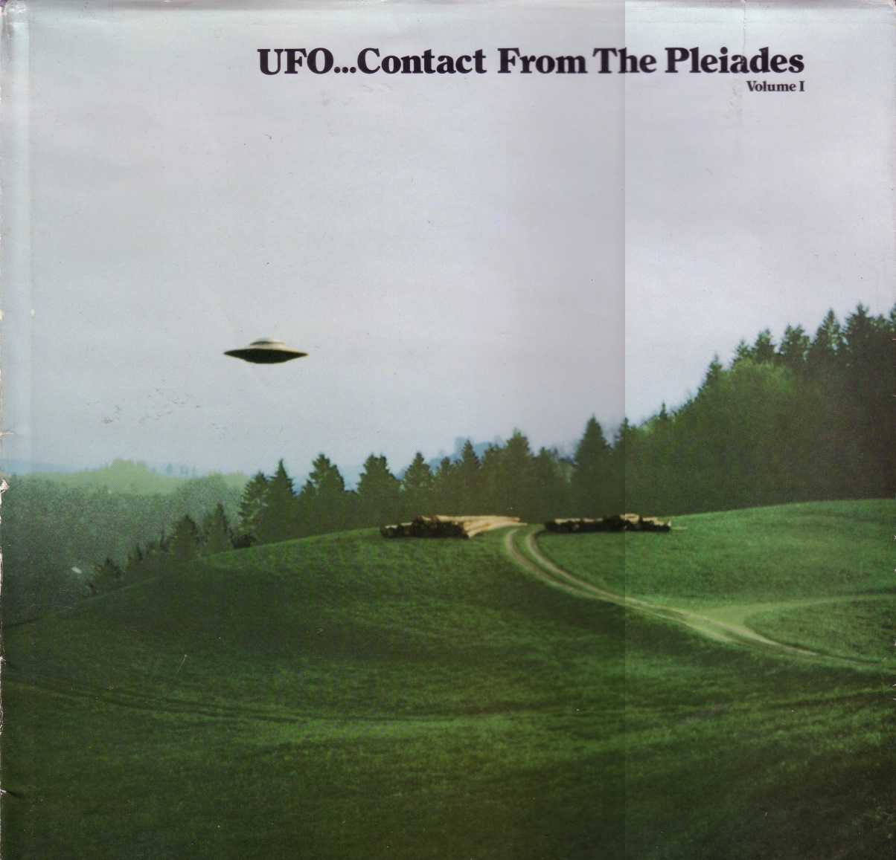
Billy Meier –Photo Books 1 & 2

Slide 98
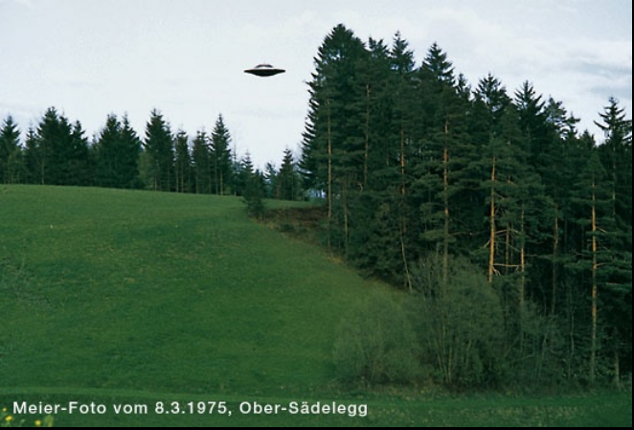
Billy Meier Lots of Photos Online – Michael Horn US Rep. for Billy
http://www.theyfly.com/photos/photos.htm

Slide 99
CMS Ret. Robert Dean - NATO “An Assessment”
His Last Assignment – NATO HQ – Paris, France
Cosmic TS Report in the Safe – 1963!
- Eyes Only -
NATO Investigating many UFOs flying out of Russia, over Europe, over Iceland
USA would not tell – UK would not tell – So NATO did its own Study!
Results
Many types and shapes of UFO craft.
Many types of ETs – OVER 50!
We are being visited and we are being watched.
[My analogy is of being on a freeway bridge, and you see:
Different cars, different drivers, and different agendas…]
It is time to chose a side.

Slide 100
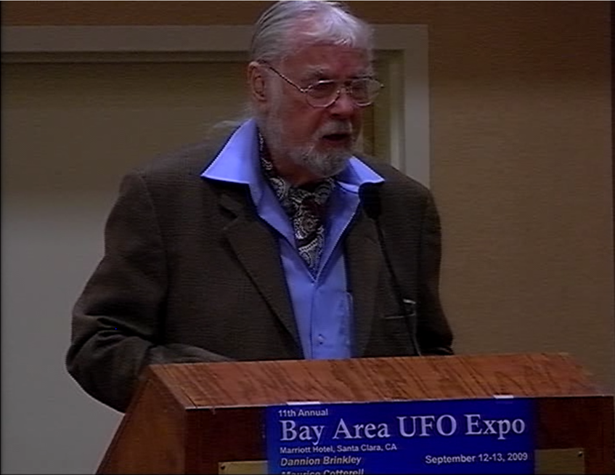
CMS Ret. Robert Dean - NATO “An Assessment”(pic 2009)

Slide 101

CMS Ret. Robert Dean - NATO “An Assessment”

Slide 102
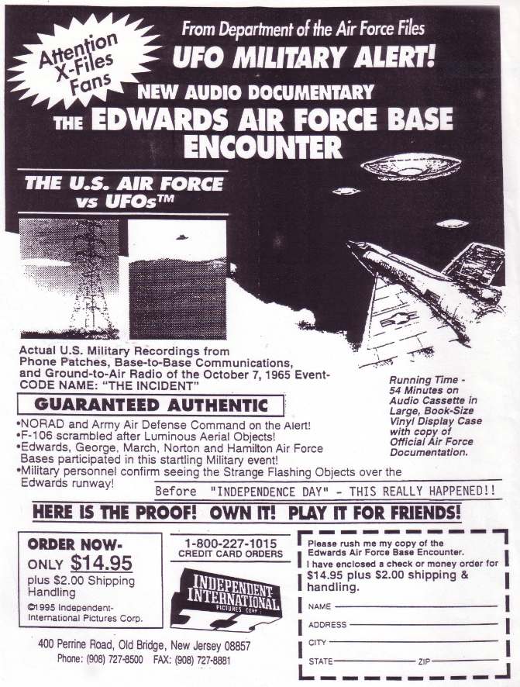
USAF Documented Sightings (1965)

Slide 103
UFOs Hang Out in the Ultra Violet
He saw it – I didn’t!
It just disappeared!
It flew off at great speed!
No it didn’t – It’s STILL THERE!
YOU just can’t see it!
My dog keeps barking but there’s nothing there!
I didn’t see it but it’s on my photo!
Particularly on Fujifilm!
Lots of photos like that from Japan!!!

Slide 104

UFOs Hang Out in the Ultra Violet
You see only Visible Light.
Film can see more!
We have some Infra-Red cameras and imagers…
Why not Ultra-Violet Imagers???

Slide 105
ALIEN LIFE FORMS (EBE) ARE THEY FRIENDS?
OR ENEMY TO THE HUMAN RACE?
STANTON T. FRIEDMAN (Long Time UFO Researcher and Publisher)
Published on Apr 18, 2015
Aliens: Love Them or Hate Them
Cincinnati: MUFON 2012
Alien life forms? UFOs? Project Blue Beam? Are they all real?
Stanton T. Friedman speaking at the MUFON 2012 International Symposium on Extraterrestrial Contact, Unidentified flying objects, and the Roswell Crash evidence.
https://www.youtube.com/watch?v=yJNzyxk6X5E (1:16)

Slide 106

ALIEN LIFE FORMS (EBE) ARE THEY FRIENDS?
OR ENEMY TO THE HUMAN RACE?

Slide 107

ALIEN LIFE FORMS (EBE) ARE THEY FRIENDS?
OR ENEMY TO THE HUMAN RACE?

Slide 108
ALIEN LIFE FORMS (EBE) ARE THEY FRIENDS?
OR ENEMY TO THE HUMAN RACE?
STANTON T. FRIEDMAN (Long Time UFO Researcher and Publisher)
Conclusions
The Evidence is Overwhelming:
A: Aliens Are Visiting
B: Governments Are Covering Up What is Going On
C: No Good Arguments Against A or B (above)
D: Biggest story of Millennium
E: Journalists and Scientists have
Grossly Neglected Their Responsibilities!

Slide 109
ALIEN LIFE FORMS (EBE) ARE THEY FRIENDS?
OR ENEMY TO THE HUMAN RACE?
STANTON T. FRIEDMAN (Long Time UFO Researcher and Publisher)
Stanton says “I Think That:
We are a primitive society whose Major Activity is Tribal Warfare.
We are so young, everybody else is [way more] advanced.
We are a threat to all other local civilizations.
We killed 60 Million Earthlings in WW [2] and [we]
Destroyed 1700 Cities.”
[I (PB) would say – who the hell would want to visit there, anyway?]

Slide 110



STANTON T. FRIEDMAN (Long Time UFO Researcher and Publisher)

Slide 111

What about the German Nazi/Vrill Corporation Connection?
Channeled Information from Aldebaran (In Taurus)
I don’t want to go there in this presentation…

Slide 112

1956

Slide 113

This is on the internet!

Slide 114

T. Townsend Brown (1920s)

Slide 115

T. Townsend Brown (US Patent 1960)

Slide 116

Electro Gravitics - AG

Slide 117

Principle of B-2 Bomber
Flame Jet (Electrostatic not Power) Engines!

Slide 118
UFOs Fly Over Los Angeles - 2/25/1942
1942 'Battle Of Los Angeles'
Biggest Mass Sighting In History?
New Photo Analysis!
Five years before Roswell, five years before pilot Kenneth Arnold's landmark sightings of "flying saucers" in the Pacific Northwest, 3 years before the Battle of the Bulge, two years before D-Day, and years before the so-called "modern UFO era" had officially begun, there was the Battle of Los Angeles, arguably the most sensational, dramatic UFO mass encounter on record.
http://rense.com/ufo/battleofla.htm

Slide 119


UFOs Fly Over Los Angeles - 2/25/1942

Slide 120

UFOs Waves - Fly Over Washington DC – 7/12-29/1952
UFOs Over Washington DC – Matched Radar Blips
https://www.youtube.com/watch?v=OHVQFqOf3yA (9:00)

Slide 121

UFOs Over WDC

Slide 122
Mike Wallace Interview with Donald Keyhoe 1958 – UFOs Area Real!
Mariner Air Corps Major Donald Keyhoe
“WALLACE: Good evening, tonight we go after a fantastic story, the story that flying saucers from other worlds are visiting our planet, just as we are exploring outerr space with our own rocket satellites. Our guest is Former Mariner Air Corps Major Donald Keyhoe, who has the support of scores of prominent businessmen, military men, and some scientists in his campaign to prove that flying saucers exist.…”
Video (25:06) [Will Skip]
Text at:
http://www.hrc.utexas.edu/multimedia/video/2008/wallace/keyhoe_donald_t.html

Slide 123
Mike Wallace Interview with Donald Keyhoe 1958 – UFOs Area Real!
THE MIKE WALLACE INTERVIEW
Guest: Major Donald E. Keyhoe
3/8/58
WALLACE: Good evening, tonight we go after a fantastic story, the story that flying saucers from other worlds are visiting our planet, just as we are exploring outerr space with our own rocket satellites. Our guest is Former Mariner Air Corps Major Donald Keyhoe, who has the support of scores of prominent businessmen, military men, and some scientists in his campaign to prove that flying saucers exist. If you're curious to know why Major Keyhoe charges that the Unites States Air Force is deliberately deluding us when it calls saucer stories the bunk, if you want to hear his own evidence that the saucers are real, and his reaction to the claim of two Americans who say they've spoken with men from Venus. We'll go after those stories in just a moment. My name is Mike Wallace, the cigarette is Parliament.
(OPENING CREDITS)
WALLACE: We'll meet Major Keyhoe in just a minute.

Slide 124
UFOs Fly Over Phoenix, AZ - 3/13/97
“The Phoenix Lights”
The Phoenix Lights UFO incident is a complex series of events that took place on March 13, 1997 over the states of Nevada, Arizona, and
possibly New Mexico, and which would quickly become known as the “Phoenix Lights” sightings. It involved sightings by tens, or perhaps even hundreds, or thousands of witnesses on the ground…
http://www.ufoevidence.org/topics/phoenixlights.htm
Lots of TV Confusing and Distracting News
Lights in the distance
vs.
HUGE objects flying directly overhead!
[Suppressed!]

Slide 125
UFOs Fly Over Phoenix, AZ - 3/13/97
The Phoenix Lights
Listen to the REAL eye witnesses!!!
As Reported to the National UFO Reporting Center (Peter):
A very scared lady witness with her kids at a pool, looking straight UP:
She calls the NUFORC (recorded) Peter asks:
Could you cover it with your finger tip? – “Peter, You don’t understand…”
Could you cover it with your thumb? – “Peter, You don’t understand…”
Could you cover it with your hand? – “Peter, You don’t understand…”
Eye witnesses driving up from Tucson underneath them (2)
Measured time and speed to calculate
These were over a mile long…
Long wide triangles with lights…

Slide 126

Brit and Lee Elders Really Great Videos!

Slide 127
Brit and Lee Elders Really Great Video Clip (1:36)
Many Japanese, US, and Mexican Reporters and
Researchers Climbing Up a Hill at Night
To See the Top of a Local Volcano…
REAL Footage!
The VHS video is much better…

Slide 128

Masters of the Stars Video - Near Mexico City
Triangular Craft Rising and Banking – Japanese Film Crew Video

Slide 129



Other UFO Videos

Slide 130



Other UFO References

Slide 131

Antigravity Technology
Great German Technology Reference Book

Slide 132

Antigravity Technology
The Hunt for Zero Point – Author’s Note (US Edition)

Slide 133

Antigravity Technology
The Hunt for Zero Point – Author’s Note (US Edition)

Slide 134
UFO Crashes – Reverse Engineering
Many Incidents
Many Witnesses (each for a while)…
All Then Classified.
Laboratories for Reverse Engineering
WPAFB, Ohio
Area 51, NV
Pine Gap, AU
NASA
Aerospace Companies
Los Alamos, NM
Palo Alto, CA

Slide 135
ETs
Who?
What?
When?
Why?....
Where?...

Slide 136

ETs

Slide 137

ETs
Not That One!...

Slide 138

Blank

Slide 139
Blank

Slide 140

Levels of G*D
Ein – The Unknowable
Ein Sof - His Self-manifestation
(Then…)

Slide 141
List of Alleged Extraterrestrial Beings
https://en.wikipedia.org/wiki/List_of_alleged_extraterrestrial_beings
Andromedans
Also called "Mirrored People" or "Glass People."
Flatwoods monster
Tall humanoid with a spade-shaped head.
Greys ["Grays", "Zetas", "Zeta Reticulians"]
Grey-skinned humanoids, usually 3–4 feet tall, bald,
with black almond-shaped eyes...
Hopkinsville goblin
Small, greenish-silver humanoids.
Little green men
Diminutive green humanoids.
Nordics
Sometimes called Space Brothers, and/or Plejarens, Venusians, Tall whites
Humanoids with Nordic features (tall, blond hair, blue eyes);
they may have 24 teeth and slightly webbed toes.
Reptilians
Tall, scaly humanoids.
Sirians
Humanoid/aquatic aliens.
Anunnaki [Also called "Gods"]
Human-like creatures, slightly larger than humans.

Slide 142

ETs

Slide 143

Our Interactions with ETs
Are What?... Really?...

Slide 144

Blank

Slide 145

Blank

Slide 146
Are We Measuring Up?
Religions
Nations
Societies
“Holy Books”
“Ten Commandments”
Are We Caretakers of Each Other?
Are We Caretakers of the Earth?
Or…
“We are a primitive society who Major Activity is Tribal Warfare.
We are so young, everybody else is [way more] advanced.
We are a threat to all other local civilizations -”
Out There…
It is time to choose a side!

Slide 147
Are We Measuring Up?
From the really good movie “Contact”:
Alien: “You're an interesting species, an interesting mix.
You're capable of such beautiful dreams and such horrible nightmares.
You feel so lost, so cut off, so alone, only you're not.
See, in all our searching,
the only thing we've found that makes the emptiness bearable
is each other.”
Are WE willing to learn from Them???

Slide 148

Are We Measuring Up?
Perhaps we are slowly being engineered to become better!
And more useful...

Slide 149

But like you, the Krell forgot one deadly danger –
their own subconscious hate and lust for destruction! (1956) [FP]
Are We – Is the Earth - “Forbidden”?

Slide 150

Blank

Slide 151

Blank

Slide 152

Blank

Slide 153

Blank

Slide 154
Our Interactions with ETs
Are What?... Really?...

Slide 155

The Secret Space Conference 2016
http://thepromiserevealed.com/summer-conference-2016-part-2-the-secret-space-program/

Slide 156
Moon Rising
A Movie by Jose Escamilla
Dr. Patrick G. Bailey, An Executive Producer
http://www.padrak.com/MoonRising/
SEE THIS JUST GREAT MOVIE TRAILER (3:05)!
(Get the link from above… too long…)
When asked:
"You guys... you lied about a lot, didn't you."
The Bell Com / NASA Insider instantly said:
"No! We didn't lie about certain things [about the moon]" -
"We lied about everything!“
[I Love This Trailer and This Movie!]

Slide 157

“No – We didn’t lie about certain things… We lied about everything”
– Bell Com/NASA Insider

Slide 158
Moon Rising
A Movie by Jose Escamilla
Dr. Patrick G. Bailey, An Executive Producer
http://www.padrak.com/MoonRising/
- The Movie is Oh So Much Better! -
(I want it with translated subtitles… I have the rights!…)

Slide 159


Selected By ETs (Book, c 2015) [Book 1 of 2…]

Slide 160
Selected By ETs (Book, c 2015)
Feb 25, 1942 Long Beach UFOs Air Raid: 17 UFOs, 8 hours…
Plans for Naval spacecraft carriers 1.5 km long.
Some ETs can live for hundreds of years.
“Earth humans can’t cut it – only live for 60-100 years.”
Black Hat ETs (grays and reptilians)
“want to increase deteriorations of our tissues, organs, and bones
Preventing us living longer lives. …
…to prevent us –
from retaliating against their threats.”

Slide 161
Selected By ETs (Book, c 2015)
Gulf of Tonkin [Incident] (pp 295-296)
Retired Navy Commander Conway stated:
On July 1976 – after dark:
I had the watch aboard the Aircraft Carrier USS Ranger CV-61,
When an estimated size 90 foot UFO round silver UFO lands on deck.
The central flight deck lighting was ordered on.
The Admiral Commander and two Officers go in (under the edge), and
Come out with 2 individuals in silver suits.
Later those two plus one officer went back into the UFO,
Which then silently departed straight up 11 minutes later.
The next day, the Admiral returned by helicopter.
I gave the order to log this event in the
Classified Ship Log.

Slide 162


Selected By ETs (Book, c 2015)
[I think, the] Description of Roswell Crash Plane (p 395)
[Remember that the Roswell UFO was like a plane,
That glanced off the ground and then later on suck into a cliff
Like a dart into a dart board.
The UFO Flying Saucer disc (upside down) was at Aztec, not Roswell.]
“They are similar to a manta-ray with shark fin stabilizers on the upper outer wing tips. The are configured for two to six, small personnel and appear to be operated on recon missions. – The alien pilots use their fingers pressed on the control panel surface to guide it.”

Slide 163
Selected By ETs (Book, c 2015)
Lots of Information Regarding the Apollo Program (p 410)
October 11 [?], 1968, Apollo 7, In Stable Moon Orbit
Walter Cunningham radioed to Houston Control,
“There is a Santa Claus and Mrs. Claus, too, sir.”
Santa Claus is code for UFO.
Houston said, “You were instructed not to discuss that.”
Commander Schirra said, “Look at the size of those alien ships!”
Cunningham added, “Our cameras are programmed to automatically focus
on any incoming vehicle; they will record all of that.”
Schirra said, “Damn, hit the replay.”
“We got it all, sir.”

Slide 164
Selected By ETs (Book, c 2015)
Lots of Information Regarding the Apollo Program (p 411)
On December 21, 1968, the author gets a phone call:
“Bill get your ass over here right now, you SOB; you were right,
those bastards have got bases on our Moon.”
He said: “You mean Admiral Sergei Gorbashev, sir?”
“No, you ****, aliens!”
“As I explained to them – Lunar Orbiter II and III –
had reportedly many photos of decaying artificial cities on the Moon.
I also told them that these photographs have remained classified.”

Slide 165
Selected By ETs (Book, c 2015)
Lots of Information Regarding the Apollo Program (pp 414-415)
“The alien voice was very clear.
Finish a total of six of your Apollo missions;
Take your photos, pick up some rocks, go home, and don’t come back.”
The NO TRESSPASSING sign went up.
With the programs over, everybody went home, and
nearly 400,000 NASA and contractor employees got their pink slip.”

Slide 166
Selected By ETs (Book, c 2015)
Sea of Tranquility (p 417)
“NASA was attempting to find the most interesting location for our astronauts to land.
…in a specific area within the Sea of Tranquility.
These objects were arranged similar in plan to the Egyptian pyramids and the three stars of Orion.
What is most interesting is that NASA picked that location
for our first landing.”
http://www.astrosurf.com/lunascan/argosy_cuspids.htm
[Remember to mention the crosses etched into the
glass faceplates on the Apollo cameras –
Later missing when NASA blacked out portions of the Moon photos! ]
[PS – The Hubble Telescope CAN photograph the Moon…]

Slide 167


Selected By ETs (Book, c 2015)
Sea of Tranquility (p 417)
http://www.astrosurf.com/lunascan/argosy_cuspids.htm

Slide 168
Status – UFO
Photographed and Described for Thousands of Years
In ALL Ancient Writings
In Bible and Religious Paintings
Their Back!
[They Never Left!...]
We have photos from the Moon!
NASA and the DOD are Classified (Perhaps rightfully so…)
Many UFO Shapes, Many Sizes (3 feet to over a mile)
EM/Radiation Dangers, Immediate, and Lingering Effects
Different Groups of ETs (Over 50)
Different Appearances, Different Agendas
Are some of them teaching us?
Can we chose to learn?
It is time to chose a side.

Slide 169
Politics and Life in the USA Today

Slide 170
USA Corporations
In the beginning the
Virginia Trading Company
Financed the expansion into the New World others joined to form the
United States (Trading Company)
Bankrupted by Lincoln in 1863 and others emerged, chief among them
The United States of America, Inc., the
District of Columbia Municipal Corporation, and the
United States of America, Inc.
All of which were bankrupted and/or morphed into still other corporate entities.
It was the United States of America, Inc. that Franklin Delano Roosevelt bankrupted in 1933 and which stayed in reorganization until 1999.
WASHINGTON DC MUNICIPALITY, one of the most corrupt and inefficient governments to ever exist on planet Earth, and from 1944 onward, we have suffered all the slime-ball tactics of the
UNITED STATES, INC., a French-sponsored IMF spin-off, here on our soil acting as the colluding partner to the United States of America, Inc., during its bankruptcy reorganization from 1944 to 1999 and since then operating as the overall "service provider" under March of 2015 when it finally went insolvent and couldn't even pay the interest on its debts.
Since then we have had yet another one of the "governmental services corporations" go bankrupt, this one calling itself
THE UNITED STATES OF AMERICA, INC.

Slide 171

The Grand Plan (1998)

Slide 172
The US Government is Classified
The “United States of America, Inc.” corp. went Bankrupt in 1933.
War Powers Act of 1933 =
We are Still Now in a “State of National Emergency:
Classified Presidential Executive Orders
Classified Congress Meetings
Classified Federal Government Agencies
NASA
FBI
CIA
DHS
Vested Interests are Still Winning!

Slide 173
The US Government is Classified
War Powers Act of 1933 =
We are Still Now in a “State of National Emergency:
And the Suspending of “The Constitution”
--- Actively Suppressed! ---
THE US CONSTITUTION AND WAR AND EMERGENCY POWERS
A SUMMARY REPORT ON THE NATIONAL EMERGENCY
IN THE UNITED STATES OF AMERICA
http://www.padrak.com/paperfiles/bailey_082414.pdf

Slide 174

Learn from Perry Mason
Where is Evidence for a Trial Logged In and Stored?

Slide 175
Federal Trials Having Federal Evidence Lockers
People vs. USA – Use of Agent Orange and Nukes in SE Asia.
People vs. Greenspan, Bush Sr., Mobil Oil, etc.
People vs. ENRON.
DO YOU HAVE ANY IDEA OF
HOW MUCH MONEY WAS INVOLVED IN THESE TRIALS???
$$$ HUGE AMOUNTS $$$

Slide 176
Federal Trials Having Federal Evidence Lockers
People vs. USA – Use of Agent Orange and Nukes in SE Asia.
People vs. Greenspan, Bush Sr., Mobil Oil, etc.
People vs. ENRON.
So, where were the Federal Evidence Lockers?
WAS THIS ON THE Controlled NEWS???

Slide 177
Federal Trials Having Federal Evidence Lockers
People vs. USA – Use if Agent Orange and Nukes in SE Asia.
Federal Building – Oklahoma City, OK
People vs. Greenspan, Bush Sr., Mobil Oil, etc.
First Twin Tower to be Hit Destroyed
People vs. ENRON.
Building 7 “Pulled” (Way over there…)

Slide 178

Books Documenting What Was Happening in 2000

Slide 179

Jim Marrs – Award Winning Investigative Journalist

Slide 180

Books Documenting What Happened on 9-11-01

Slide 181


Books Documenting What Happened on 9-11-01

Slide 182
Book Reports – Cover Pic, Back Pic, TOCs, and Summaries!
http://www.padrak.com/bookson911/
Divided We Stand - A Biography of New York's World Trade Center
http://www.padrak.com/dividedwestand/
THE TERROR CONSPIRACY - Deception, 9/11, and the Loss of Liberty
http://www.padrak.com/theterrorconspiracy/
Inside Job - Unmasking the 9/11 Conspiracies
http://www.padrak.com/insidejob/
The New Pearl Harbor
http://www.padrak.com/insidejob/
THE WAR ON FREEDOM
http://www.padrak.com/waronfreedom/
The Official FAHRENHEIT 9/11 READER
http://www.padrak.com/f911reader/

Slide 183
For Find Out What Is REALLY Going On
If you want to solve Any Puzzle
Make Sure that you have a BIG ENOUGH BOX
To Think In!
Free Energy Concepts
UFO Realities
Suppression of Truth by a Classified Government
Do or DoNot – There is no Try!
- Yoda

Slide 184
Greed Is Good – Greed Is Right! – Greed Works! (1:09)
From the Movie: Wall Street
Greed in All of Its Forms!
Greed for Life,
For Money,
For Love,
For Knowledge…

Slide 185

Blank

Slide 186
EXTRA SLIDES

Slide 187
9-11-01 Videos of Building 7 Collapsing (2:50)

Slide 188

Blank

Slide 189
Thank you for Coming!
What are you going to do now?
Be Responsible!
Choose Wisely!
Q & A Now?

Slide 190

“Let’s get on down to the Main Attraction – With a little less talk and a lot more action!”
- By Toby Keith

Slide 191
Q & A
30 Minute Q & A
Limit 1 minute per person per Q and A
More Questions!

