Slide 1
Heretics & Heroes
This does in 14 minutes what many longer articles and interviews attempt in bringing truth & clarity as to what has transpired since the end of 2019.
Spot on, with cultural and historical perspective as well.
Created and narrated by Children’s Health Defense activist & national board member Kristina Kristen.
https://rumble.com/vxro64-heretics-and-heroes.html

Slide 2
Heretics and Heroes
chdca Published March 18, 2022
169 Views

Slide 3
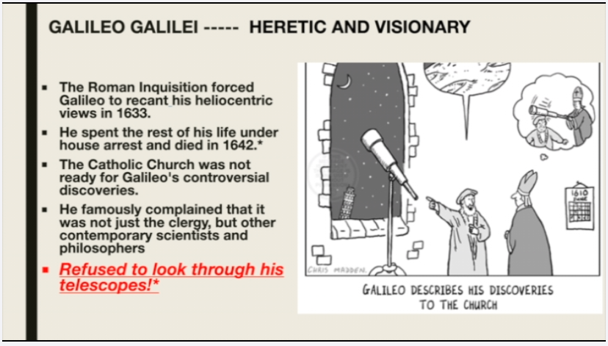

Slide 4
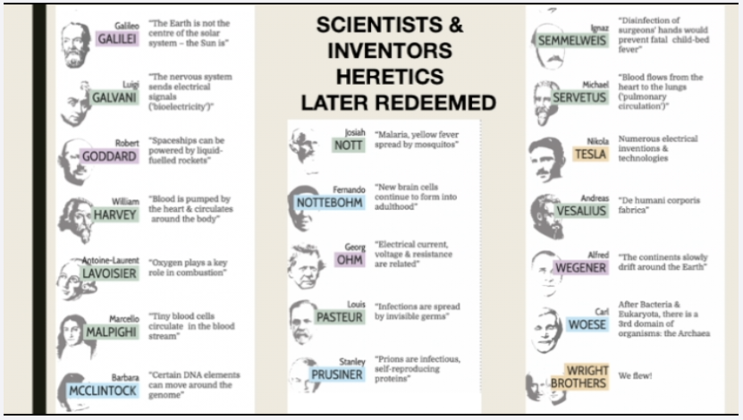

Slide 5


Slide 6
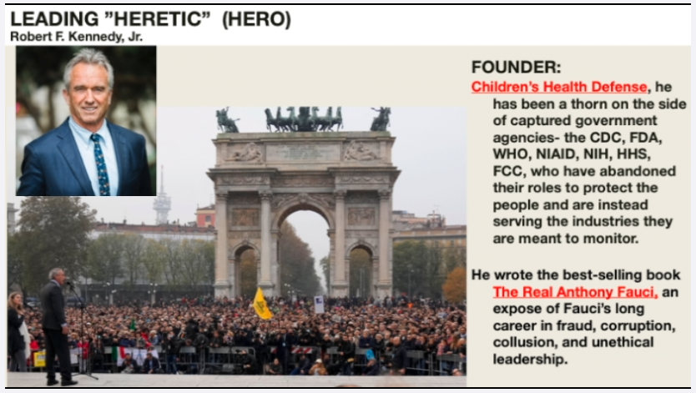

Slide 7


Slide 8


Slide 9
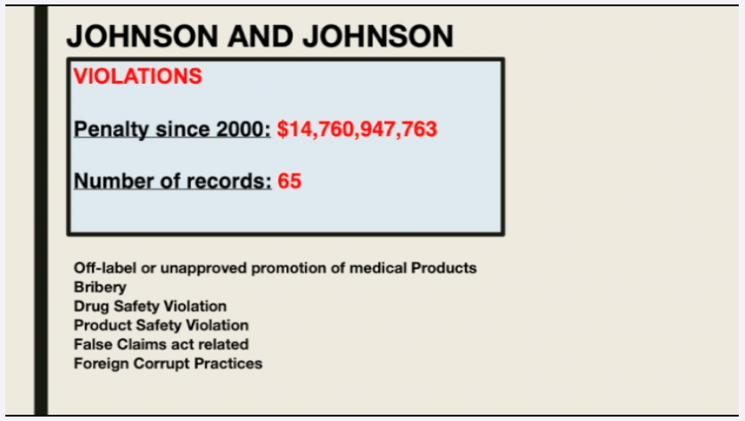

Slide 10


Slide 11


Slide 12
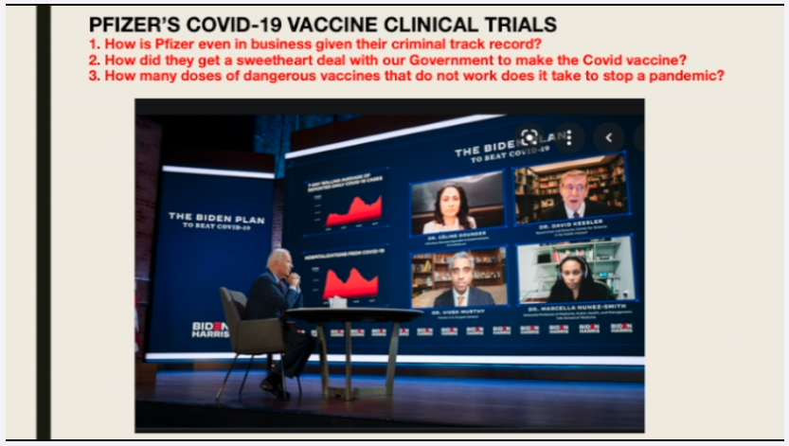

Slide 13
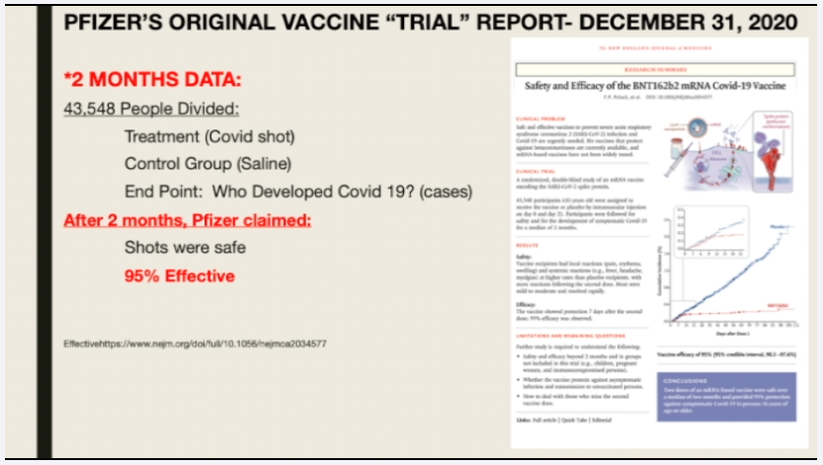

Slide 14
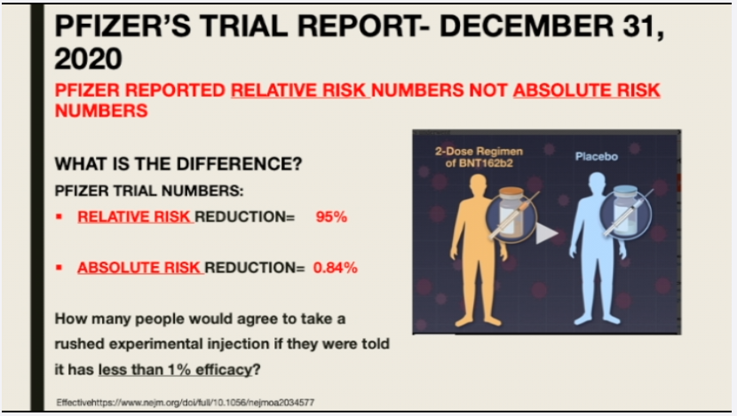

Slide 15


Slide 16
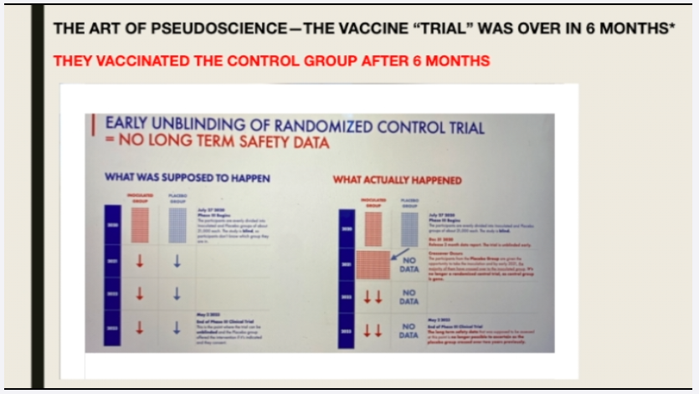

Slide 17
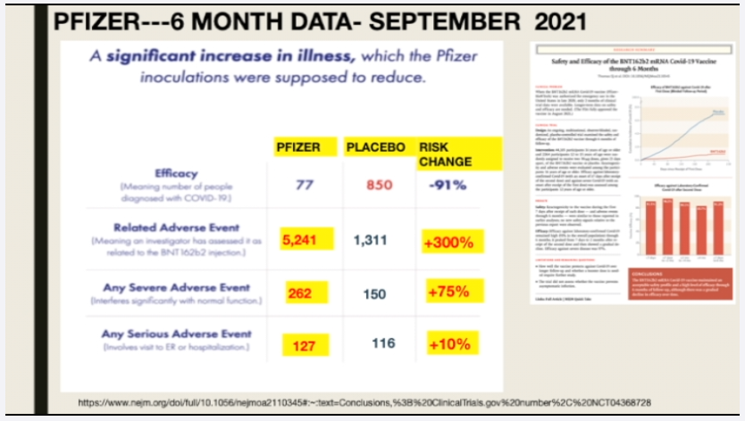

Slide 18
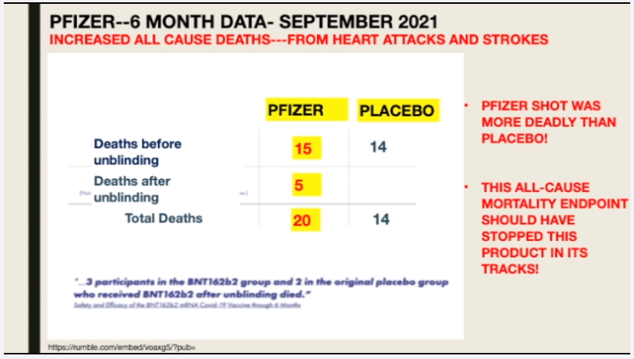

Slide 19


Slide 20
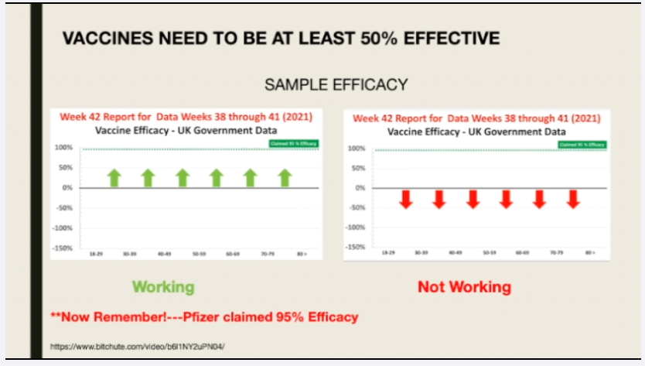

Slide 21
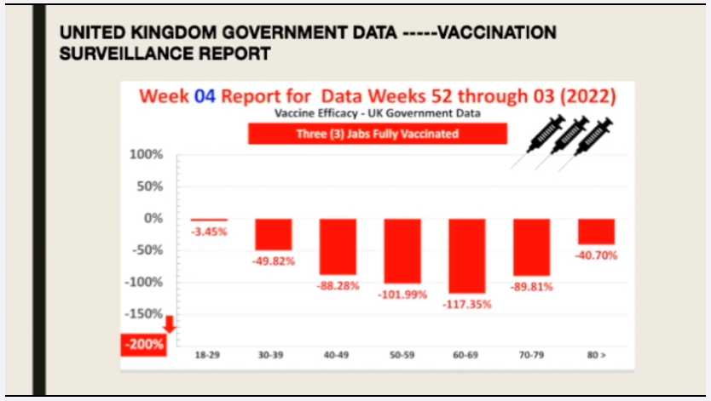

Slide 22
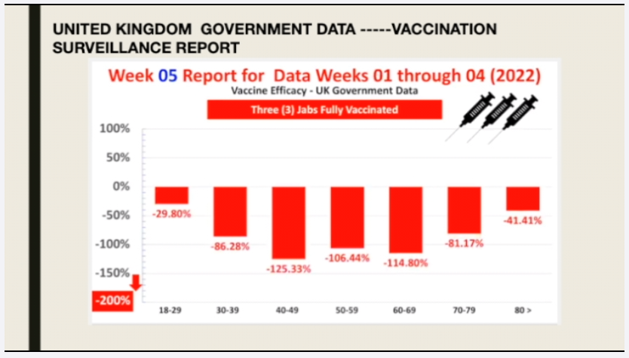

Slide 23
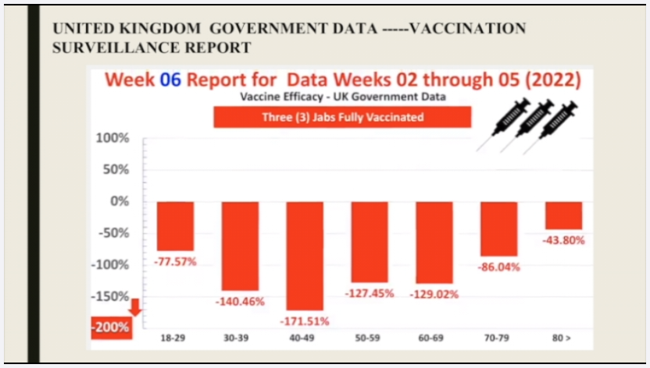

Slide 24
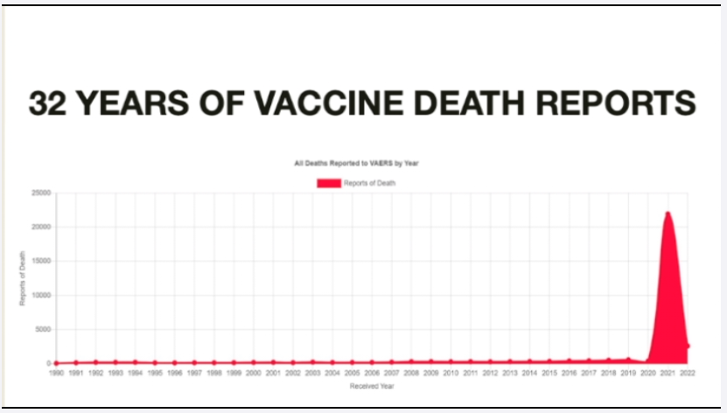

Slide 25
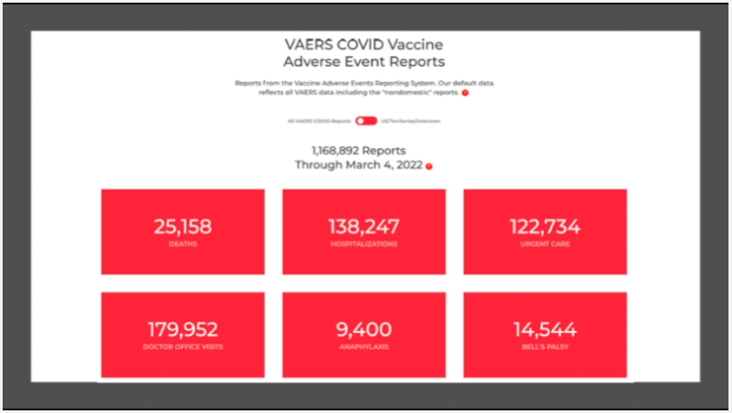

Slide 26
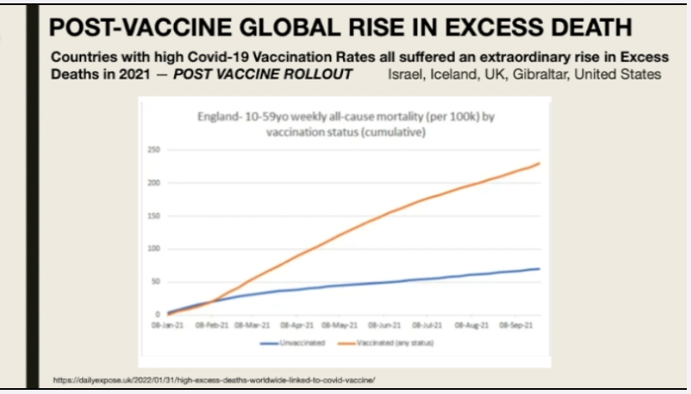

Slide 27
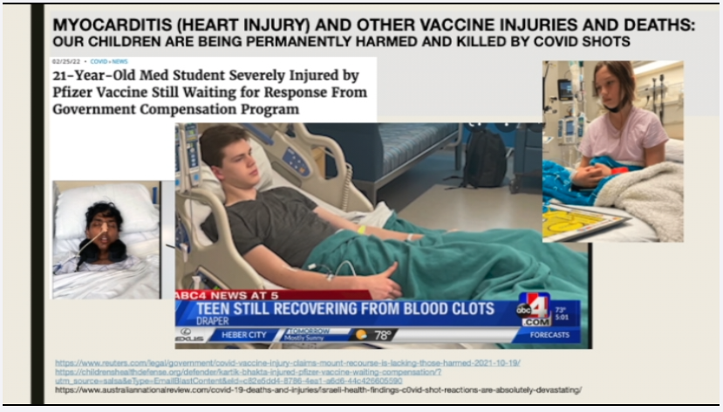

Slide 28


Slide 29
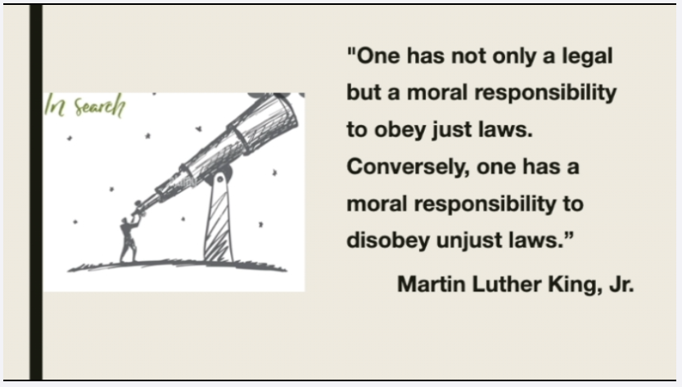

Slide 30
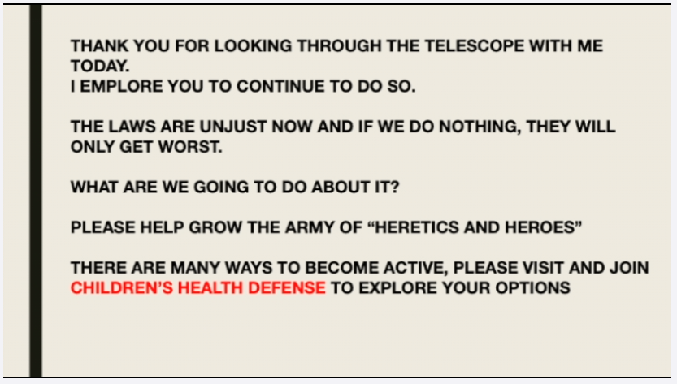

Slide 31
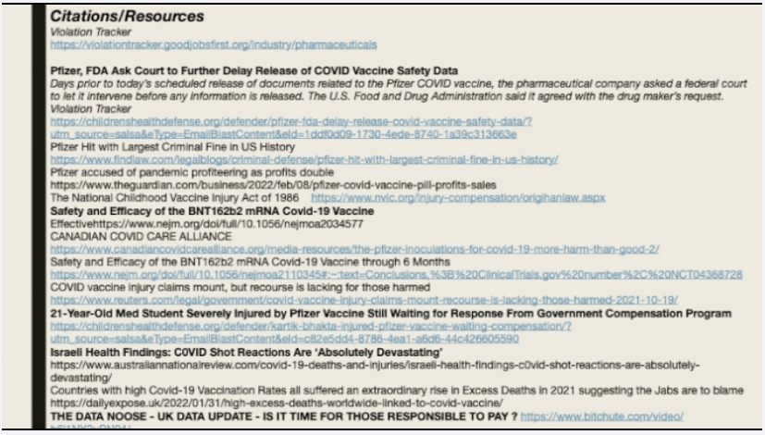

Slide 32
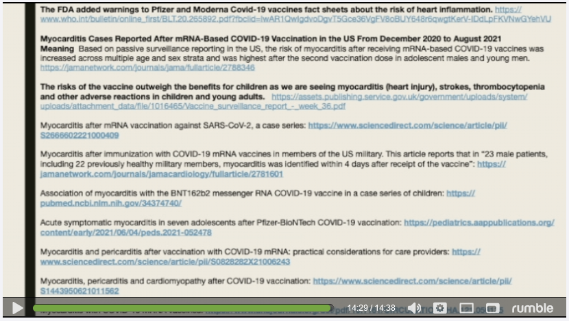

Slide 33
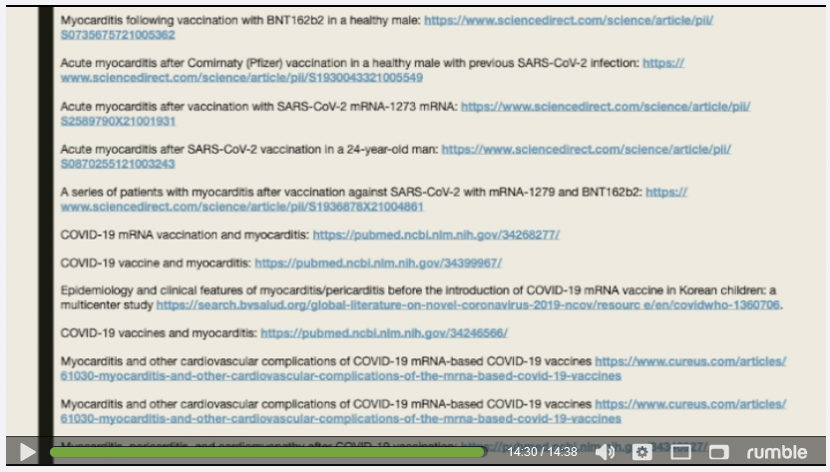

Slide 34
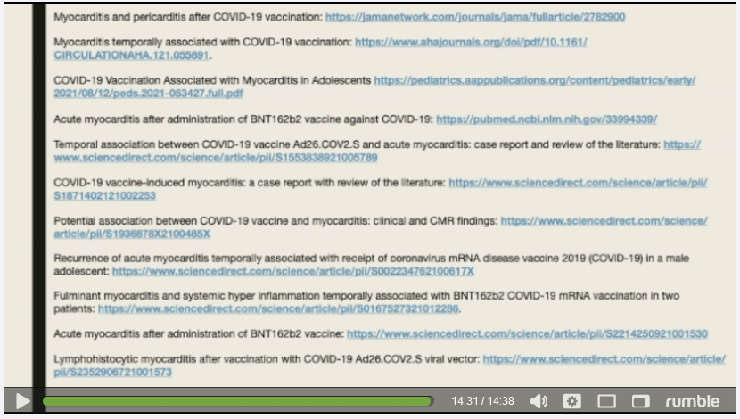

Slide 35
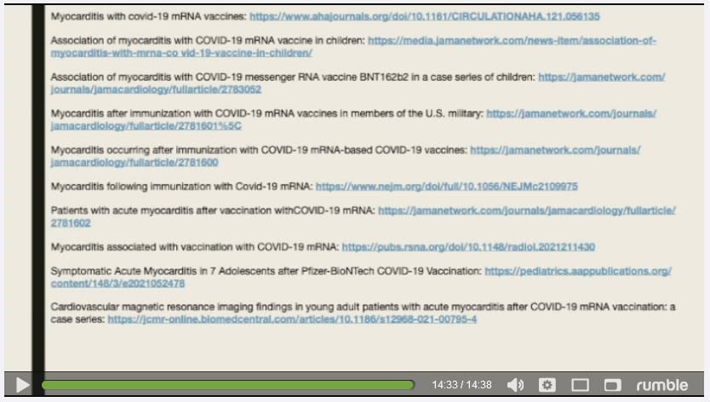

Slide 36
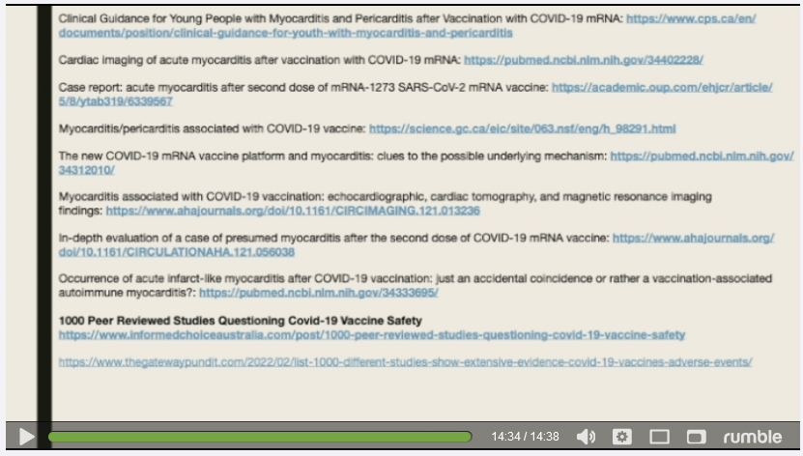

Slide 37
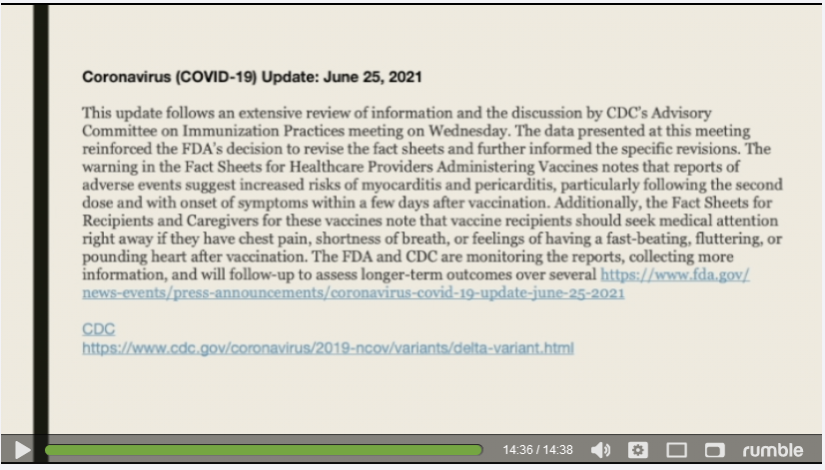

Slide 38
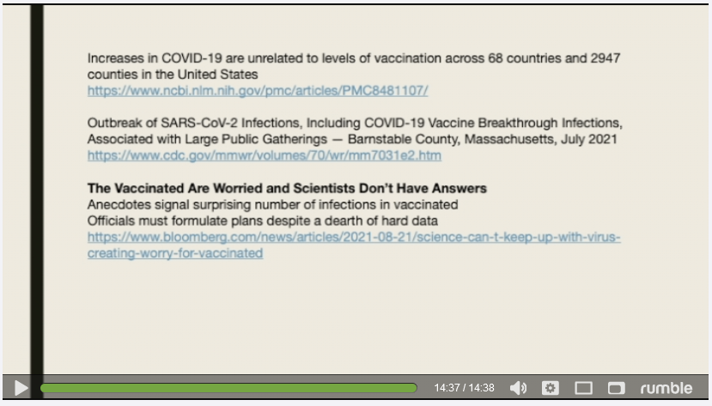

Slide 39


Slide 40

https://childrenshealthdefense.org/

Slide 41


